Slide 1
ADS54J60 Test

Slide 2
ADS54J60
Test Setup:
Single tone is given as input to the device.
Test conditions:
Fs = internal 983.04Msps
Fin =70MHz
LMF = 8224
TSW14J10 and VC707

Slide 3
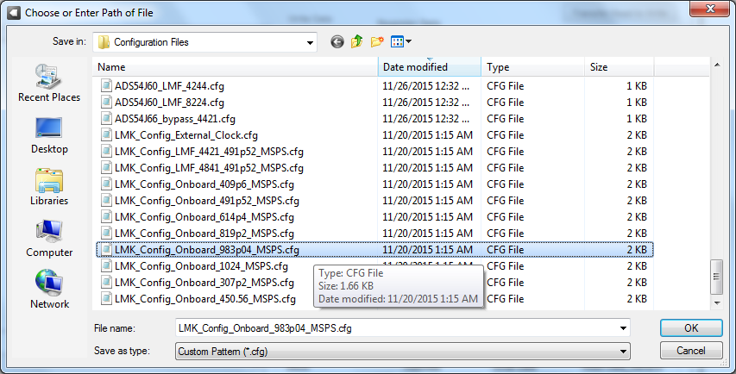
ADS54J60

Slide 4
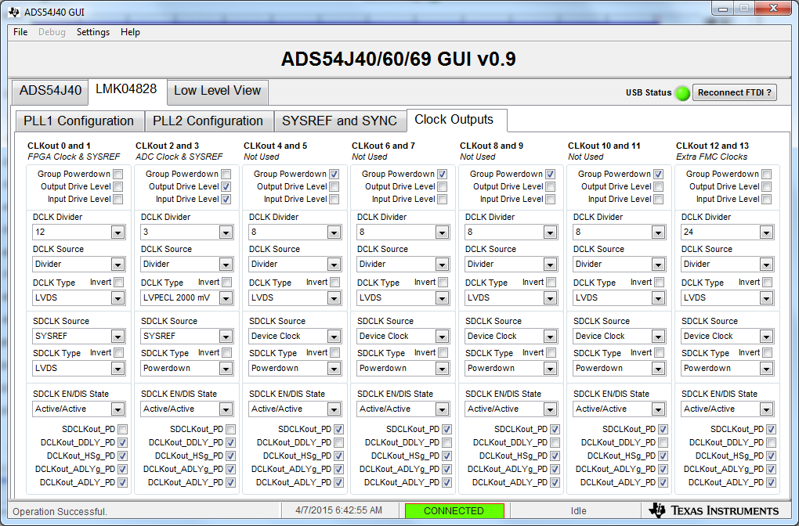
ADS54J60

Slide 5
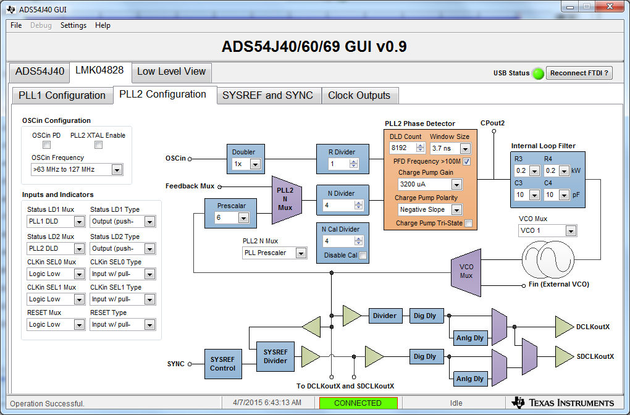
ADS54J60

Slide 6
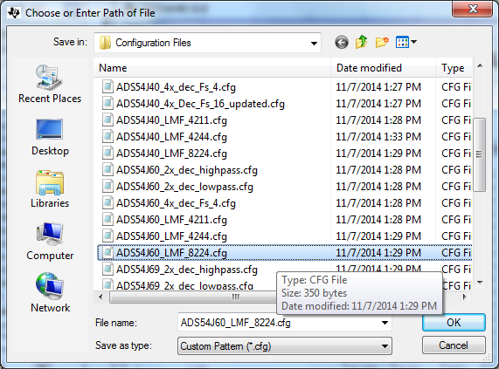
ADS54J60

Slide 7
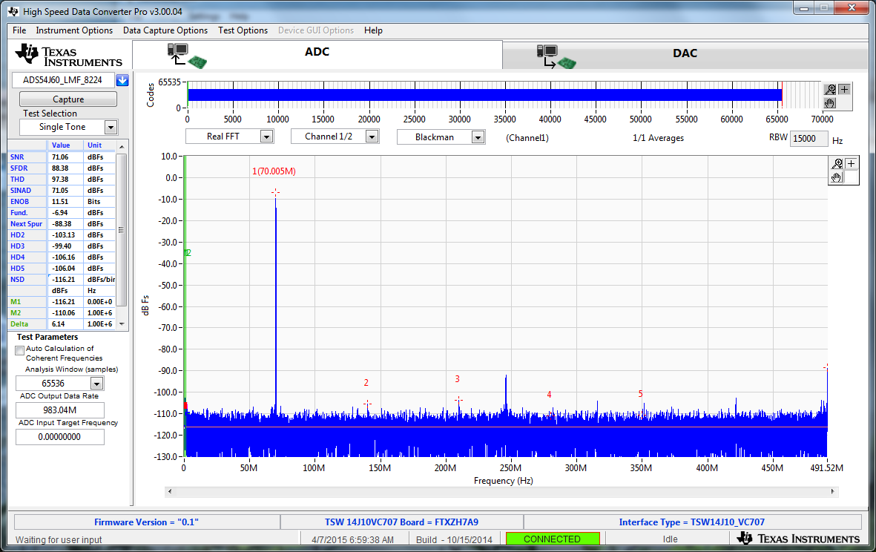
ADS54J60

Slide 8
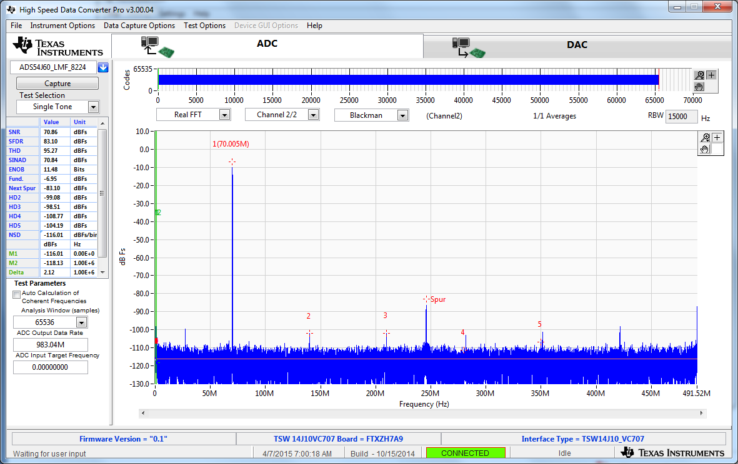
ADS54J60

Slide 9
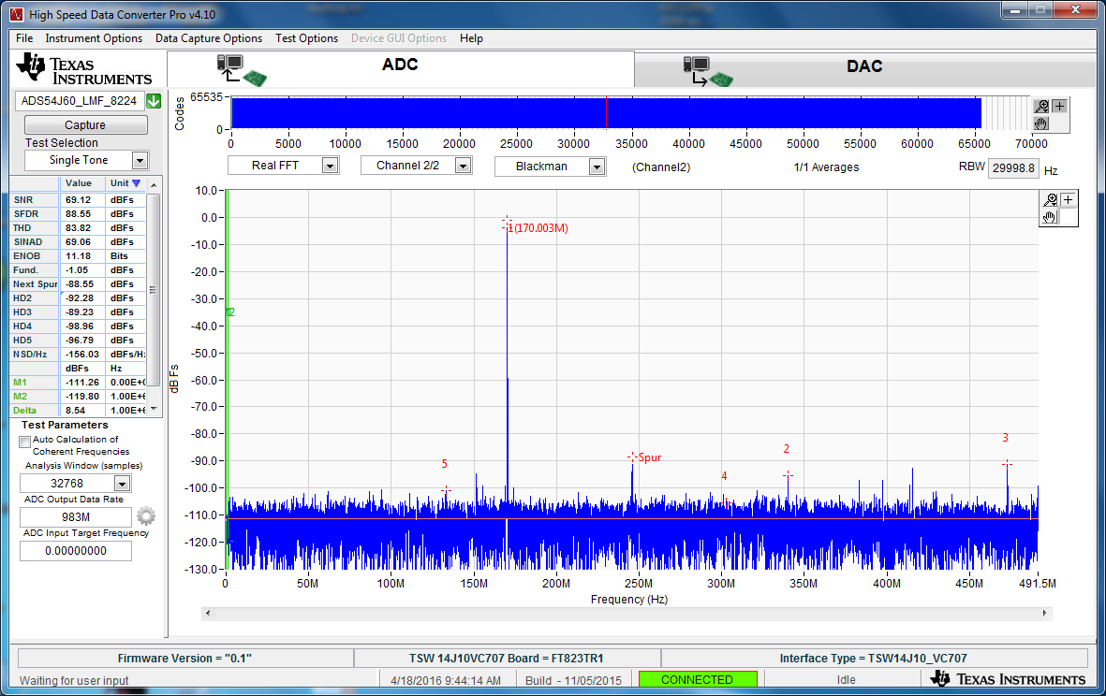
ADS54J60 170MHz IF

