Slide 1
LMK Settings for 200MHz ADC Sample CLK
ADS42JB69 Rev C EVM
LMK04828 (Dual VCO device)
VCO0 range = 2370 – 2600
VCO1 range = 2945 - 3005

Slide 2
Setting the PLL parameters
LMK04828 VCO 1 range = 2945-3005
Target VCO1 = 3000MHz
VCXO = 100MHz
REF = 10 MHZ
PLL1
  R Divider (CLKin1) = 10
  N Divider = 100
  CP Gain = 450uA
  REF/PLL1 R divider = VCXO/PLL1 N Divider
  10MHz/10 = 100MHz/100
PLL2
  R Divider = 1
  Prescal = 3
  N Divider = 10
  CP gain = 3200 uA
  VCX0/PLL2 R Divider = VCO1/(PLL2 N Divider x PLL2 Prescal)
  100MHz/1 = 3000MHz/(10 x 3)

Slide 3
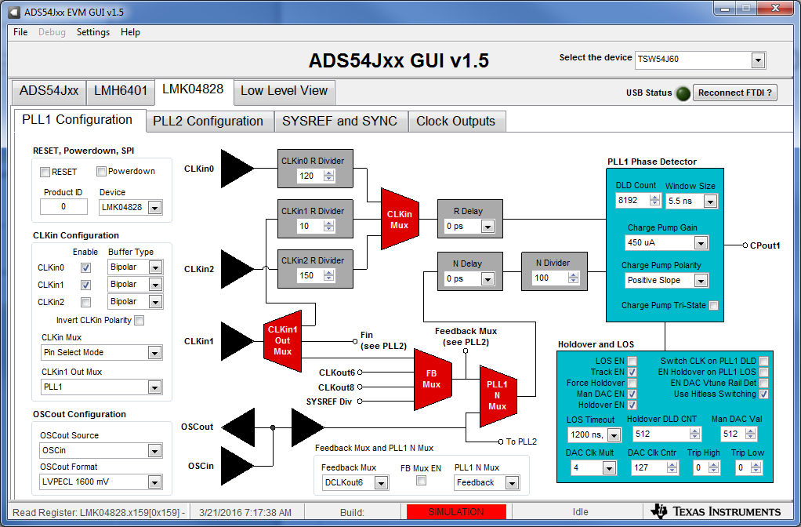
PLL1 Configuration

Slide 4
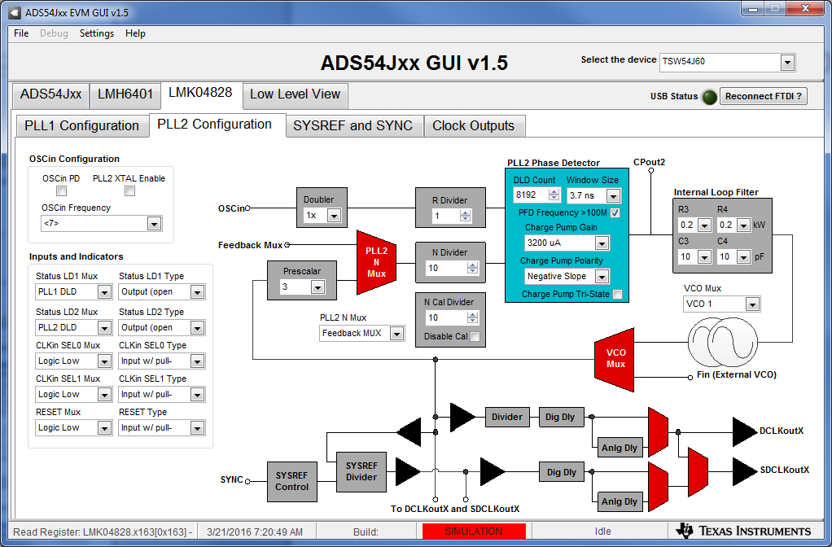
PLL2 Configuration

Slide 5
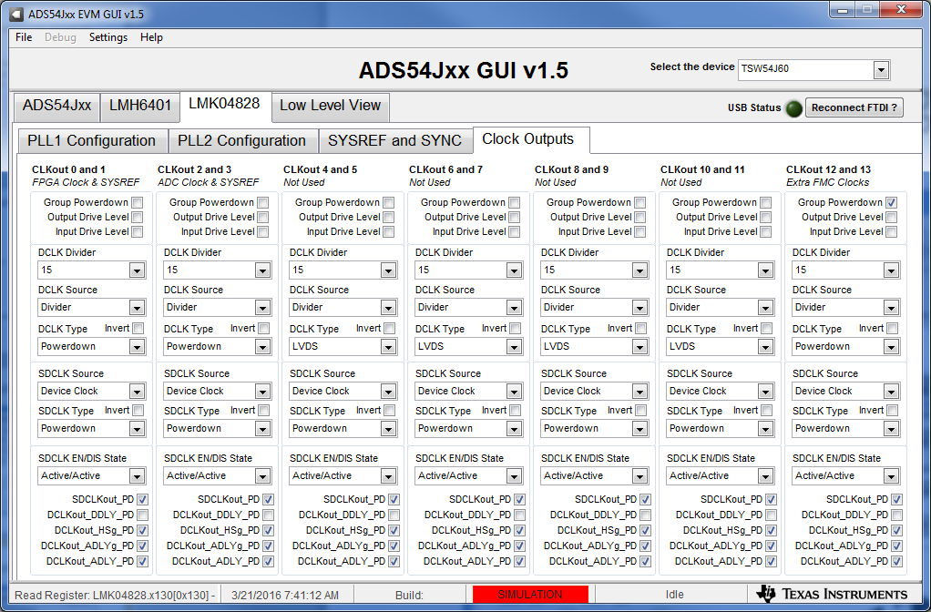
Clock Outputs Configuration

