Slide 1
LMK04828 Fundamentals
Chase Wood
Applications Engineer, High Speed Data Converters
October 17, 2022

Slide 2
Typical clocking approaches
Highest performance
External clocking using low-noise signal generator:
R&S SMA100B w/ B711 package (ultra low phase noise)
Anritsu MG36221A w/ low phase noise package
LMX2820:
Highest performance wideband clock synthesizer
Supports output frequencies between 45MHz through 22.6GHz
LMX1204:
Cleanest 1:4 clock distribution on market
Allows for FPGA clock generation (logic_clk)
Highest flexibility/channels
LMK04828:
Dual band VCO
2370MHz – 2630MHz
2920MHz – 3080MHz
14 clock outputs
7 data clock outputs
7 SYSREF outputs
LMK04832 (-SP version available):
Dual band VCO
2440MHz – 2580MHz
2945MHz – 3255MHz
14 clock outputs
Up to 14 data clock outputs
Up to 7 SYSREF outputs

Slide 3
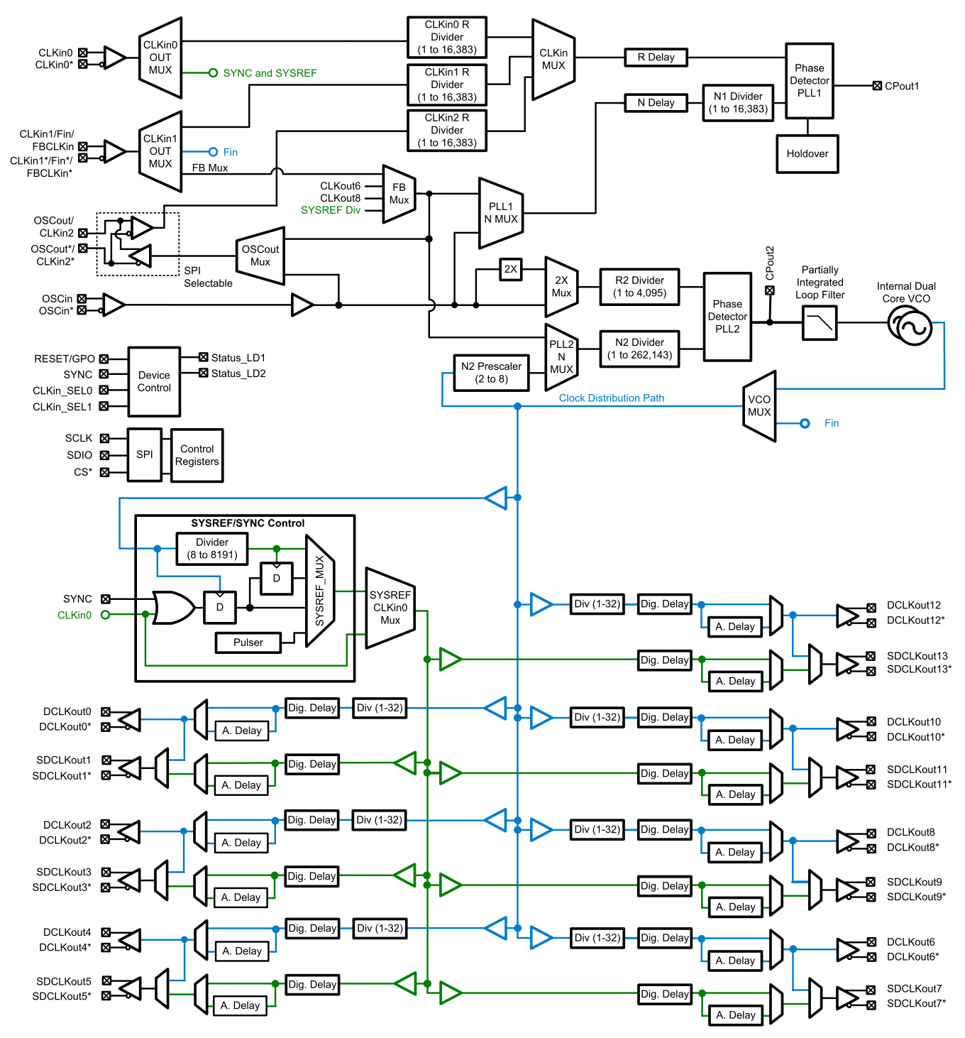
LMK04828
Dual PLL
PLL1 acts as jitter cleaner
PLL2 locks the VCO frequency
Dual band VCO (voltage-controlled oscillator)
2370MHz – 2630MHz
2920MHz – 3080MHz
14 clock outputs
7 data clock outputs
7 SYSREF outputs
High flexibility device
LMK04828 is primary FPGA clock generation/distribution across JESD EVMs
DCLKout0 = FPGA
DCLKout2 = ADC/DAC

Slide 4
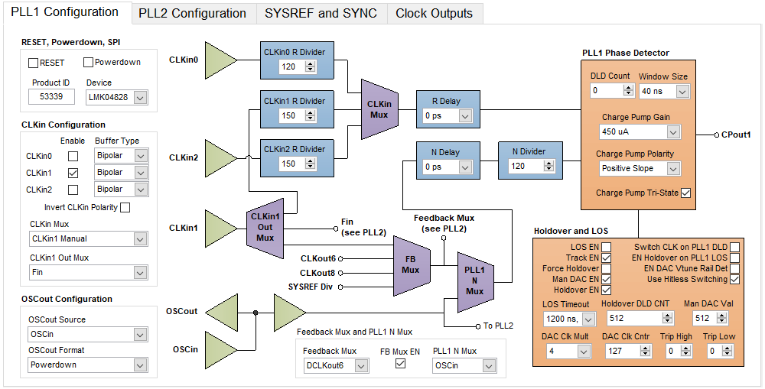
Typical GUI Appearance – PLL1 Configuration

Slide 5
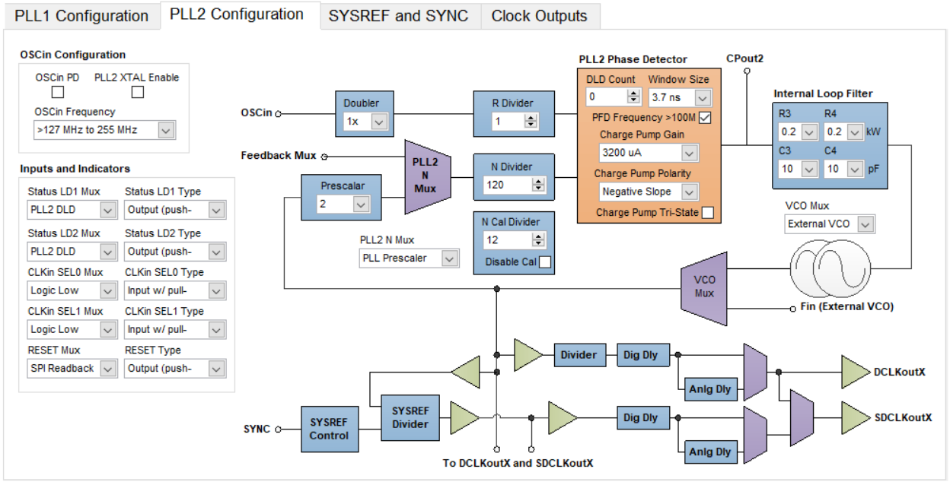
Typical GUI Appearance – PLL2 Configuration

Slide 6
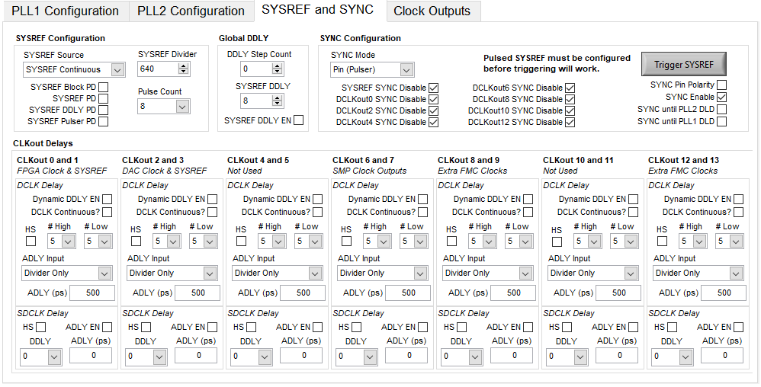
Typical GUI Appearance – SYSREF

Slide 7
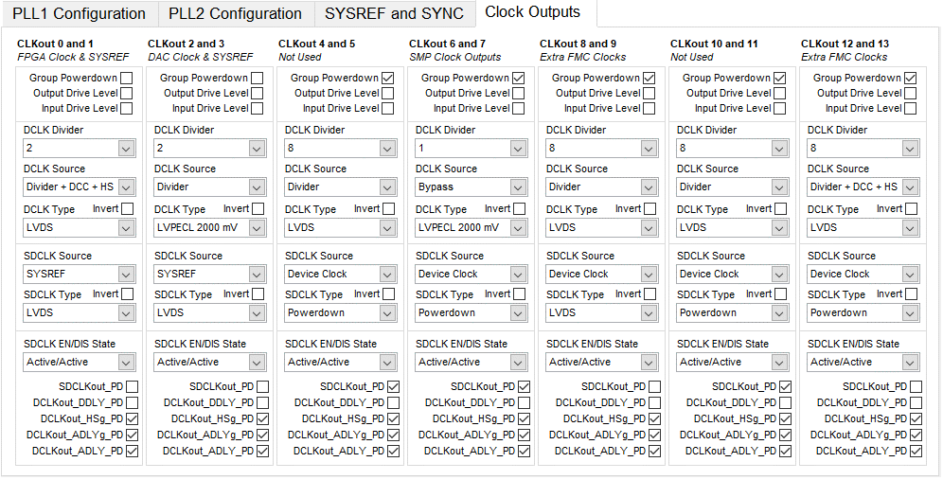
Typical GUI Appearance – Clock Outputs

Slide 8
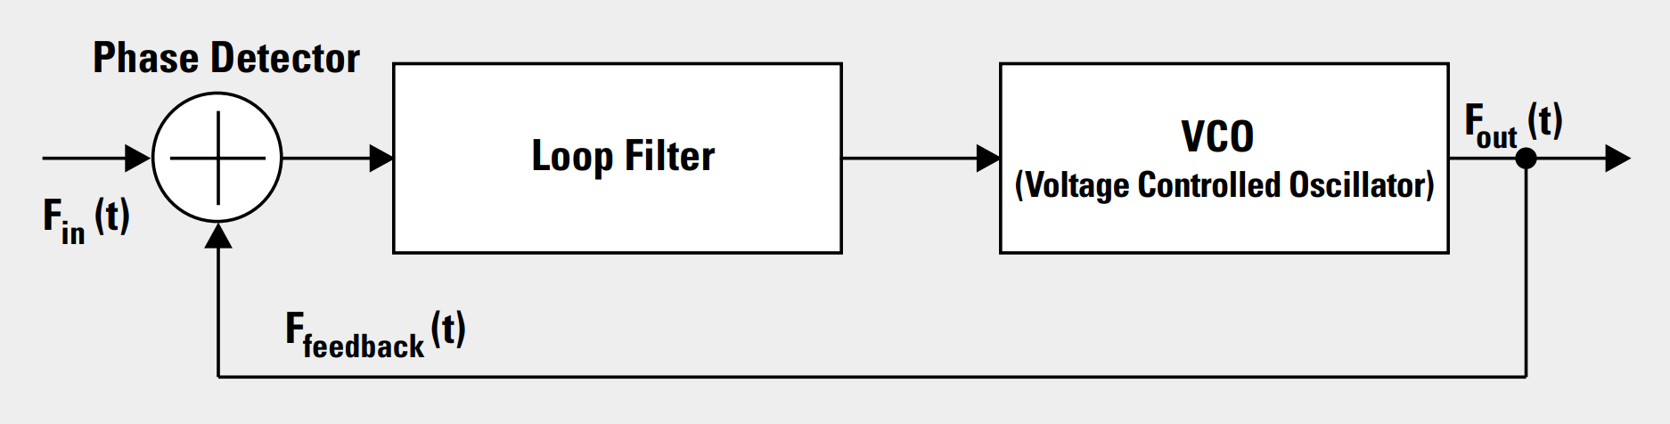
PLL Basics
Phase-Locked Loop (PLL)
3 main components:
Phase Detector
Loop Filter
VCO
Purpose: Generate an output tone resistant to phase drift

Slide 9
Conditions for locking a PLL
Two main conditions:
Input frequency into the PFD (phase-frequency-detector) from both the input and the feedback (VCO) must match
Phase variation between the input and the feedback paths must not vary beyond a user defined value (typically 3.7ns)
Specific to the LMK048xx, the above two conditions must be held for DLD (digital-lock-detect) number of cycles before the PLL will lock (DLD is a user defined value)

Slide 10
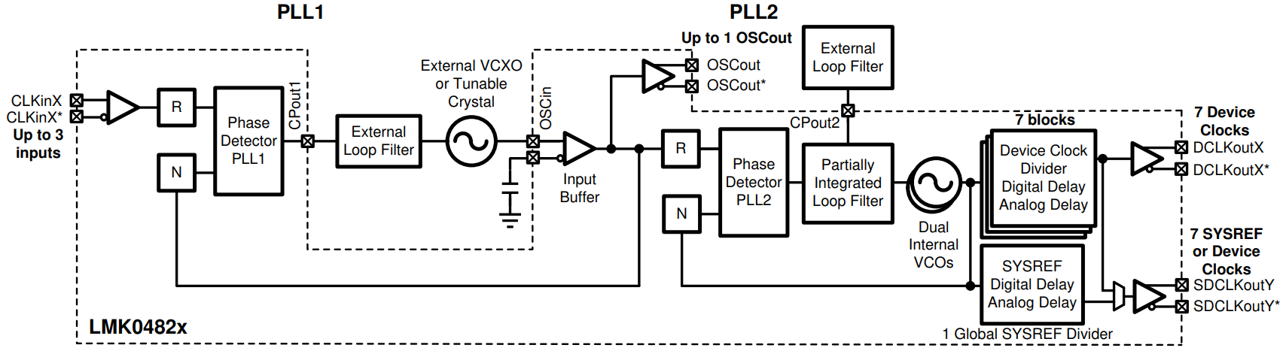
LMK04828 – PLL1
Referred to as jitter cleaner stage
Narrow-loop bandwidth:
Typically between 10Hz and 200Hz
Useful for reference locking LMK outputs to external equipment (required for coherency)
The reference input clock is NOT the PLL2 reference frequency!
The PLL2 reference frequency is the VCXO – typically a 122.88MHz or 100MHz Crystek
122.88MHz Crystek

Slide 11
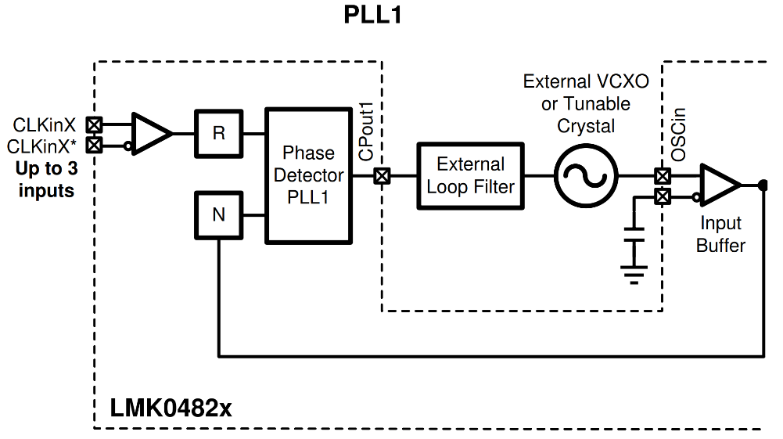
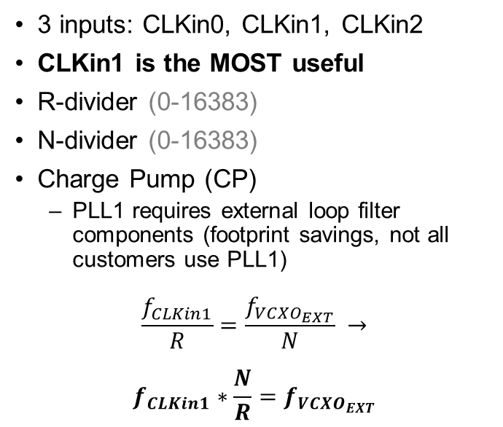
LMK04828 – PLL1
3 inputs: CLKin0, CLKin1, CLKin2
CLKin1 is the MOST useful
R-divider (0-16383)
N-divider (0-16383)
Charge Pump (CP)
PLL1 requires external loop filter components (footprint savings, not all customers use PLL1)
$$\frac{f_{CLKin1}}{R}=\frac{f_{VCXO_{EXT}}}{N} →$$
$$f_{CLKin1}∗\frac{N}{R}=f_{VCXO_{EXT}}$$

Slide 12
LMK04828 – PLL2
Referred to as main PLL stage
Wide-loop bandwidth:
Typically between 50kHz and 200kHz
Used for synthesizing output clock(s)
The PLL2 reference frequency is the VCXO – typically a 122.88MHz or 100MHz Crystek
Contains 2 internal VCOs covering 2370MHz – 2630MHz and 2920MHz – 3080MHz
122.88MHz Crystek

Slide 13
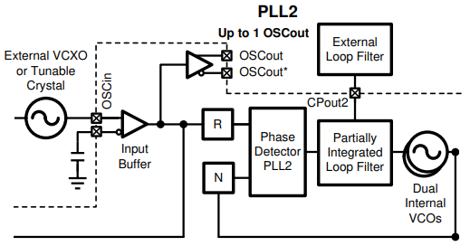
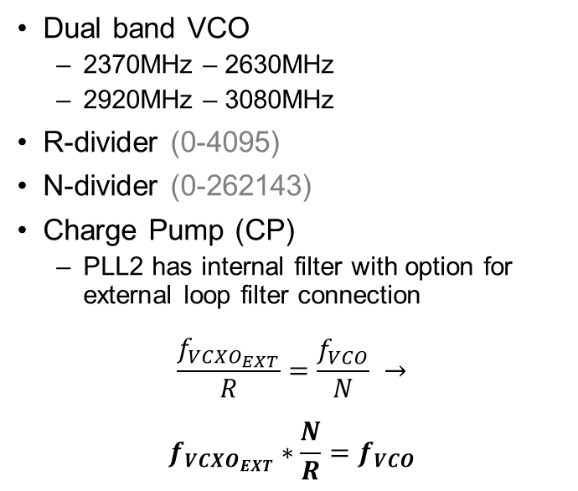
LMK04828 – PLL2
Dual band VCO
2370MHz – 2630MHz
2920MHz – 3080MHz
R-divider (0-4095)
N-divider (0-262143)
Charge Pump (CP)
PLL2 has internal filter with option for external loop filter connection
$$\frac{f_{VCXO_{EXT}}}{R}=\frac{f_{VCO}}{N} →$$
$$f_{VCXO_{EXT}}∗\frac{N}{R}=f_{VCO}$$

Slide 14
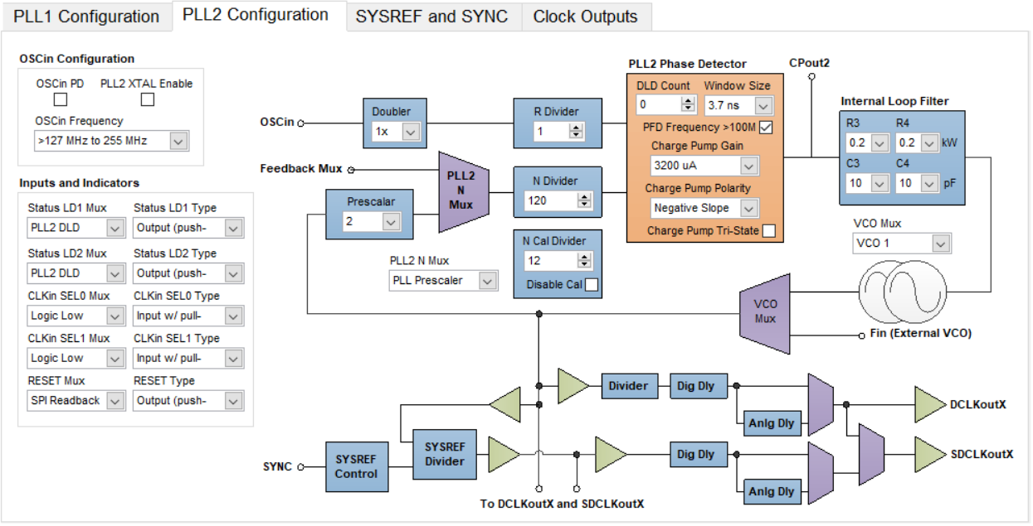
Additional PLL2 Configuration Options
Optional (*2) to double VCXO reference frequency
Pre-scalar: (/2 through /8)
VCO frequency exceeds PLL input range

Slide 15
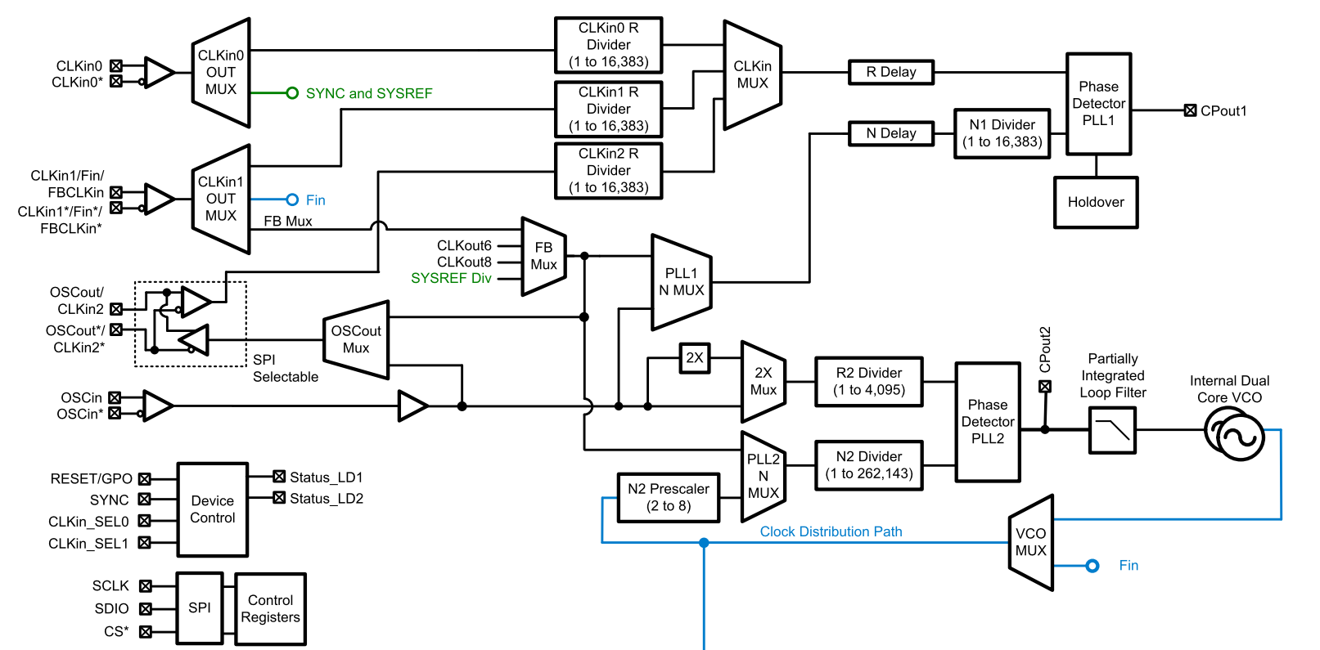
PLL1 Configuration Tab
PLL2 Configuration Tab
To divider stages

Slide 16
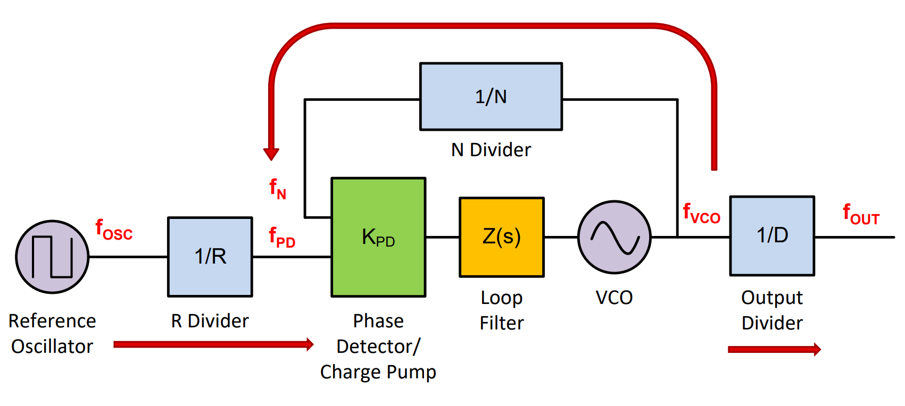
PLL Summary
Input frequency into the PFD (phase-frequency-detector) from both the input and the feedback (VCO) must match
Phase variation between the input and the feedback paths must not vary beyond a user defined value (typically 3.7ns for LMK04828)

Slide 17
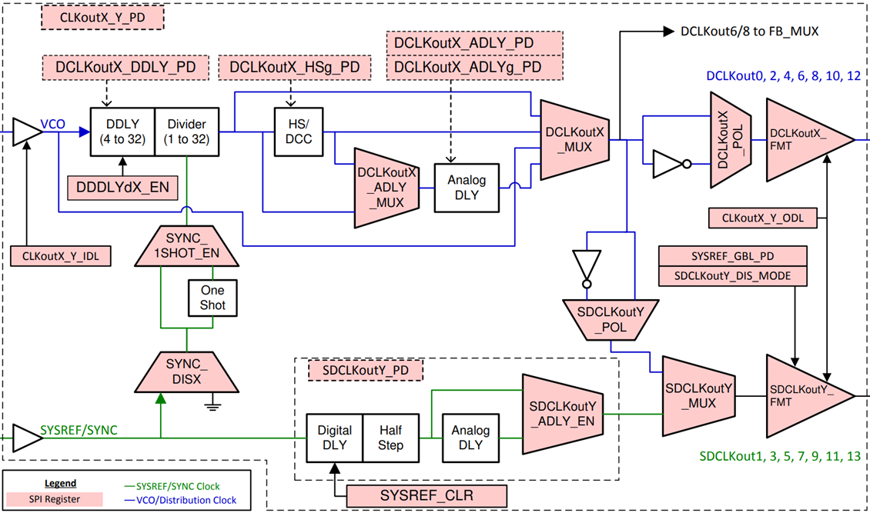
LMK04828 – SYSREF
SYSREF is used for JESD204B Subclass 1 - deterministic latency spanning multiple devices
SYSREF can be:
Supplied through CLKin0 input
Generated via SYSREF divider
All 7 SYSREF outputs are the same
Can be continuous SYSREF or pulsed SYSREF (aka. Pulser modes)

Slide 18
LMK04828 – Output dividers
Integer dividers (1 through 32)
Individually controlled per each DCLKoutX
LMK04832 supports many integer dividers (1 through 1023)
Also includes delays (however we typically do not touch these ever)
122.88MHz Crystek

Slide 19
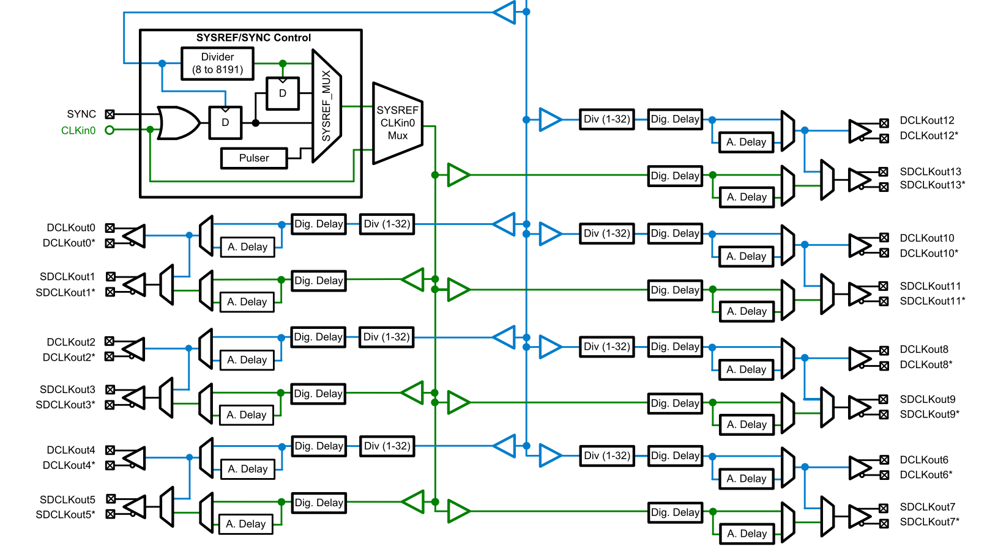
Clock Outputs Tab

Slide 20
Operational modes
Dual-loop mode (PLL1 + PLL2)
Single-loop mode (PLL2)
Zero-delay mode (special case of dual-loop mode)
Distribution mode (Bypass both PLLs)

Slide 21
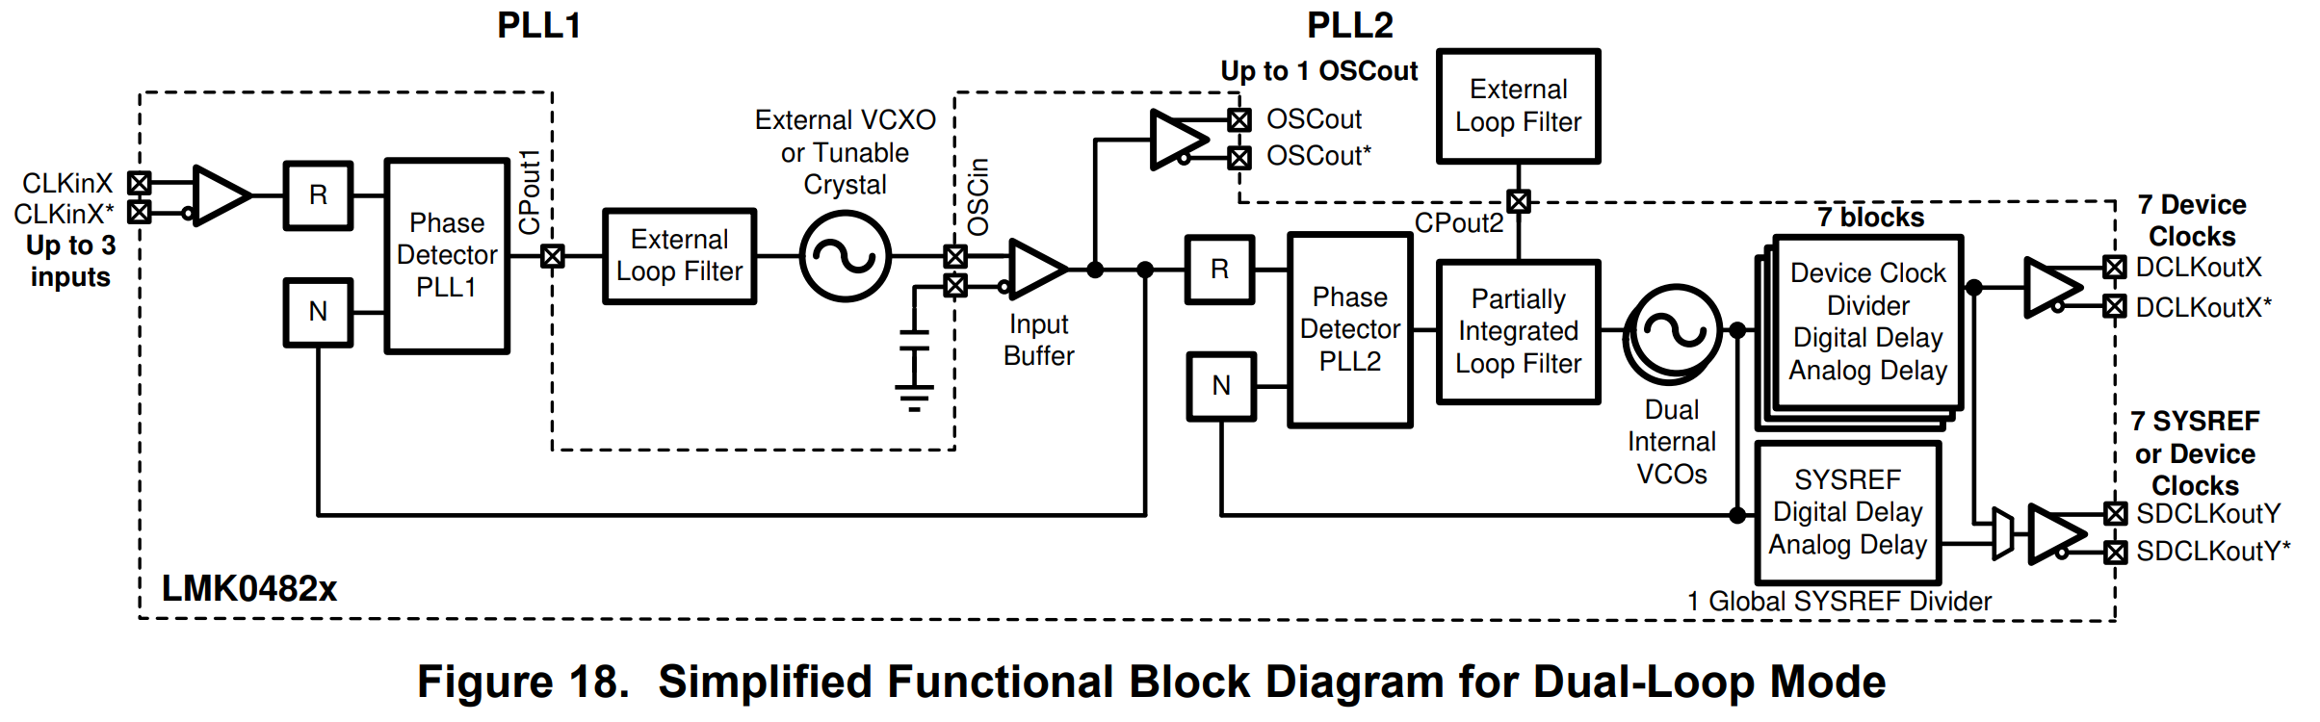
Dual-Loop Mode
PLL1 used for jitter cleaning and locking VCXO to the reference input to achieve coherency
PLL2 synthesizes a frequency on VCO0 or VCO1
Output dividers are used to create ADC/DAC clock and FPGA reference clock

Slide 22
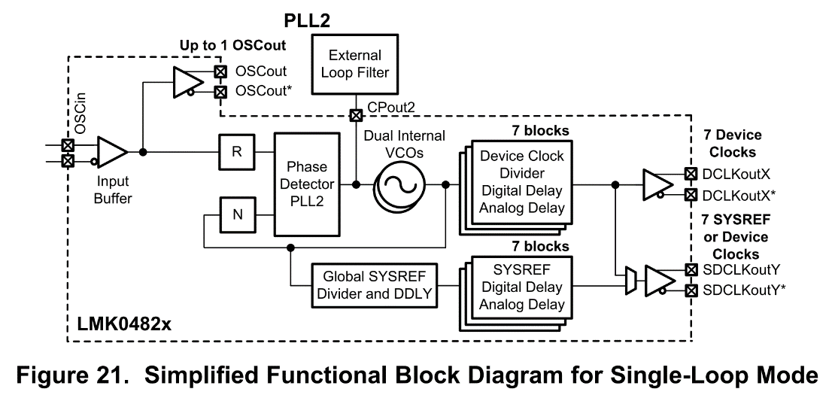
Single-Loop Mode
PLL1 is bypassed by tri-stating the PFD (phase-frequency-detector)
PLL2 synthesizes a frequency on VCO0 or VCO1
Output dividers are used to create ADC/DAC clock and FPGA reference clock

Slide 23
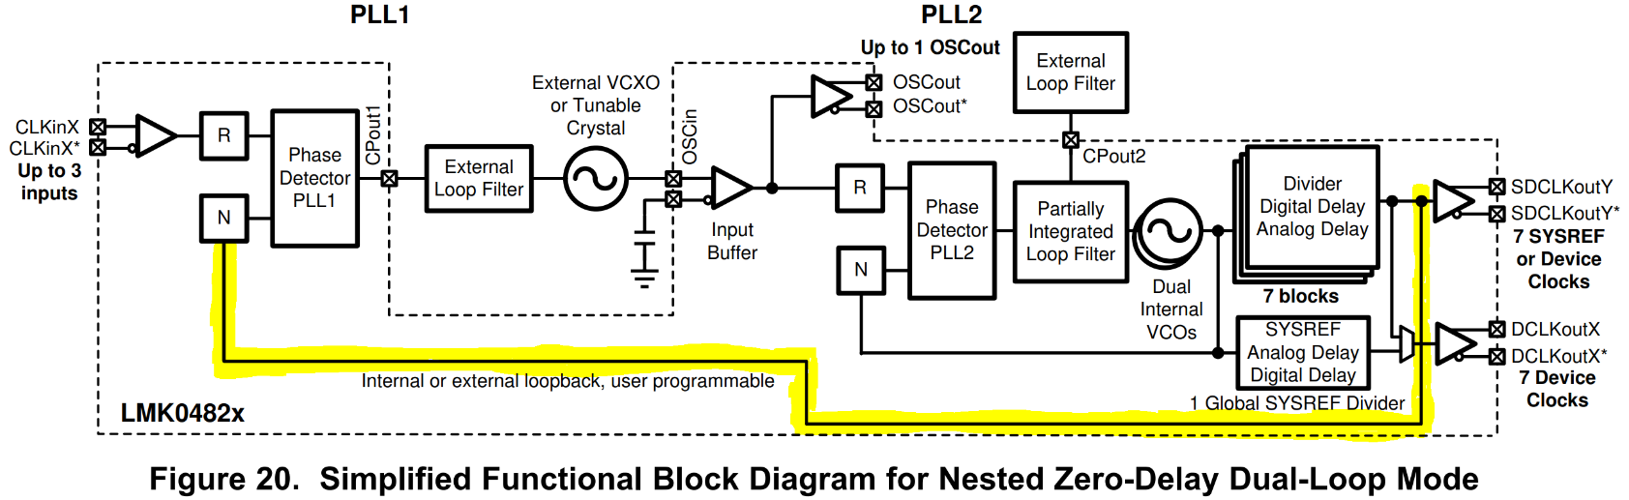
Nested Zero-Delay Mode
PLL1 is active and R and N dividers are set to 1 (zero-delay mode)
PLL2 synthesizes a frequency on VCO0 or VCO1
Essentially the same as dual-loop mode, but feedback into PLL1 PFD comes from DCLKout6/8 or SYSREF (and not the CLKin0/1/2 input)
Makes it useful for synchronizing across multiple EVM’s quickly
Ensures that PLL2 VCXO input is deterministic in phase to the output clock/SYSREF/feedback mux
Output dividers are used to create deterministic ADC/DAC clock and FPGA reference clock

Slide 24
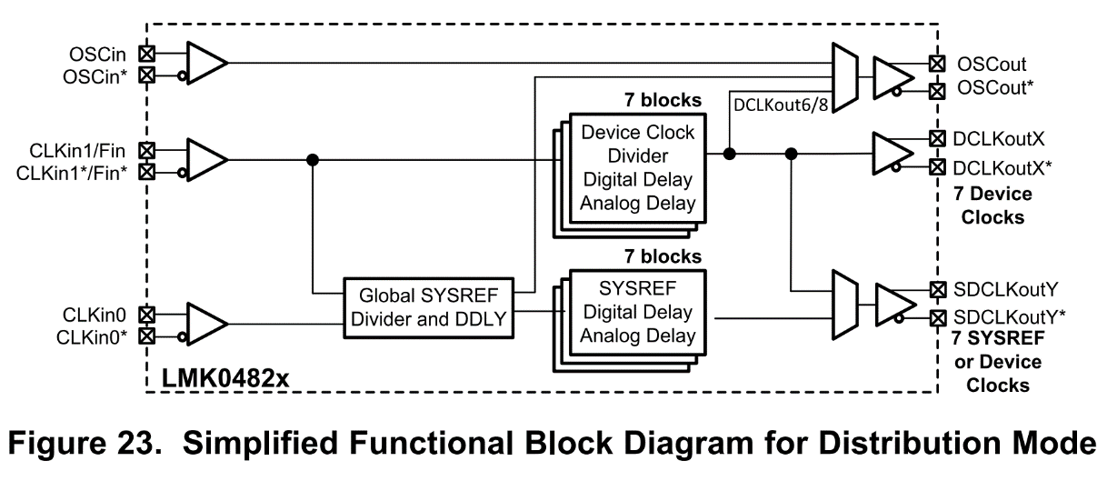
Distribution Mode
PLL1 is bypassed by tri-stating the PFD (phase-frequency-detector)
PLL2 is bypassed by tri-stating the PFD (phase-frequency-detector)
Passes the CLKin1 input to the divider stage, allowing for division of signal generator
Output dividers are used to create deterministic ADC/DAC clock and FPGA reference clock

Slide 25
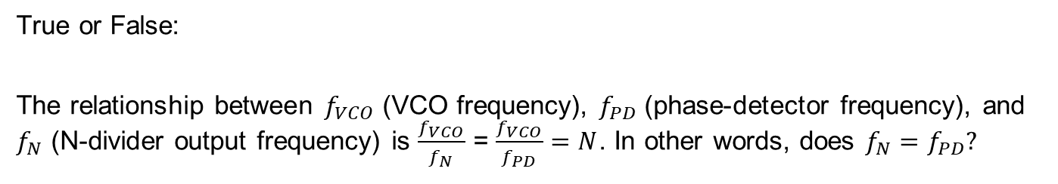
Quiz
True or False:
The relationship between $f_{VCO}$ (VCO frequency), $f_{PD}$ (phase-detector frequency), and $f_{N}$ (N-divider output frequency) is $\frac{f_{VCO}}{f_{N}}$ = $\frac{f_{VCO}}{f_{PD}}=N$. In other words, does $f_{N}=f_{PD}?$

Slide 26
Quiz
True or False:
The relationship between $f_{VCO}$ (VCO frequency), $f_{PD}$ (phase-detector frequency), and $f_{N}$ (N-divider output frequency) is $\frac{f_{VCO}}{f_{N}}$ = $\frac{f_{VCO}}{f_{PD}}=N$. In other words, does $f_{N}=f_{PD}?$

Slide 27
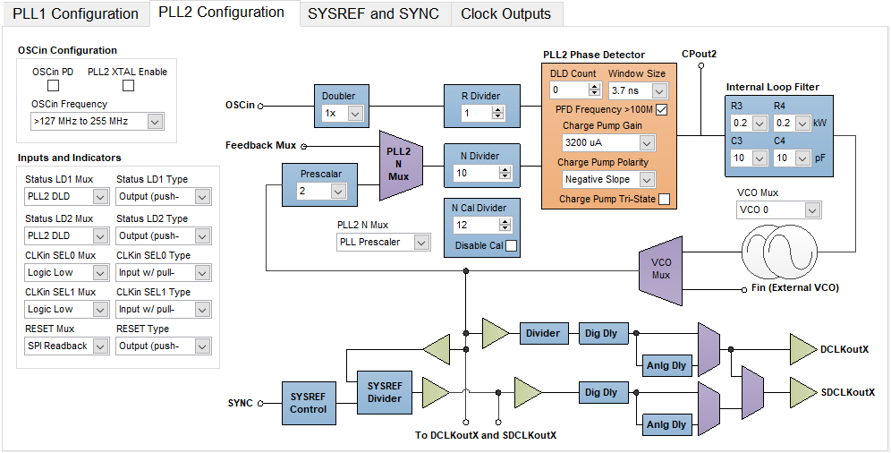
Quiz
What is the VCO frequency in the below configuration? Which VCO supports this frequency?
122.88MHz
VCO0 = 2370MHz – 2630MHz
VCO1 = 2920MHz – 3080MHz

Slide 28
Quiz
What is the VCO frequency in the below configuration? Which VCO supports this frequency?
122.88MHz
122.88MHz
122.88MHz
1228.8MHz
122.88MHz
2456.7MHz
2457.6 MHZ falls within VCO0 range
VCO0 = 2370MHz – 2630MHz
VCO1 = 2920MHz – 3080MHz

Slide 29
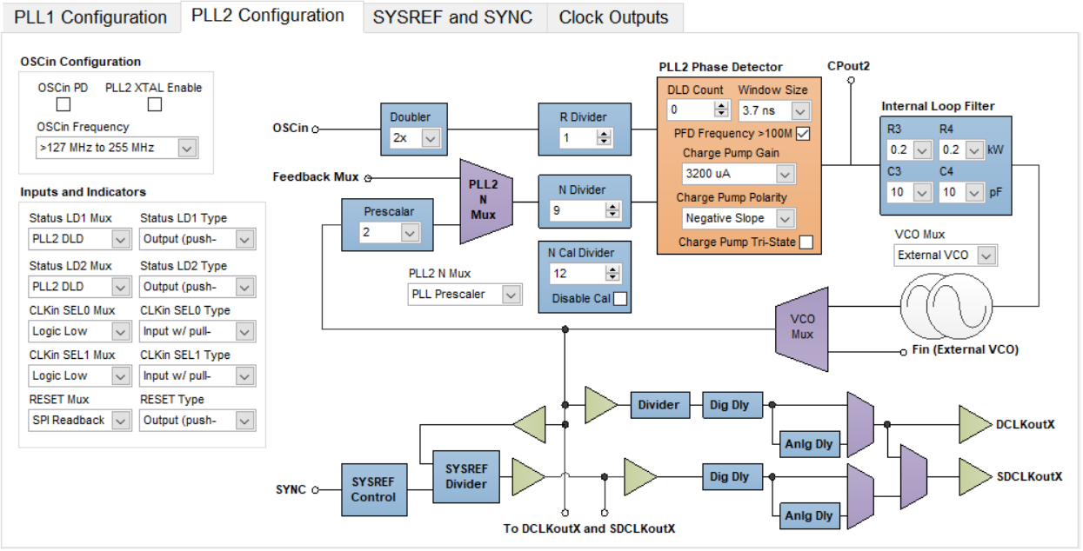
Quiz
Same question as before, but with different OSCin frequency
What is the VCO frequency in the below configuration? Which VCO supports this frequency?
80MHz
VCO0 = 2370MHz – 2630MHz
VCO1 = 2920MHz – 3080MHz

Slide 30
Quiz
TRICKY QUESTION, the answer is neither VCO can support this frequency!
What is the VCO frequency in the below configuration? Which VCO supports this frequency?
160MHz
80MHz
160MHz
1440MHz
160MHz
2880MHz
2880 MHZ falls into the VCO gap, must use External VCO
VCO0 = 2370MHz – 2630MHz
VCO1 = 2920MHz – 3080MHz

Slide 31
Resources
https://training.ti.com/ti-precision-labs-clocks-and-timing-phase-lock-loop-fundamentals
https://www.ti.com/lit/an/slyt169/slyt169.pdf

