Slide 1
DAC38J84
NSD measurement
fDAC = 2460MSPS, 2x interpolation, 0dBFS digital input, 20mA full scale output current with 2:1 transformer, LMF = 841 and PLL is disabled. Frequency Output of 247MHz

Slide 2
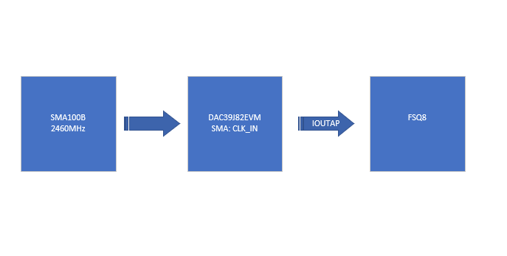
Hardware Setup

Slide 3
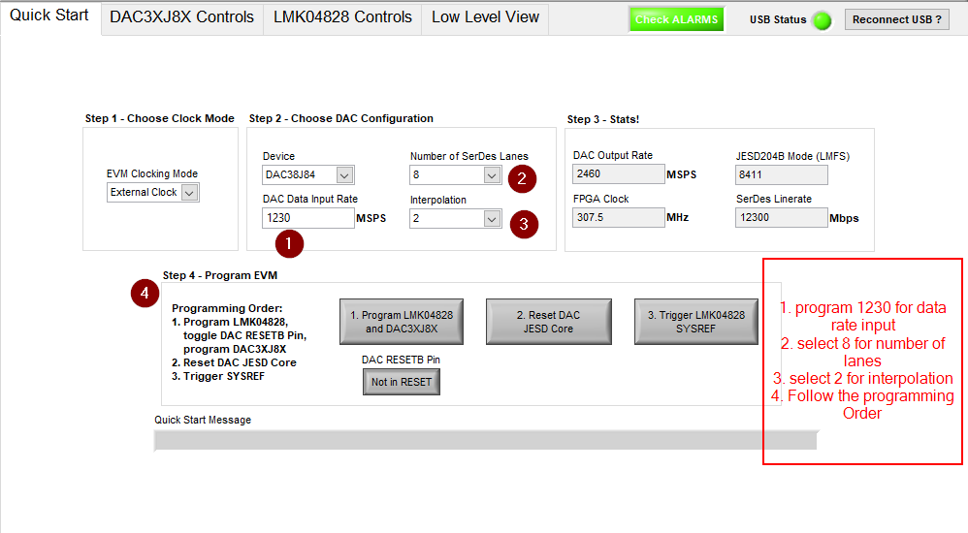
DAC GUI Setup

Slide 4
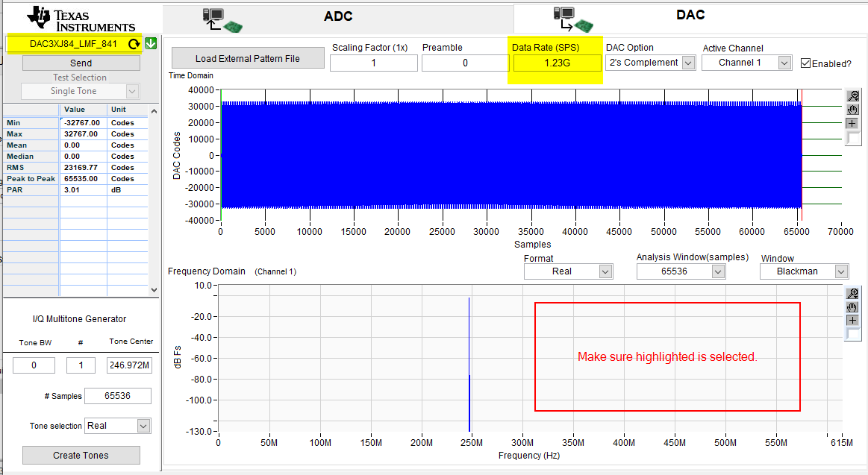
HSDCPRO Setup

Slide 5
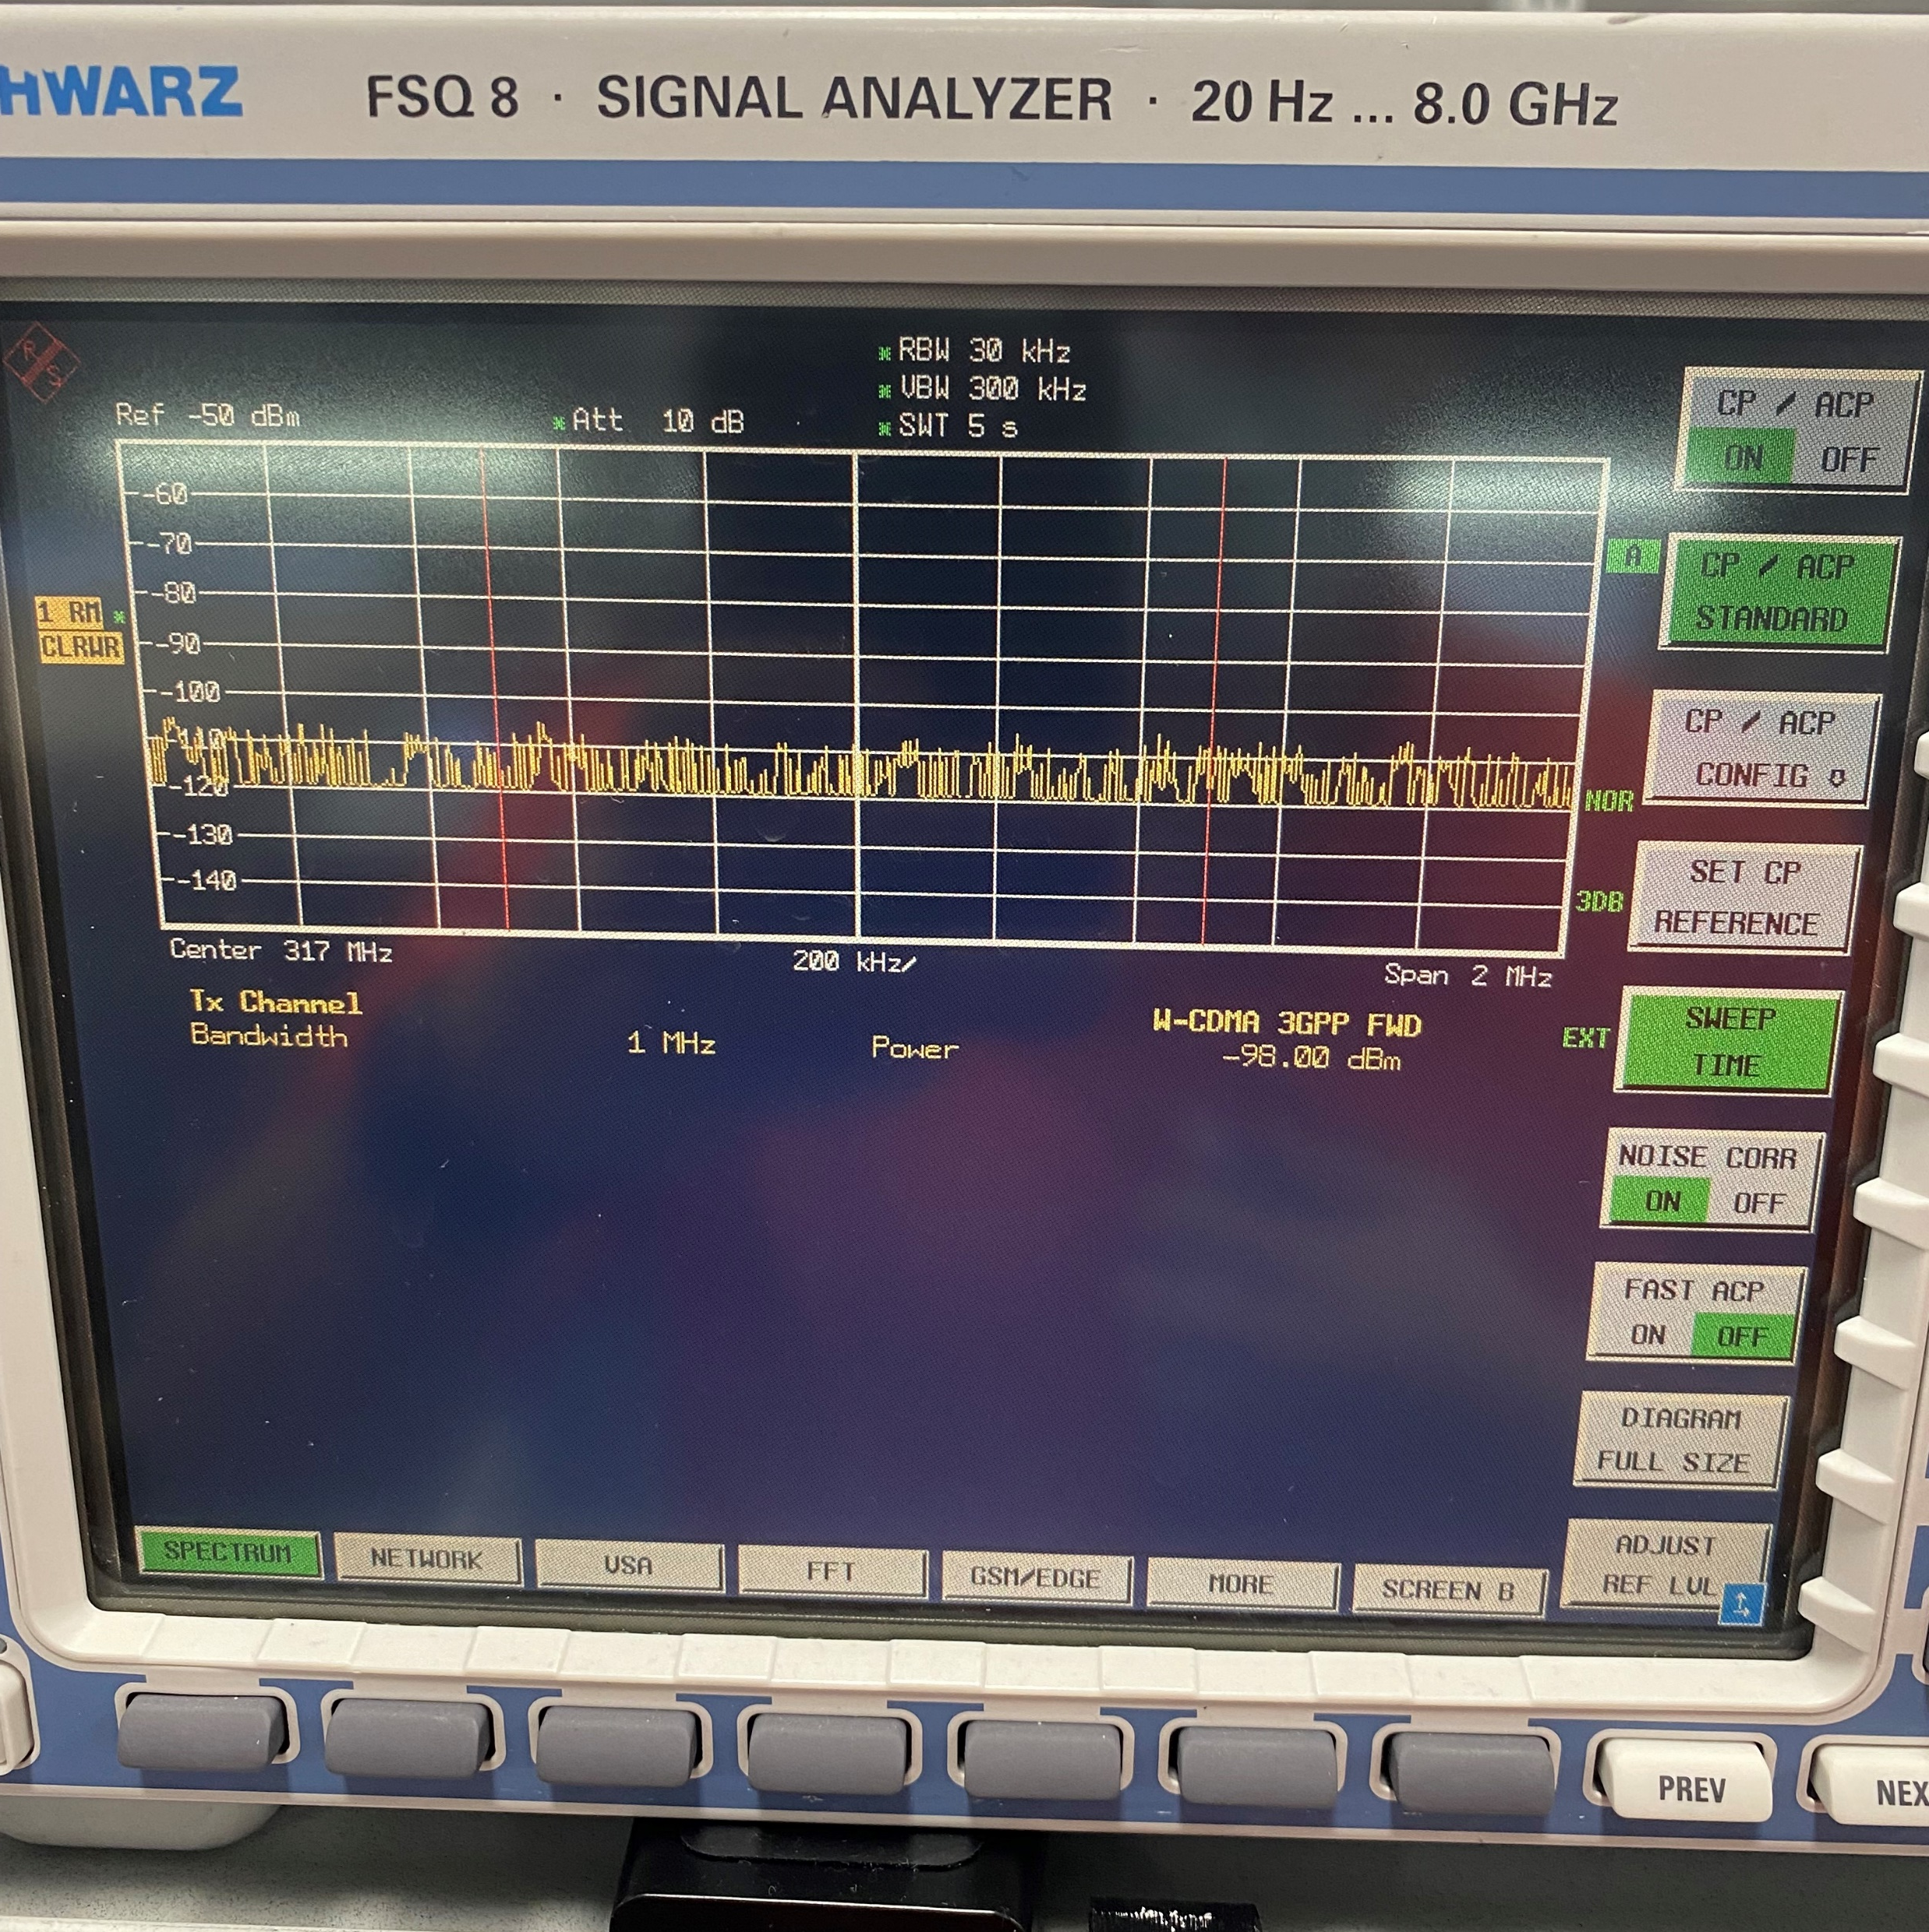
FSQ8
-NOISE CORR must be on to remove noise added by FSQ8
-CH BW select 1 MHz since it’s easier for calculations
-Turn off other adjacent CH’s only interested in Tx CH
-Center Freq Fund+70Mhz (want to make sure measurement is DAC noise)
-SPAN 2MHz (make sure measurement is not including any possible mixing spurs)
- Firmware w-cdma 3gpp fwd
NSD= -98(measurement)-10log(CH BW)-Fund
NSD= -157.5 dBc/Hz
It’s close to what the datasheet has for 247MHz output tone.

