Slide 1
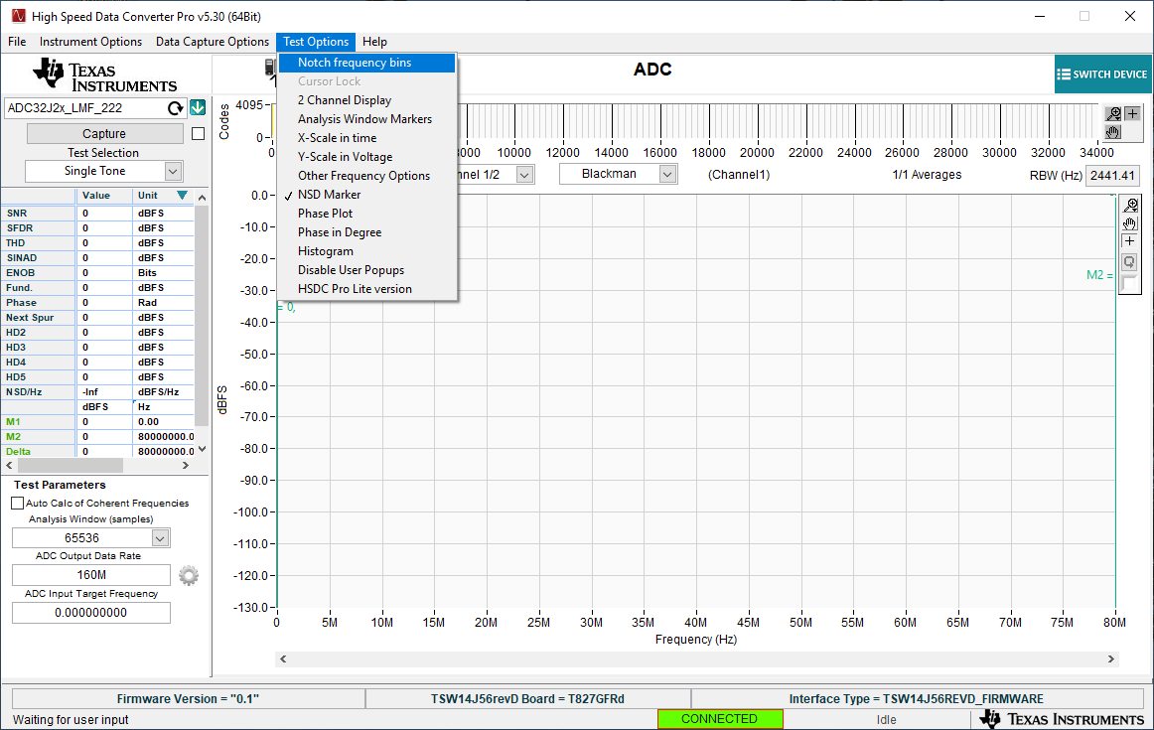
Go to “Test Options” tab then “Notch frequency bins” tab

Slide 2
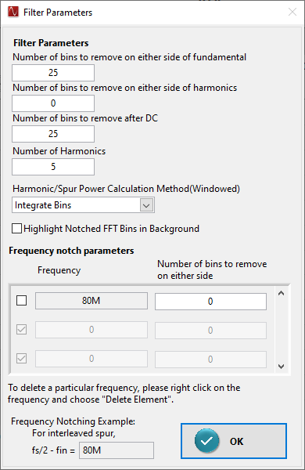
To remove flat line, set this to “0”

