Slide 1
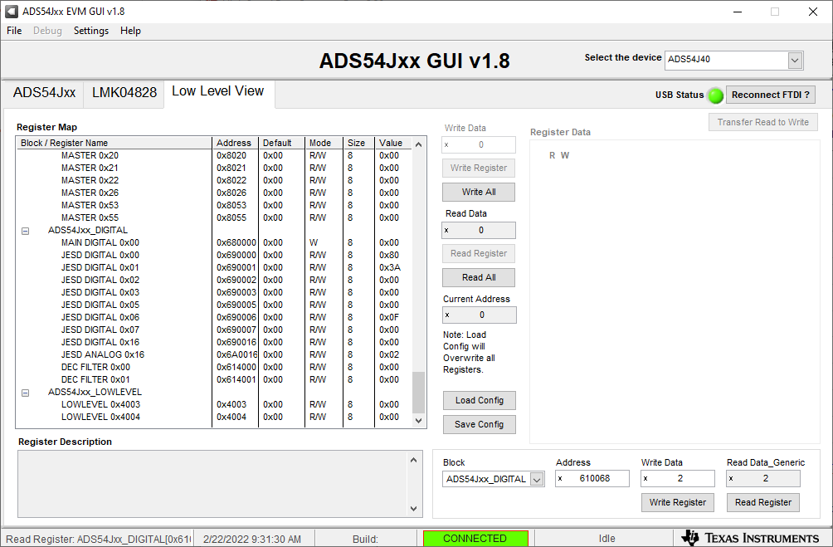
Load the LMK config file, press the board rest switch, then load the ADC config file. Open Low Level View tab in ADC54Jxx GUI Go to ADS54Jxx_DIGITAL Block Enter address 610068 and click on “Read Register” as shown below. Default value should be 2

Slide 2
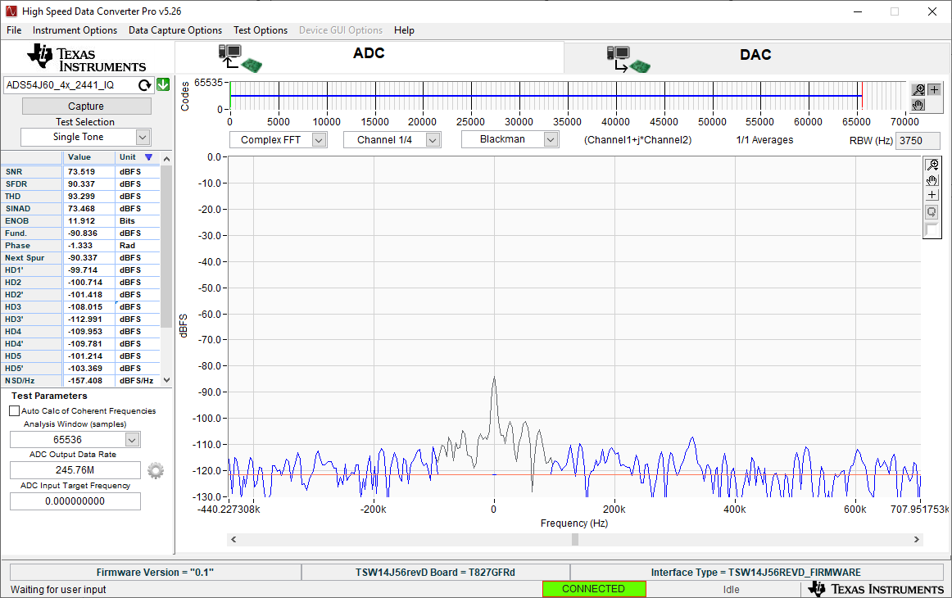
Capture ADC data.

Slide 3
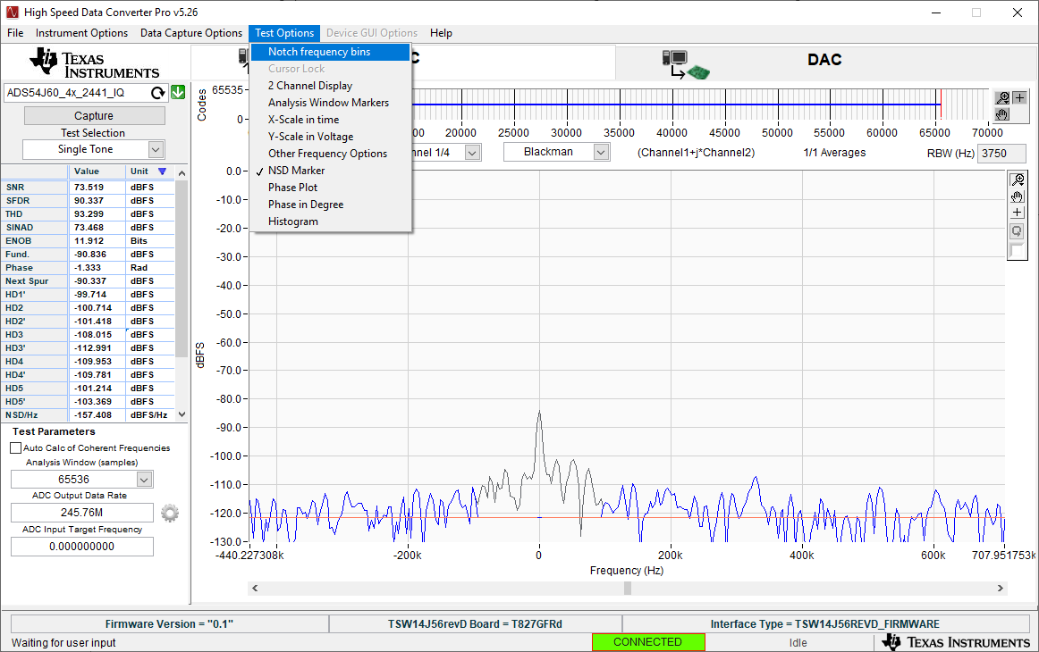
In HSDC Pro, click on “Test Options” and select “Notch frequency bins”.

Slide 4
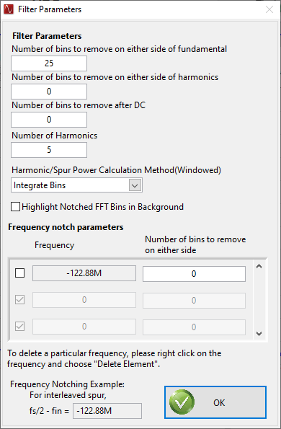
Change the Number of bins to remove after DC from “25” to “0”.

Slide 5

Open Low Level View tab in ADC54Jxx GUI Go to ADS54Jxx_DIGITAL Block Enter address 610068 and 6 for the Write Data. Click on “Write Register”

Slide 6
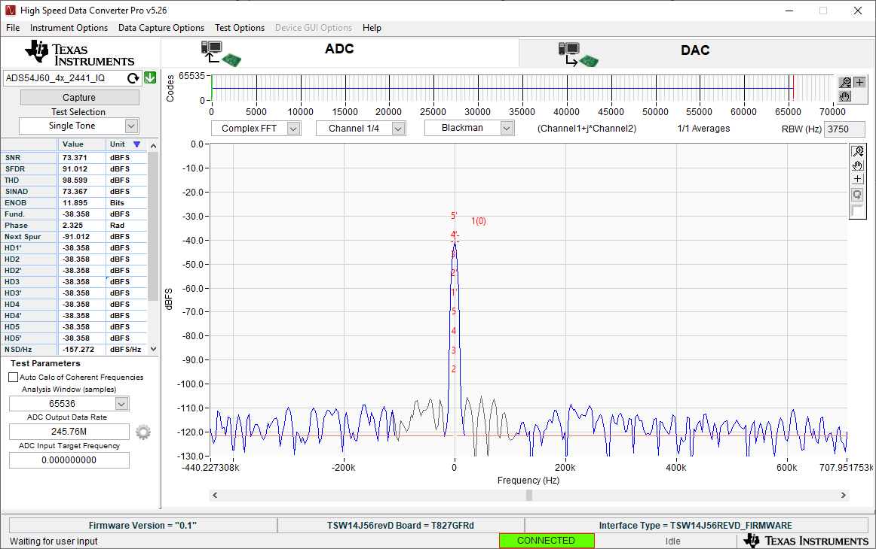
Capture ADC data. You should now see data at Fs/4.

