Slide 1
Observations & Modifications on ADS54J60

Slide 2
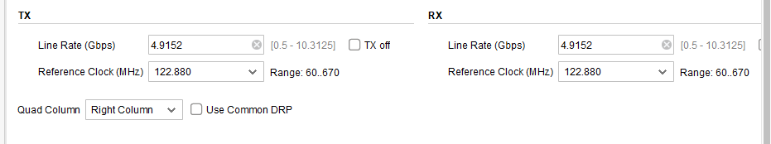
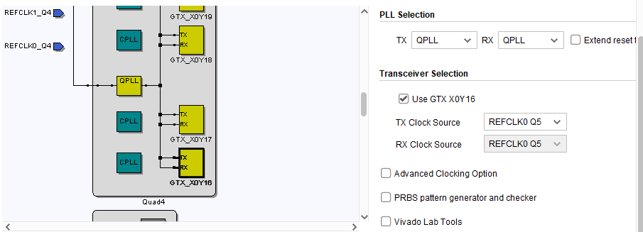
Changes made in the transceiver xci
Ref clock – 122.88 MHz
Line rate – 4.9152 Gbps
Since am using the (QUAD 4 )115 and (QUAD 5) 116 (MGT banks ) and MGT ref clock to bank 116 CLK 0 (REF CLK0 Q5)

Slide 3
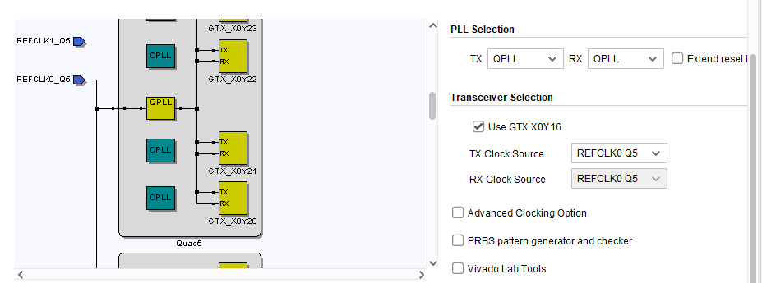
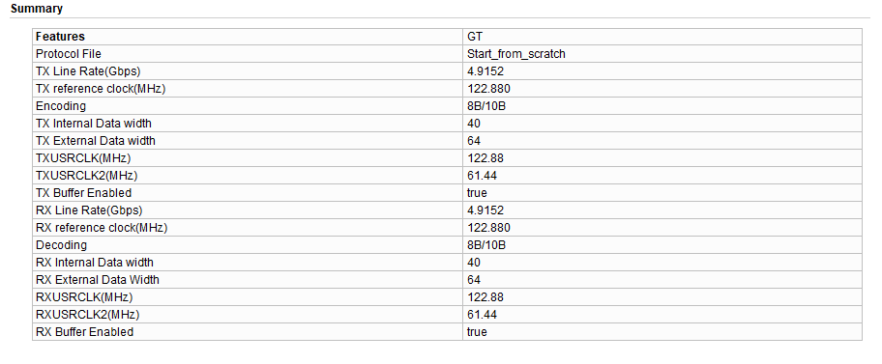

Slide 4
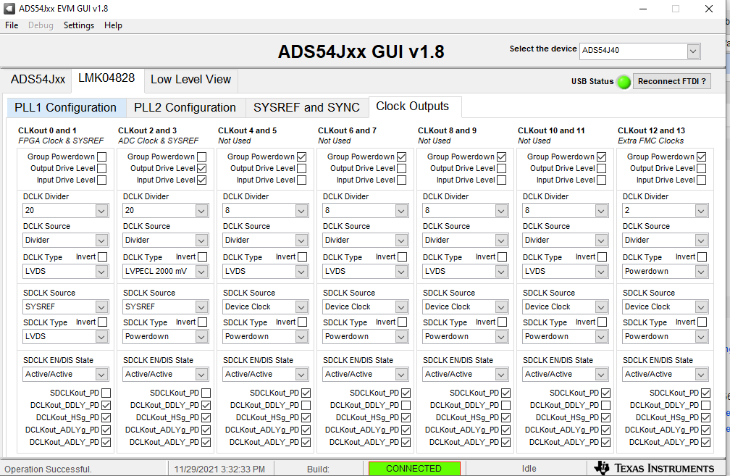
In LMK
Using the LMK config file : LMK_Config_Onboard_122p88_MSPS
Since VCO 1 is used for
clock generations
i.e
Input → 122.88 →
2949.2(vco1 freq) →
div 20 → 147.46MHz
(it is getting locked )

Slide 5
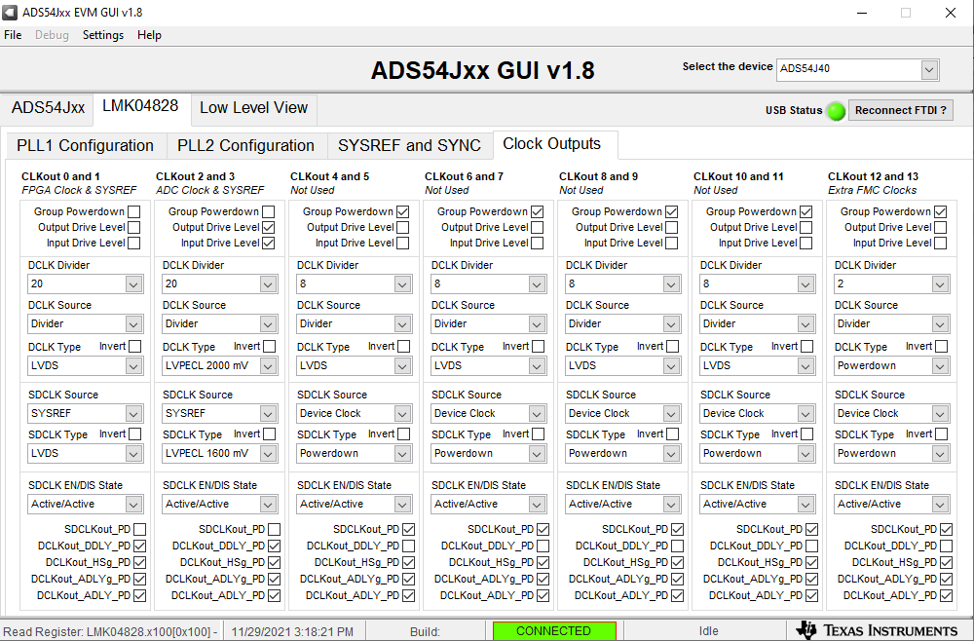
ADC
Using the ADC config file : ADS54J60_LMF_8224

Slide 6
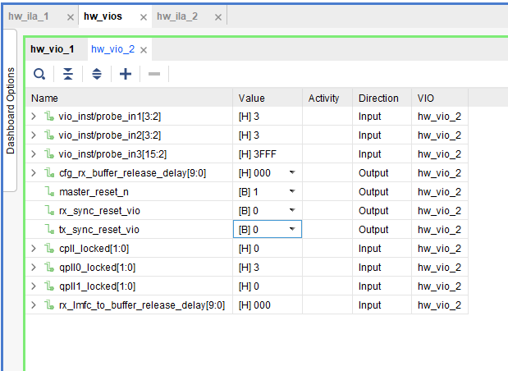
In VIO
After the master_reset_n → 1
qpll0 locked → “11”
Firmware

Slide 7
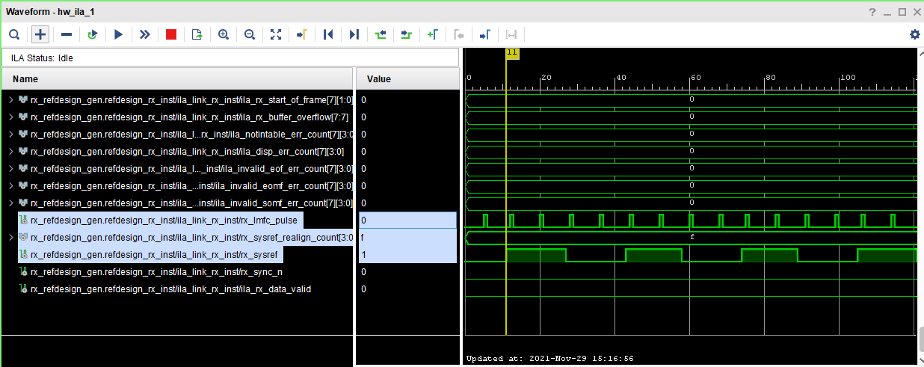
In ILA
I could only see the
  Sysref signal
  LMFC pulse
  Rx_Sysref realign counter
  Sync_n is still ‘0’

