Slide 1
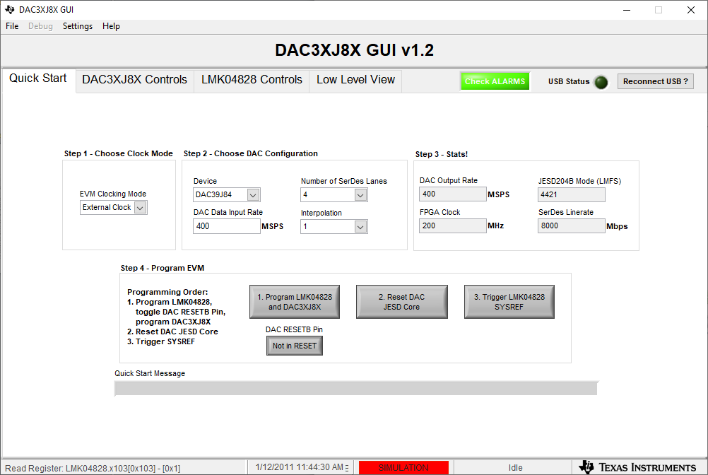
Program DAC and LMK as shown below with a 400MHz clock connected to J17.

Slide 2
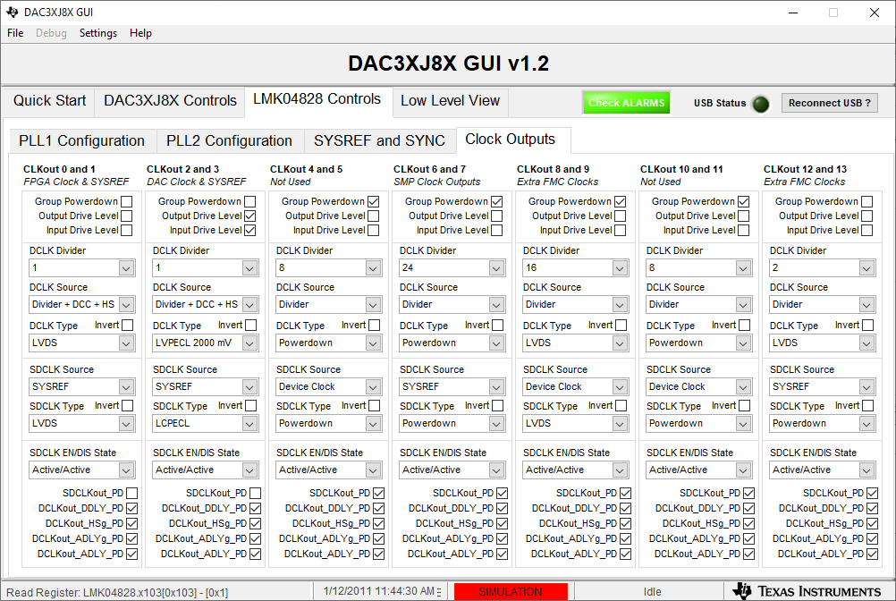
Set CLKout 0 and 1 DCLK Divider to 1 and DCLK Source to Divider + DCC + HS Set CLKout 2 and 3 DCLK Divider to 1 and DCLK Source to Divider + DCC + HS Unselect Group Powerdown for CLKout 12 and 13 Set CLKout 12 and 13 DCLK Divider to 2 and DCLK Source to Divider

