Slide 1
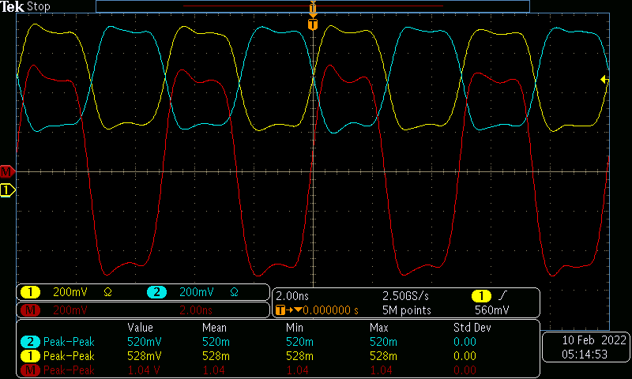
RX_DIV = 64, Fs = 1600MHz, Jmode = 0

Slide 2
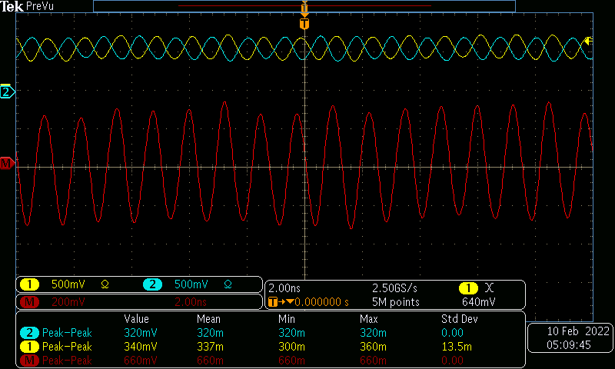
RX_DIV = 16, Fs = 1600MHz, Jmode = 0

Slide 3
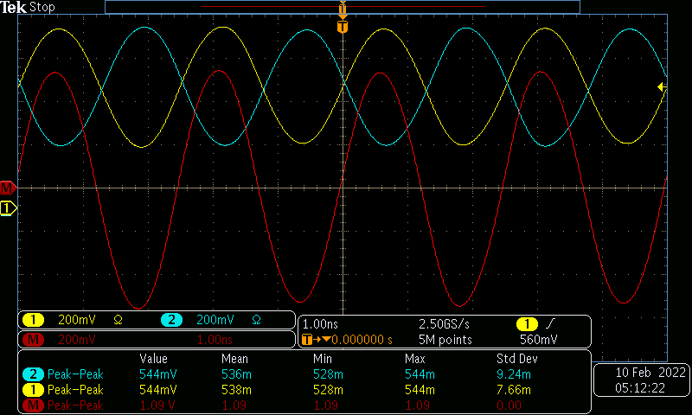
RX_DIV = 32 , Fs = 1600MHz, Jmode = 0

Slide 4
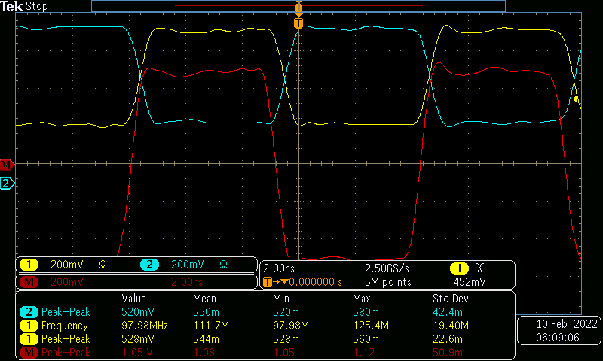
RX_DIV = 32, Fs = 500MHz, Jmode = 10

Slide 5
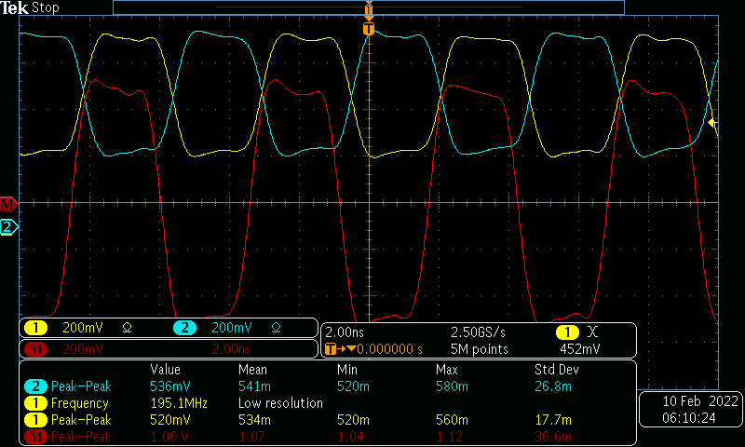
RX_DIV = 16, Fs = 500MHz, Jmode = 10

Slide 6
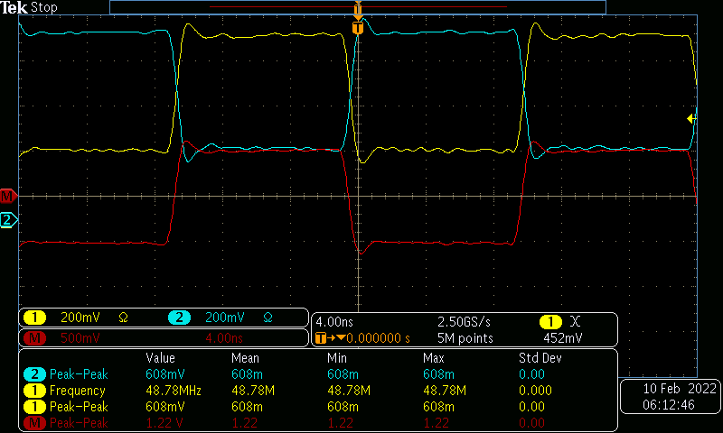
RX_DIV = 64, Fs = 500MHz, Jmode = 10

Slide 7
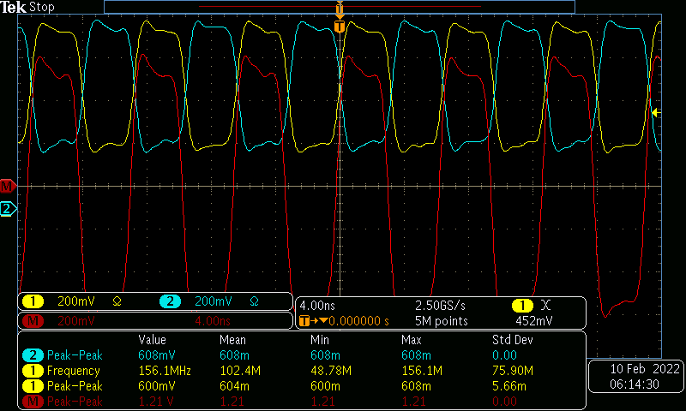
RX_DIV = 32, Fs = 800MHz, Jmode = 10

Slide 8
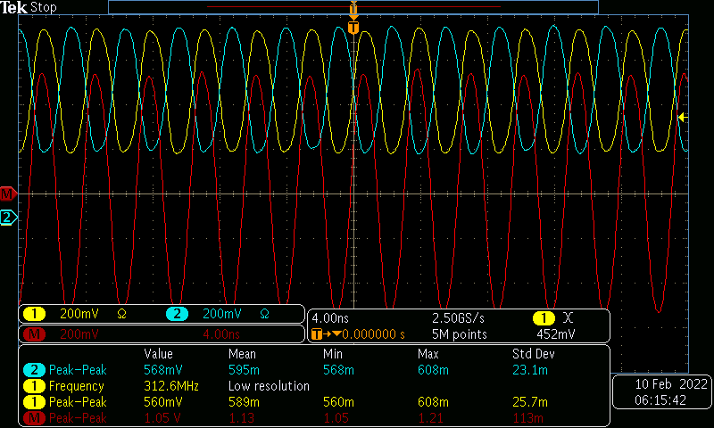
RX_DIV = 16, Fs = 800MHz, Jmode = 10

Slide 9
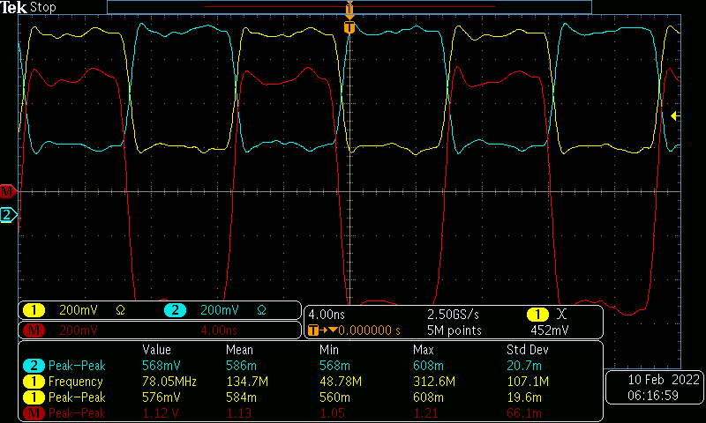
RX_DIV = 32, Fs = 800MHz, Jmode = 10

