Slide 1
Sampling procedure
Single Channel
Input
Signal
(fc)
SG
ADC
Real Sampled Data
S(n)
fs
Input a sine wave from SG
↓
Sampling at sampling frequency fs with ADC12DJ3200EVM
↓
Save the data with the HSDC Pro GUI.

Slide 2
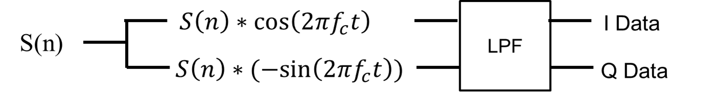
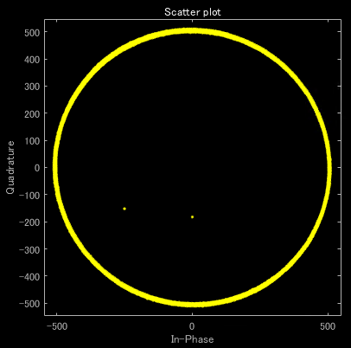
Single Channel IQ Modulation
fs = 3.2GHz, fc = 4.0GHz

Slide 3
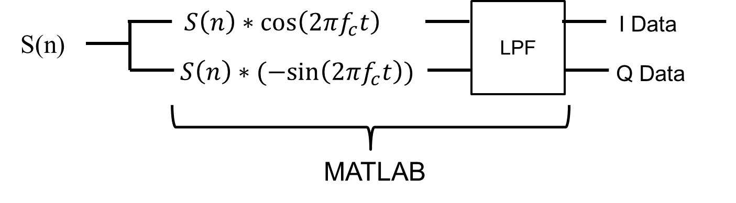
Sampling procedure
Single Channel
Input
Signal
(fc)
SG
ADC
Real Sampled Data
S(n)
Input a sine wave from SG.
↓
Sampling at sampling frequency fs with ADC12DJ3200EVM.
↓
Save the data with the HSDC Pro GUI.
↓
Process time waveforms in MATLAB.
fs

Slide 4
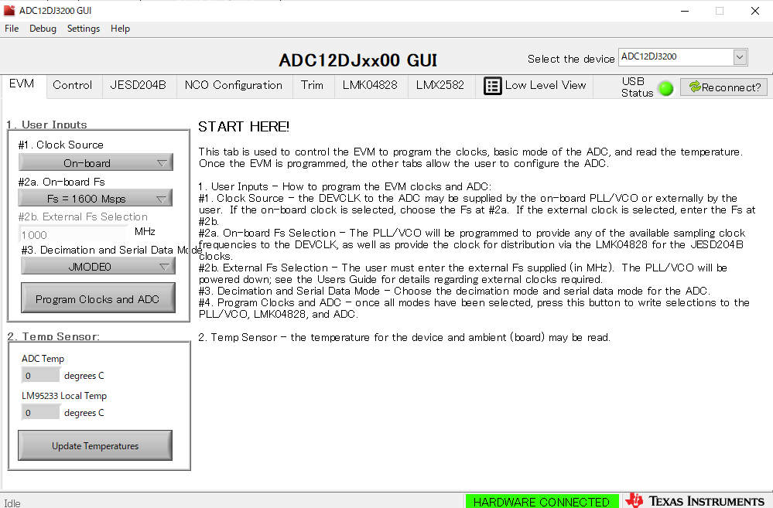
ADC settings

Slide 5
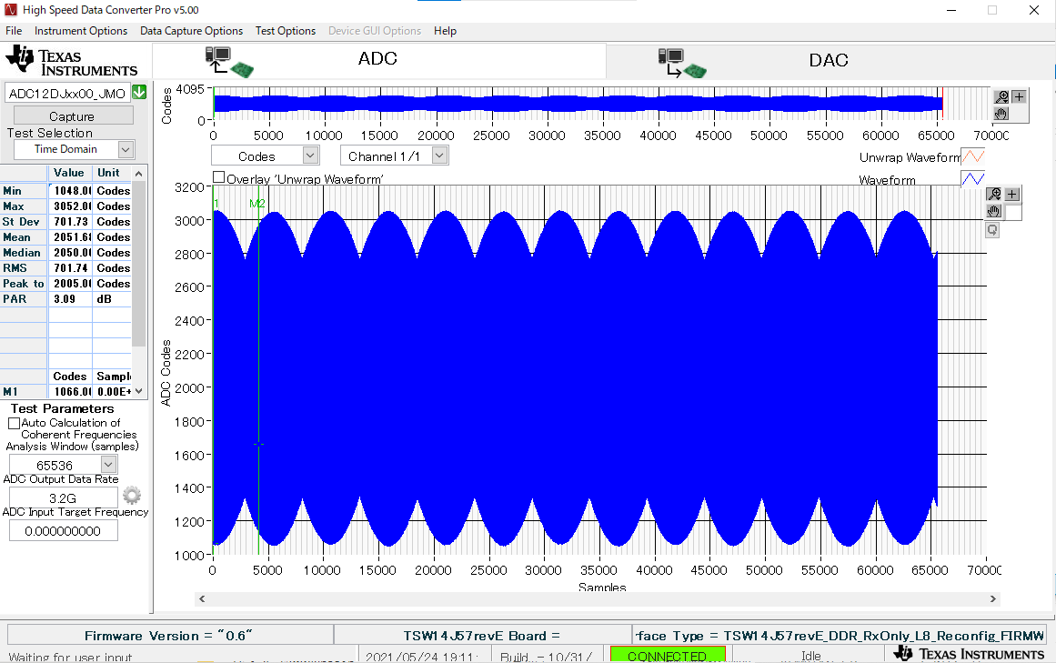
Time waveform from HSDC Pro GUI

Slide 6
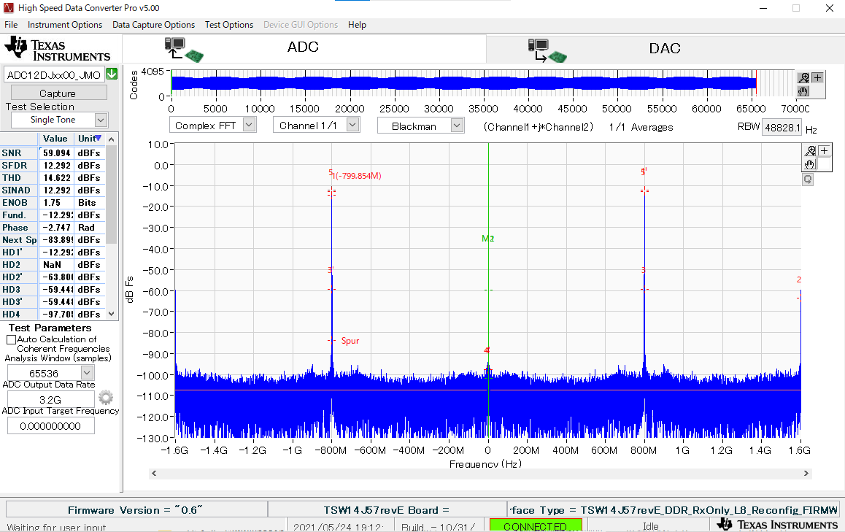
FFT result from HSDC Pro GUI

Slide 7
IQ Modulation in MATLAB
fs = 3.2GHz, fc = 4.0GHz

Slide 8
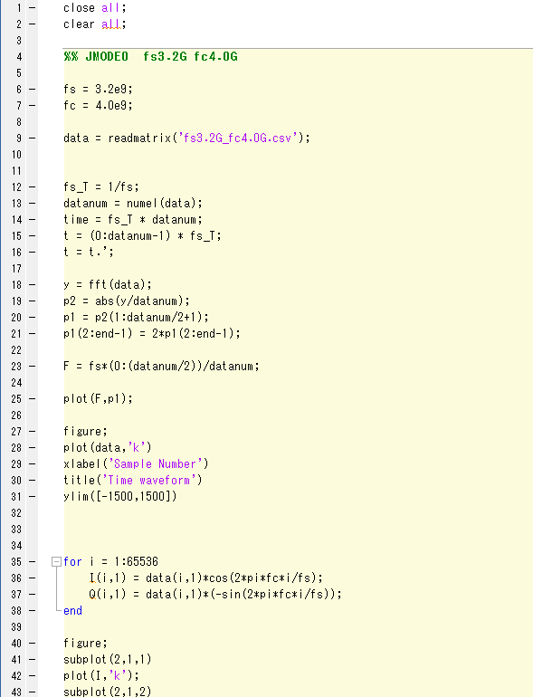
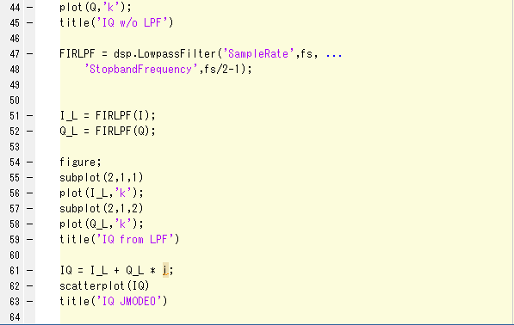
MATLAB code

Slide 9
Question
Is it the effect of aliasing that the sampled time waveform is distorted?
What kind of calculation should be performed to perform IQ modulation after obtaining the input waveform data when a sine wave is input and plot it on the constellation diagram?

