Slide 1
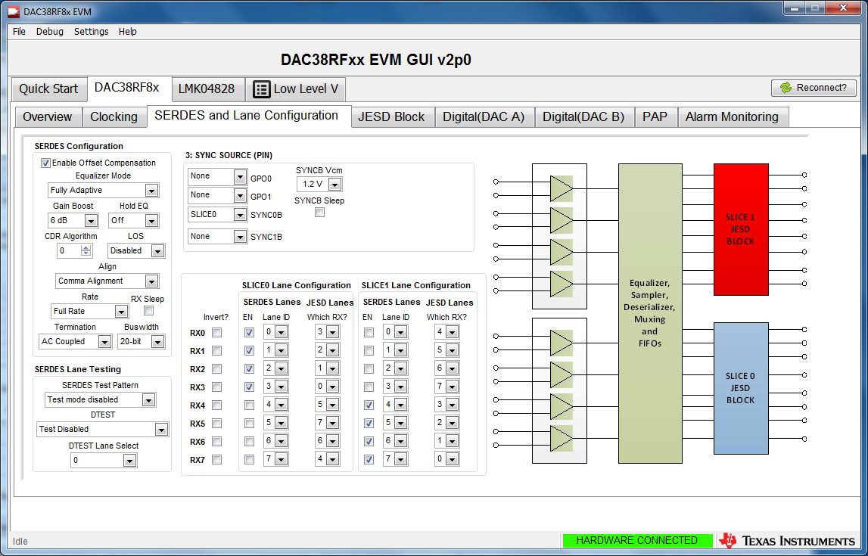
Serdes and Lane Config

