Slide 1
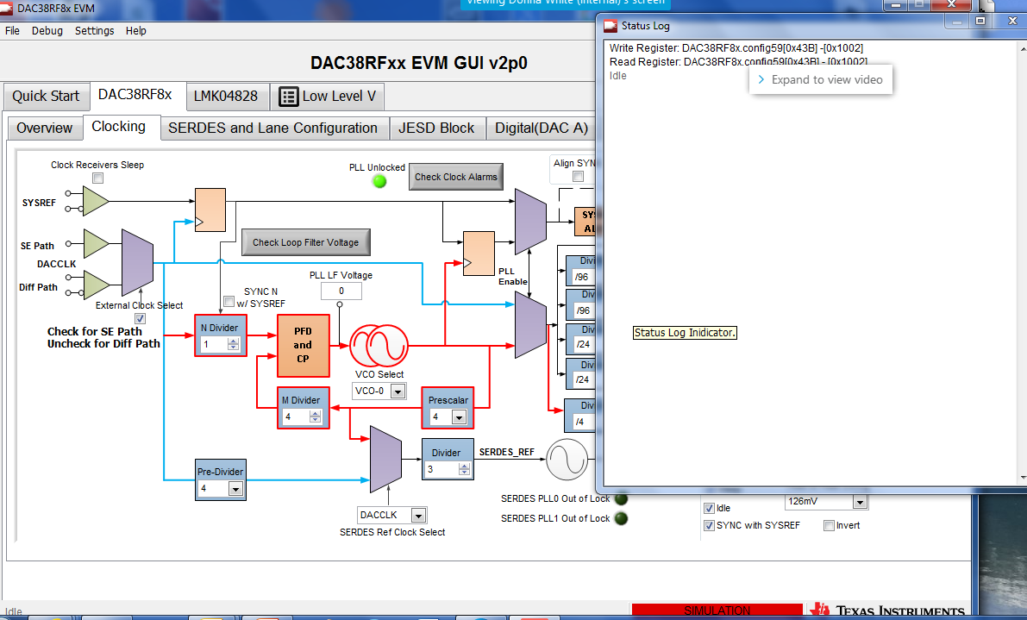
Double click in lower left corner of GUI to open log file.

Slide 2
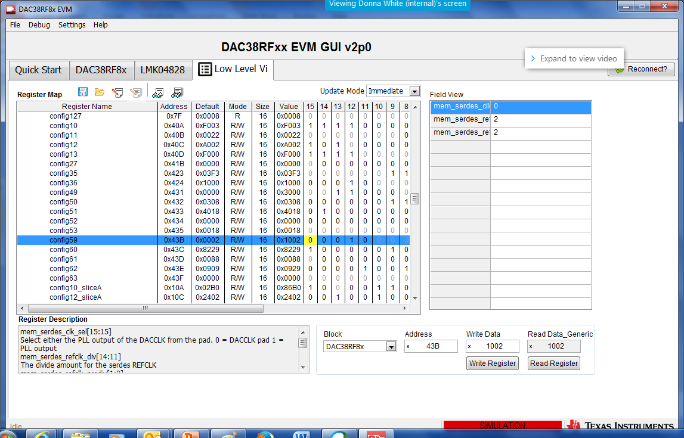
Config59 general register is Address 0x43B The “4” is used to set the page, the address is 3B

