Slide 1
Root cause investigation on PPM ECG Noise
Jan, 23, 2023

Slide 2
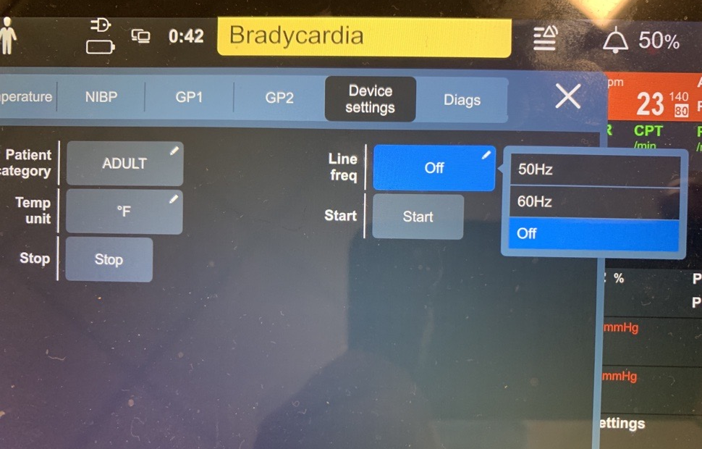
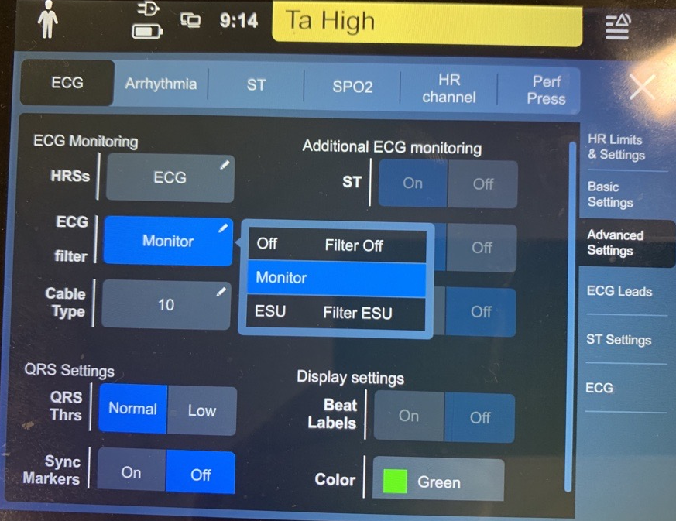
Test Config
line filter: off
ProSim 8
PPM
Data Collection
ECG filter: on
Scope

Slide 3
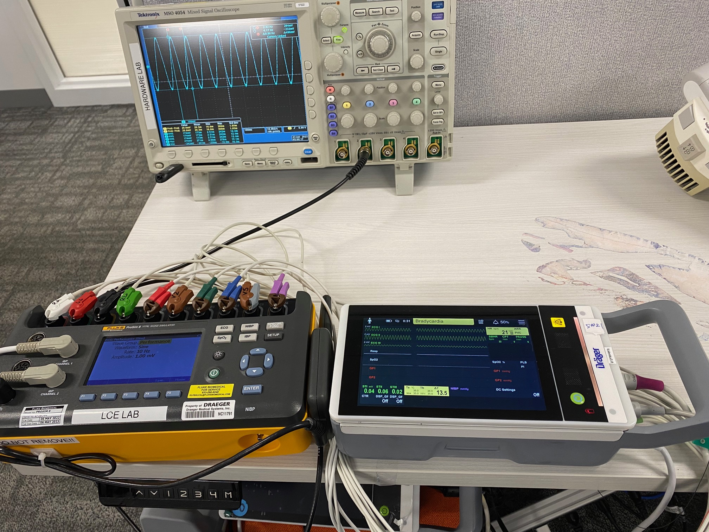
Test Config:
Prosim8: 1 mV Sine@ 2,10,25Hz,Batt; PPM: ECG filter on “Monitor”, line freq: off, batt;

Slide 4
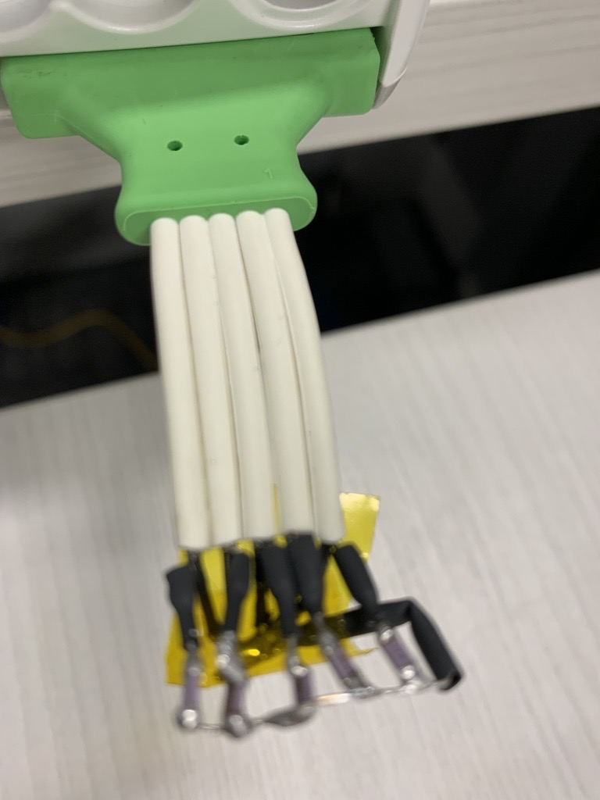
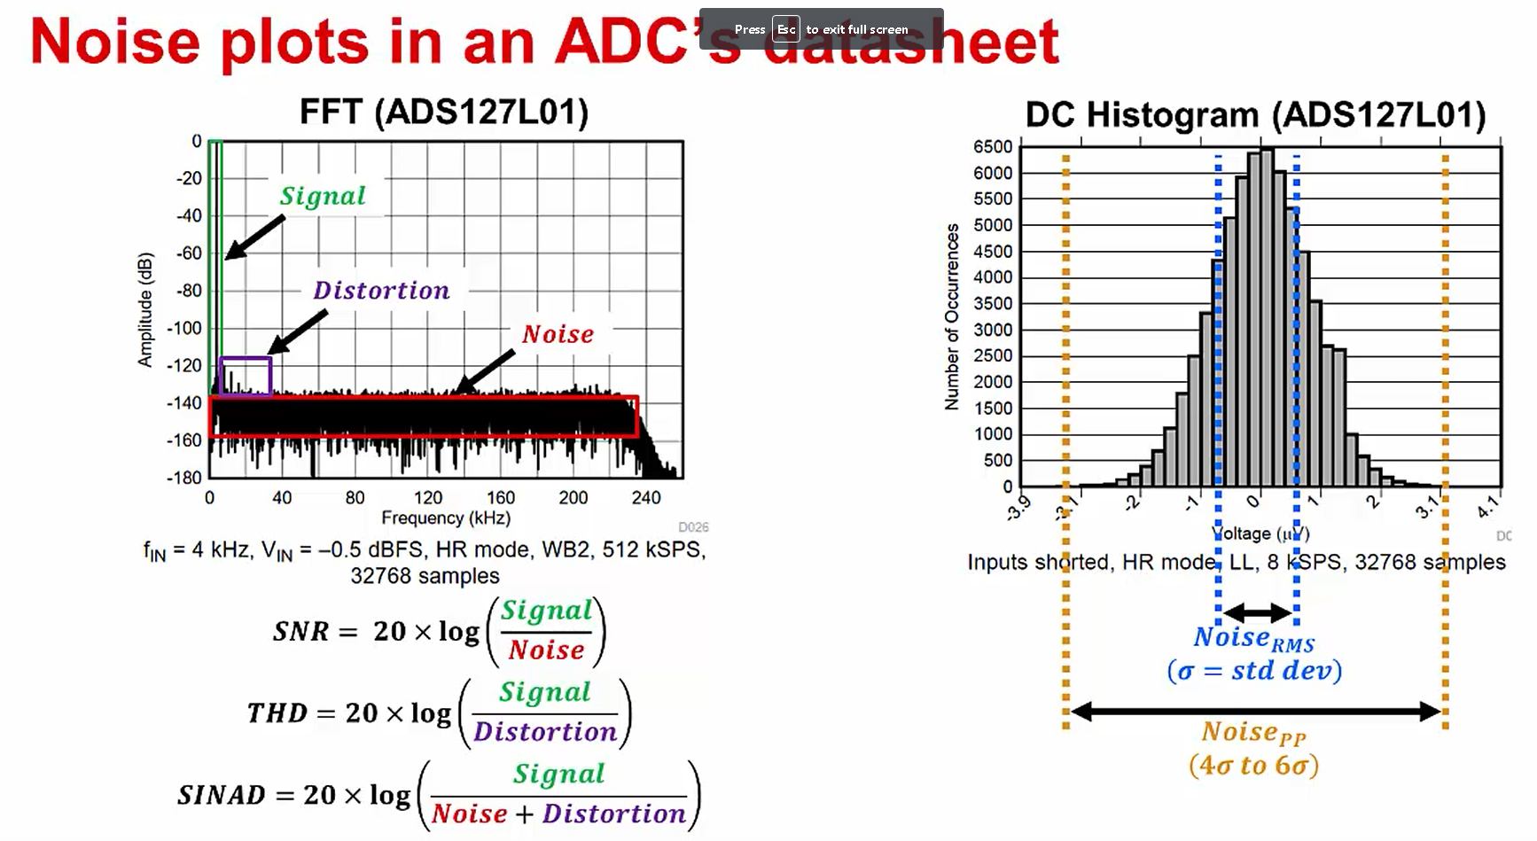
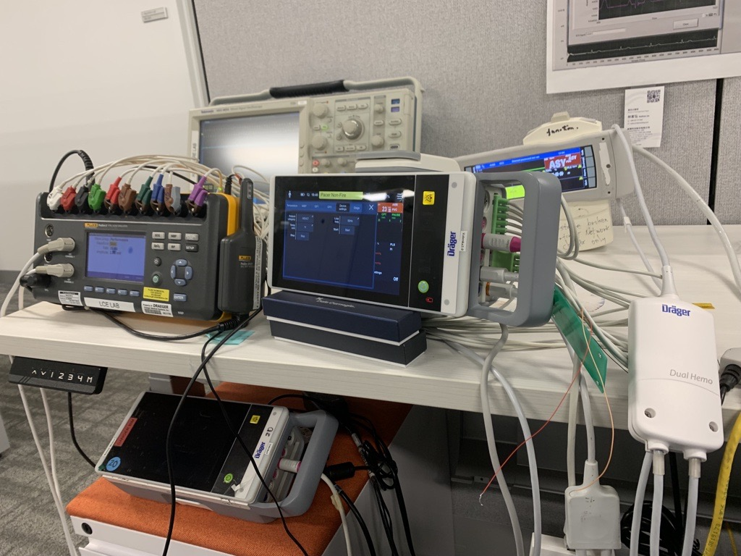
AC/DC noise measurement for ECG
AC noise
DC noise
Reduce noise from extension cable.
Notes:
Cliff: That is a type test that is needed. It is not a good way to measure performance. There is too much variation in the placement of the lead set.
The variation we are looking for is in the monitor and not in the lead set. That is why we use the shorting blocks that I gave you. With a shorting block we should be at about 13 uVpp. We have seen some chest leads at 20uVpp and we have not gotten to the root cause as to why some board have that variation in performance.

Slide 5
Sine @ 10 Hz, 2k SPS, FFT scale make no sense

Slide 6
Sine @ 10 Hz, 2k SPS
Lead | Harmonic frequency (Hz) | Note
I | 30,50,70, 90
II | 30,40, 50, 60, 70, 80, 90
III | 20, 40, 50, 60, 70, 100

