Slide 1
TSW30SH84EVM
Changing Data Rate with GUI
PLL used, No External Reference

Slide 2
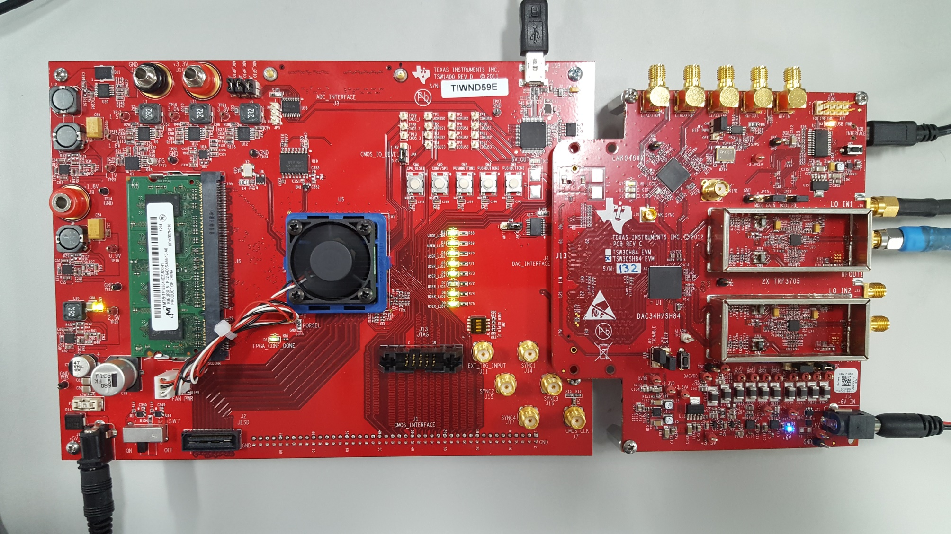
Hardware Setup

Slide 3
Hardware Setup
J12 (CLKIN1) is not connected
J19 (LO In1) is supplied with 1780 MHz, 10 dBm, signal source
Connect J7 (RFOUT1) to spectrum analyzer.
The User’s Guide says to connect Y1 (10 MHz crystal) by switching SJ5 to shunt pins 2-3. Check the output at the REFOUT SMA connector to see what the reference frequency is.

Slide 4
TSW30SH84 GUI Setup
Load Regs file “DAC34SH84_1474p58MHz_2xINT_NCO_30MHz_single_sync_source_mode.txt”
in folder “LMK04808 PLL Mode 10MHz Reference”.
This file will configure the PLL2 to output a 1474.58 MHz signal to the DAC.
Disable the NCO and other digital effects by unchecking the “Digital Mixer” box

Slide 5
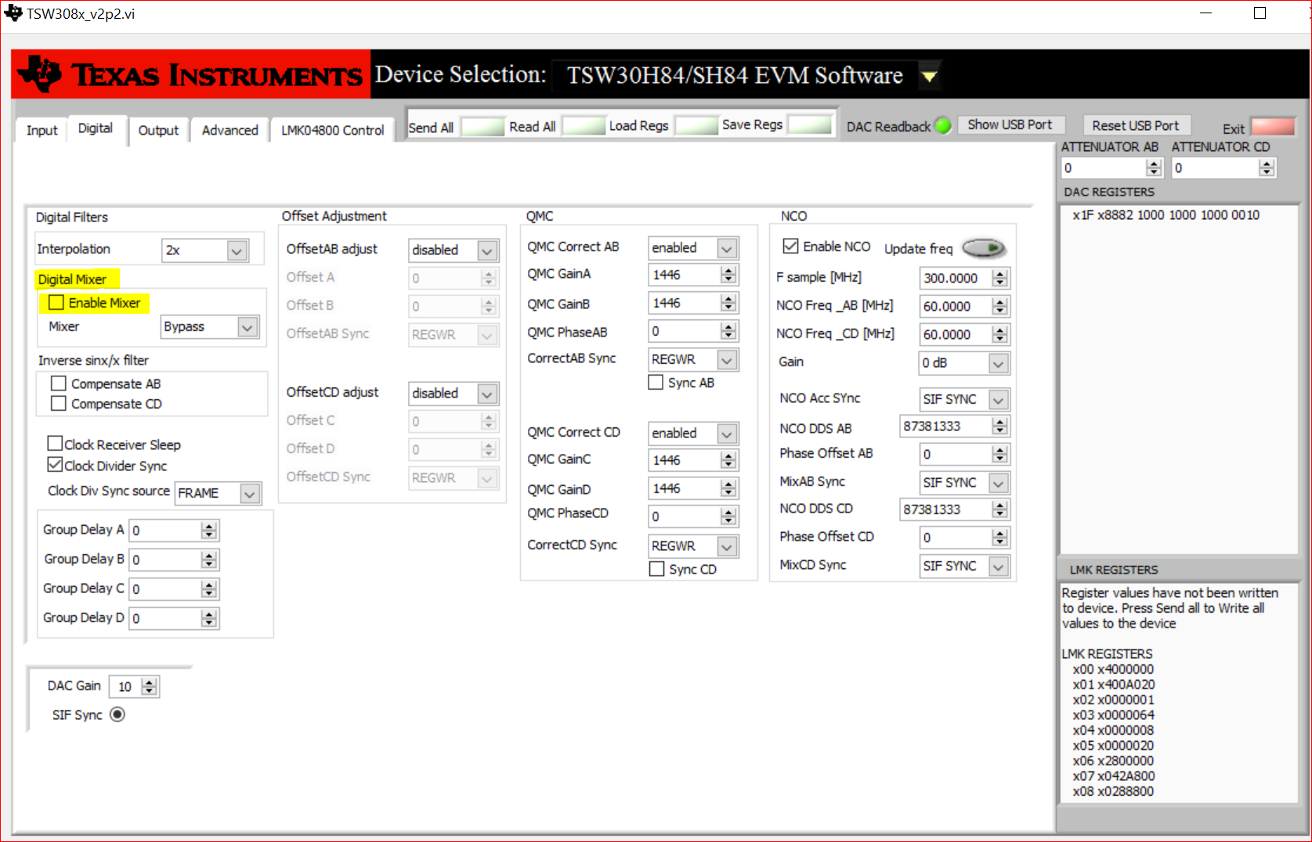
GUI Setup

Slide 6
HSDC Pro
After selecting the DAC34SH84 device, set the data rate to 737.28M (DAC_CLK/Interpolation).
Create a tone (60 MHz) using HSDC Pro as seen on next slide (Ensure that you have set the data rate before creating the tone).
Click Send button

Slide 7
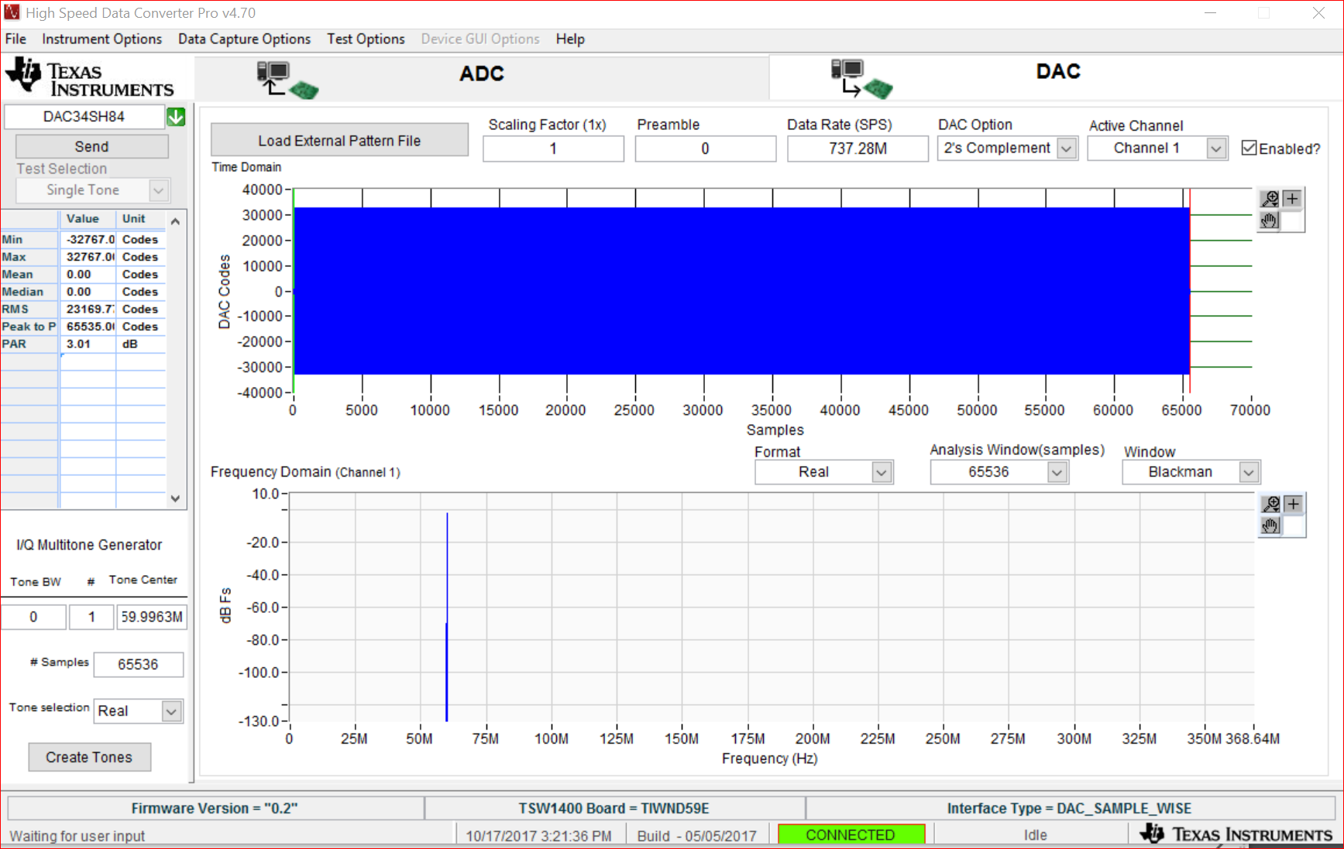
HSDC Pro: Create Tone

Slide 8
DAC Output
Looking at the spectrum analyzer, you will see the 1780 MHz LO plus the 60 MHz signal coming from the TSW1400.

Slide 9
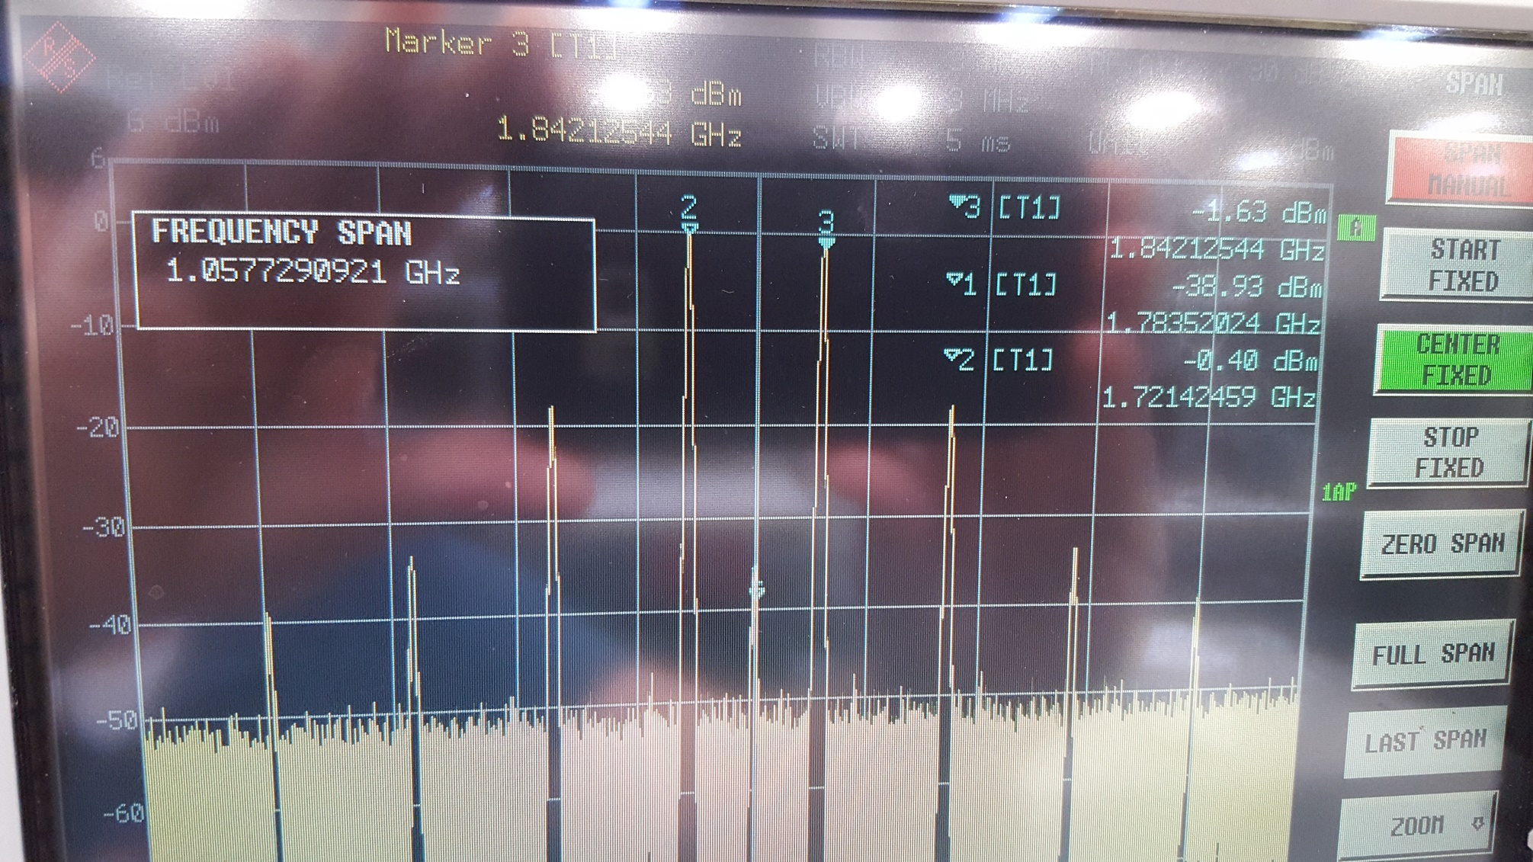
DAC Output

Slide 10
Verify
To verify that the signal seen will track, in HSDC Pro, generate a new tone of 100 MHz.
Keep all settings in the TSW30SH84EVM GUI the same.

Slide 11
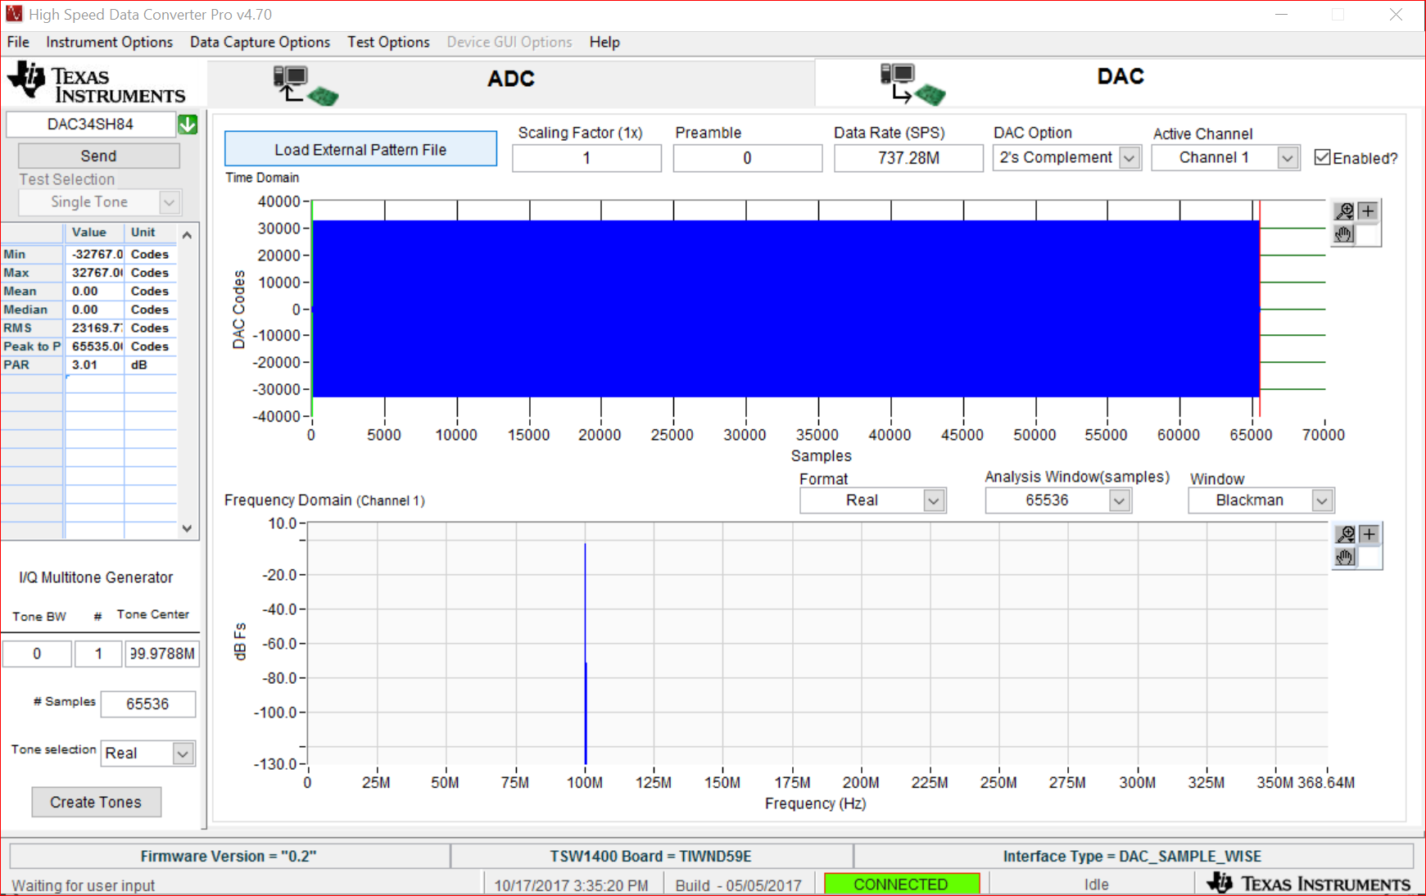
HSDC Pro: Create Tone

Slide 12
DAC Output
Looking at the spectrum analyzer, you will see the 1780 MHz LO plus the 100 MHz signal coming from the TSW1400.

Slide 13
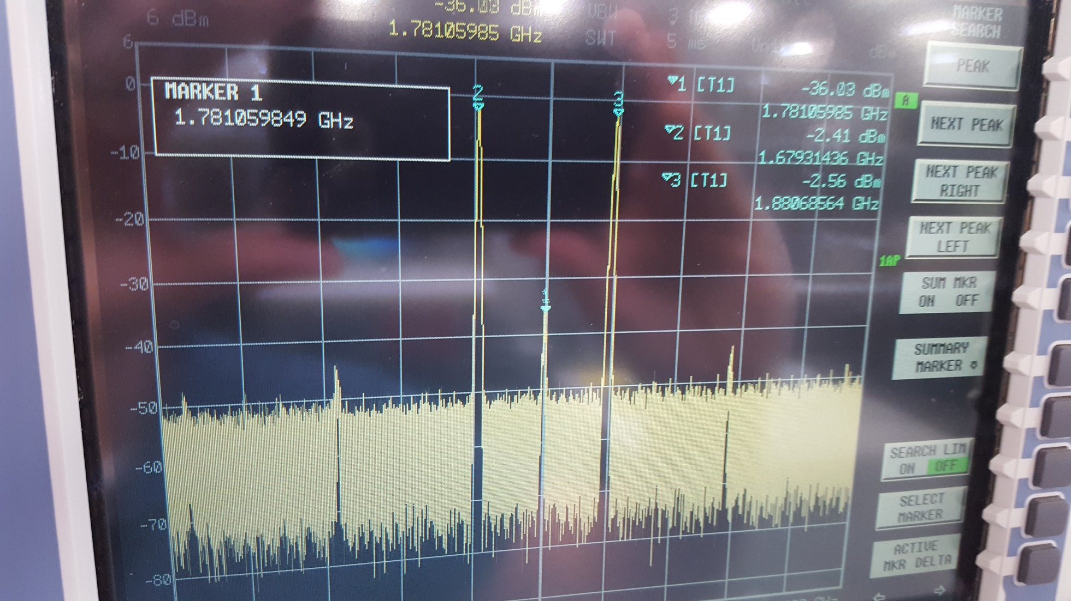
DAC Output

