Slide 1
TSW30SH84 Single Tone

Slide 2
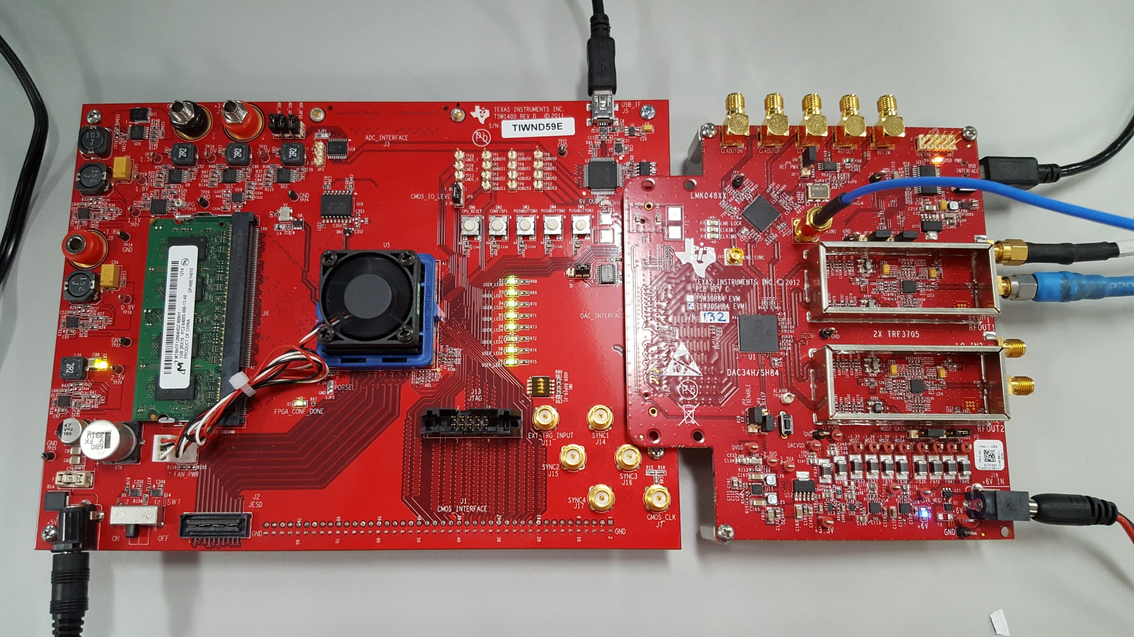
Hardware Setup

Slide 3
Hardware Setup
J12 (CLKIN1) is supplied with 500 MHz, 10 dBm, signal source
J19 (LO In1) is supplied with 1780 MHz, 10 dBm, signal source
Connect J7 (RFOUT1) to spectrum analyzer.

Slide 4
GUI Setup
Load Regs file “DAC34SH84_1474p56MHz_2xINT_NCOenabled_30MHz_single_sync_source_mode.txt”
Disable the NCO and other digital effects by unchecking the “Digital Mixer” box

Slide 5
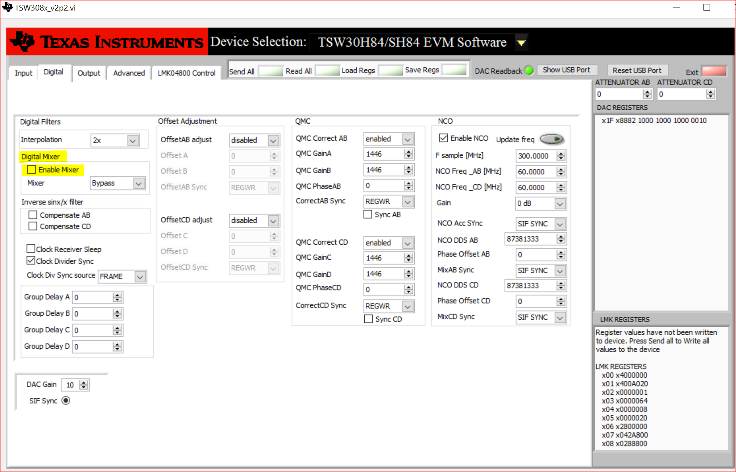
GUI Setup

Slide 6
HSDC Pro
After selecting the DAC34SH84 device, set the data rate to 250M (DAC_CLK/Interpolation).
Load the “single_tone_cmplx_32768_250MSPS__BW_25.1MHZ.csv” file
Click Send button

Slide 7
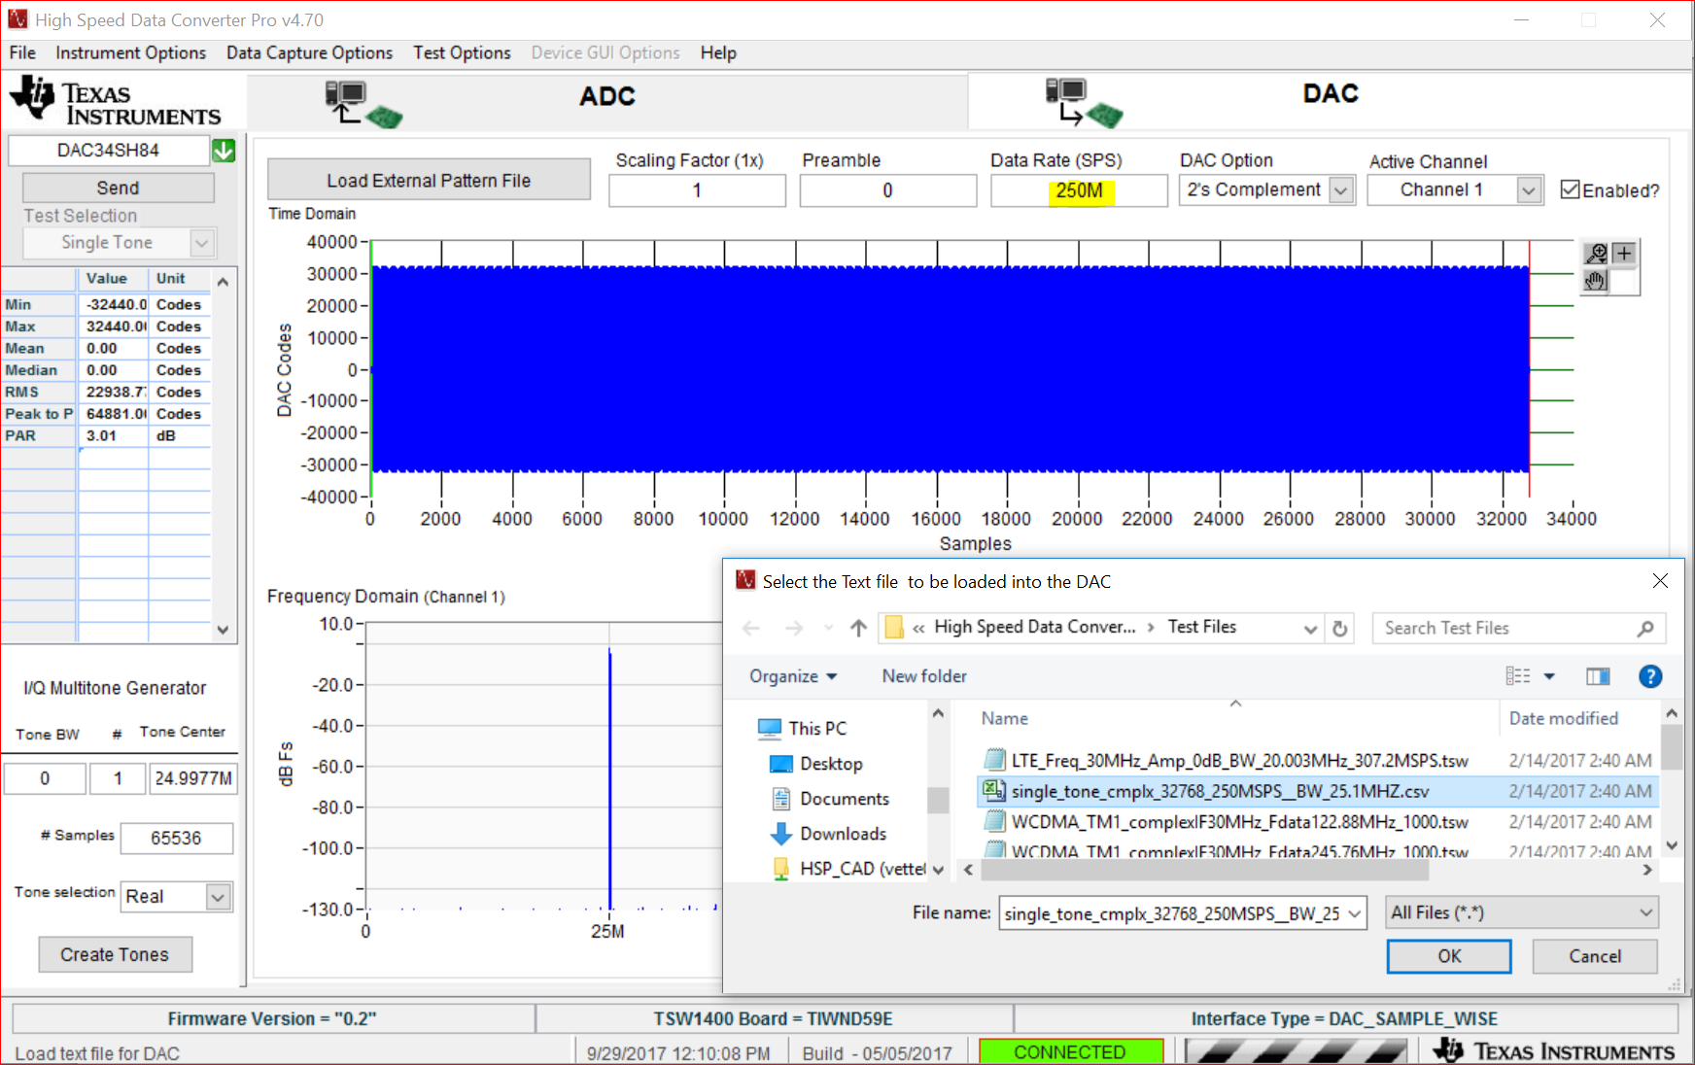
HSDC Pro

Slide 8
DAC Output
Looking at the spectrum analyzer, you will see the 1780 MHz LO plus the 25.1 MHz signal coming from the TSW1400.

Slide 9
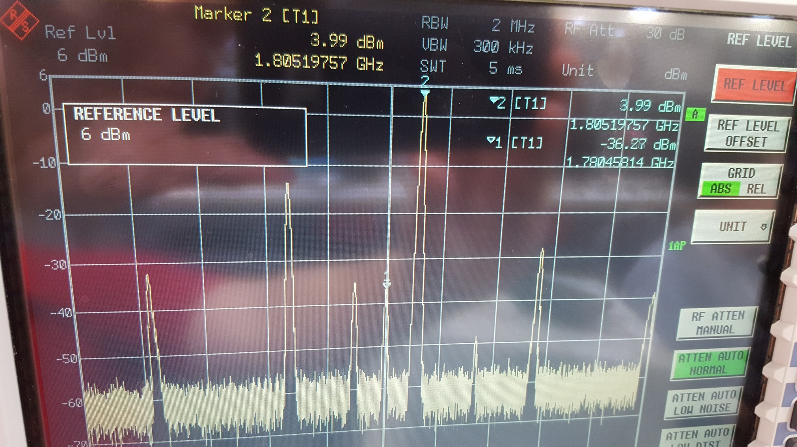
DAC Output

