Slide 1
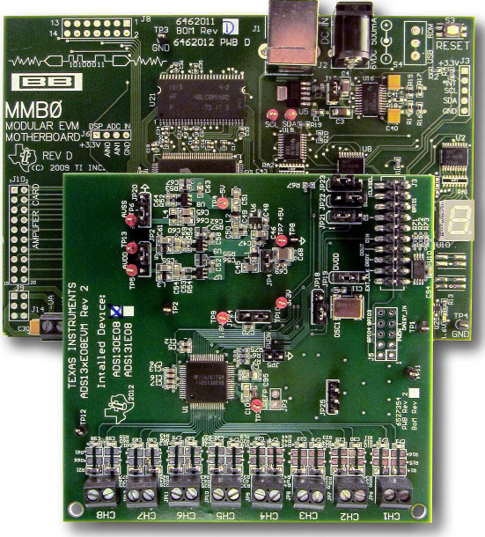
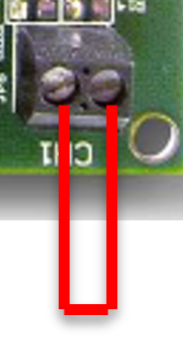
ADC input short circuit, as per your email you told that one end of reff voltage also connected to ADC shorted input , please confirm from which point we need to take connection?.
ADC input shorted

