Slide 1
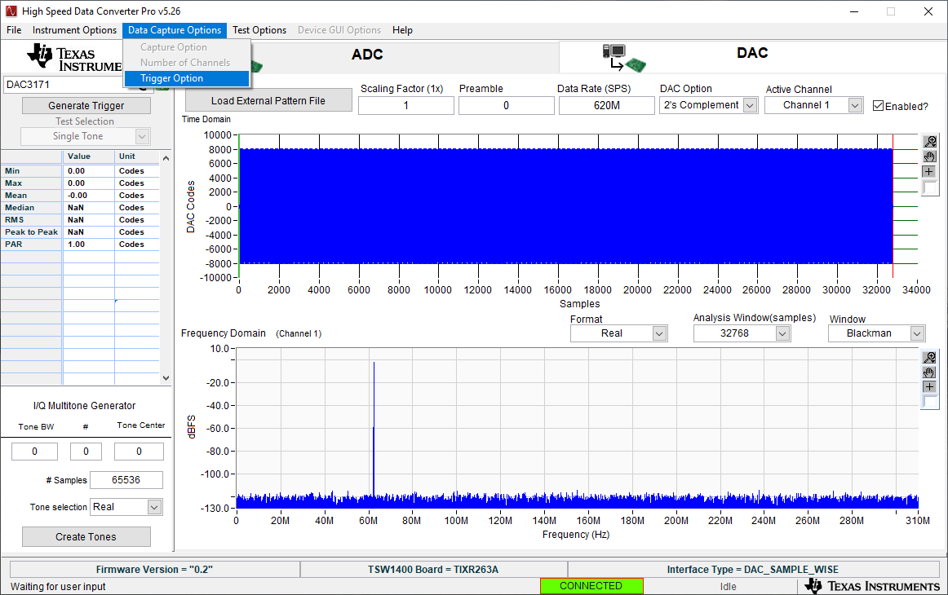

Slide 2
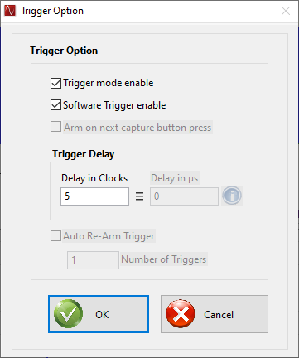
5 clock cycle delay on SYNC output J17.

