Slide 1
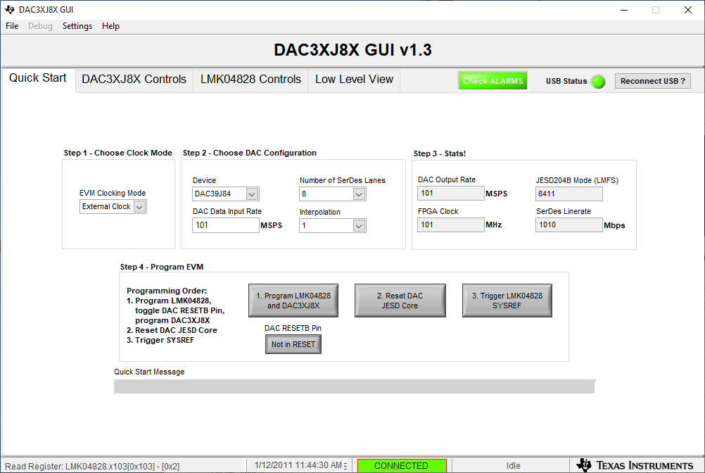
Use 101MHz for DAC Data Input Rate

Slide 2
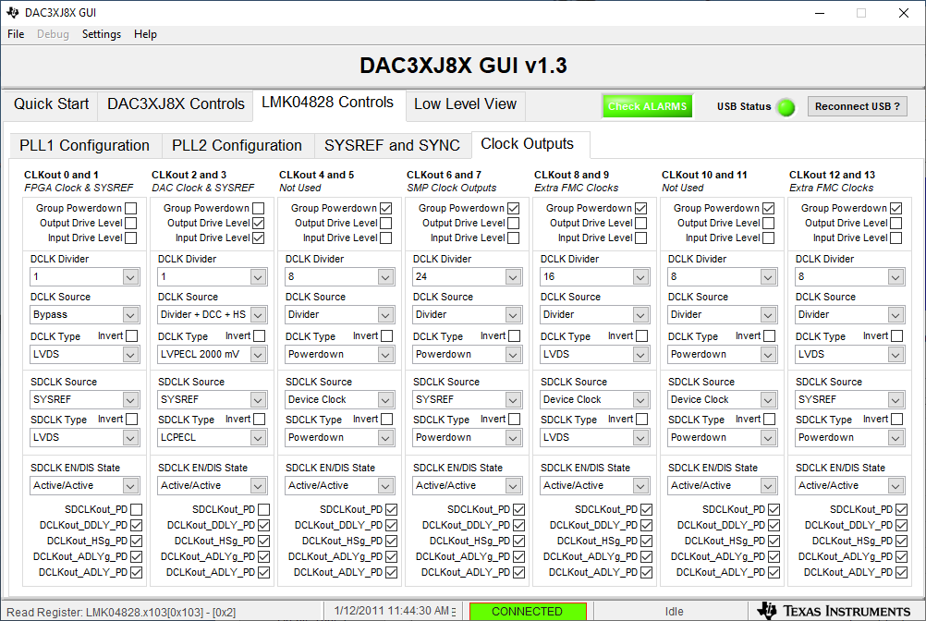
Set CLKout 0 and 1 DCLK Divider to Bypass

