Slide 1
DAC38RF89 Test

Slide 2
DAC38RF89 12 bit mode
Test Setup:
Fdac = 6400Msps external clock (J1)
LMK clock = 600MHz (J4)
Int 2X
IF = -1.2G to 1.2GHz
LMF = 823
TSW14J56 ref clock = serdes/40 = 12G/40 = 300MHz
Jumper on JP10 removed
SYSREF max = 160MHz
Example uses SYSREF = 10MHz (600/60)

Slide 3
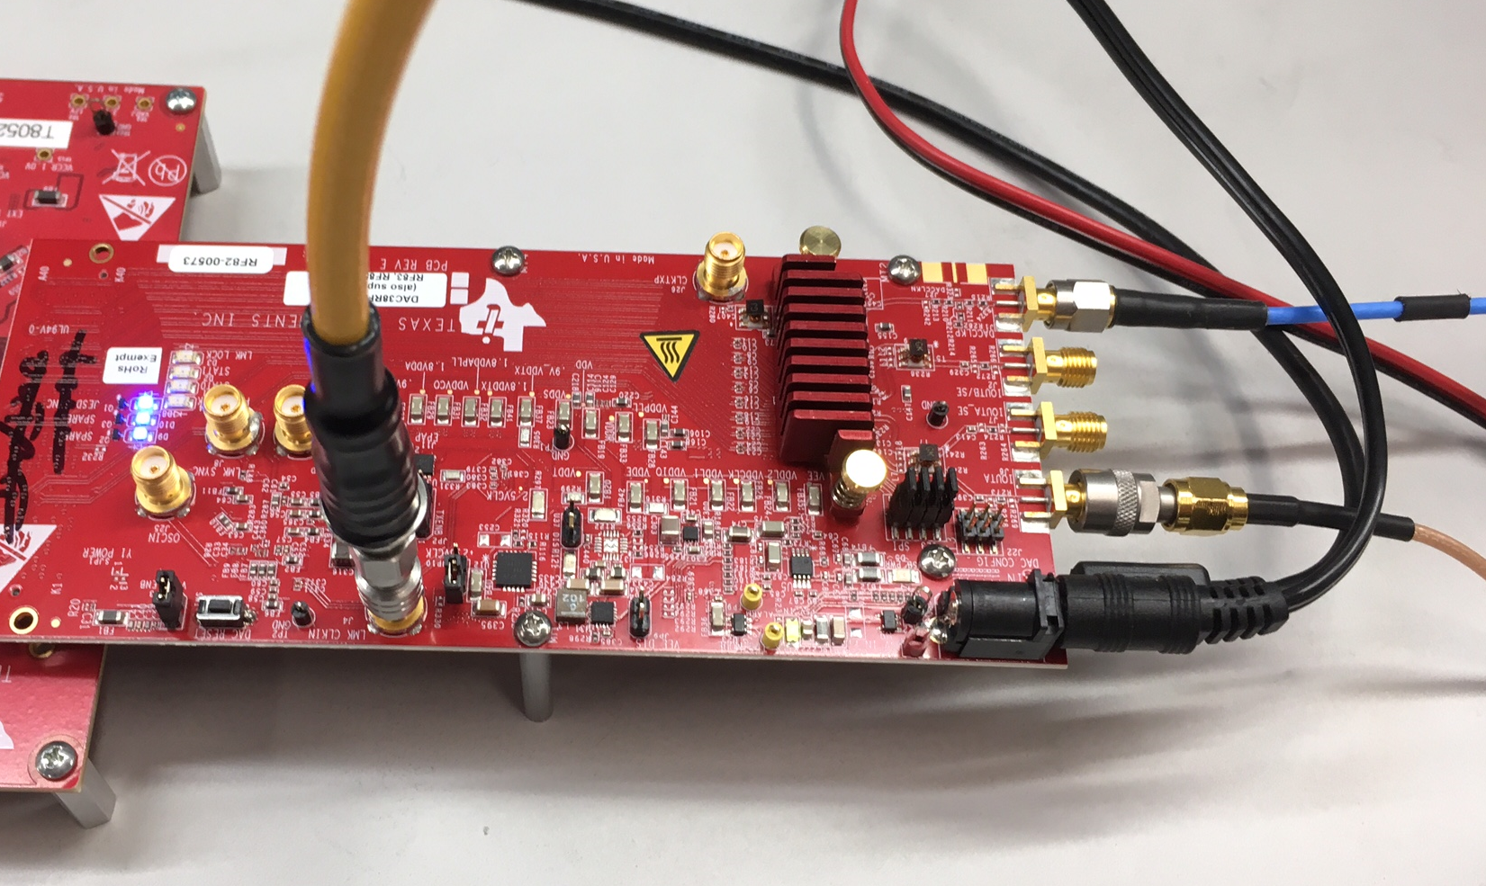
Board setup

Slide 4
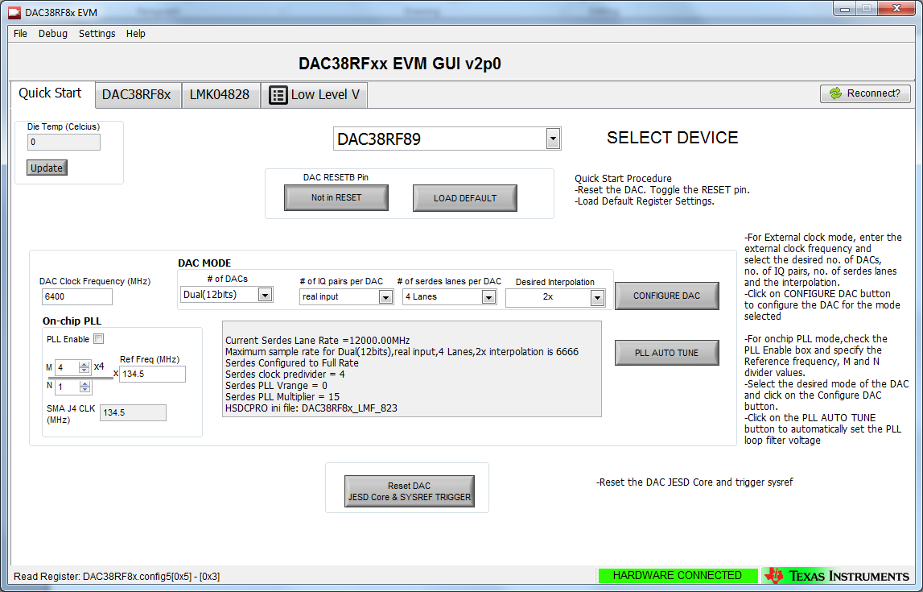
DAC38RFxx EVM GUI

Slide 5
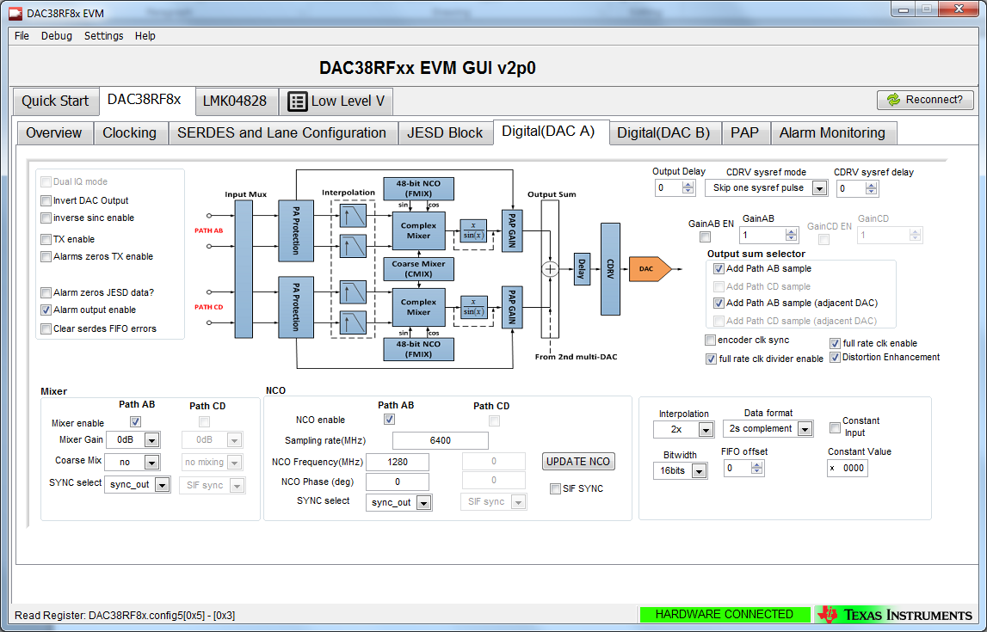
DAC38RFxx EVM GUI Digital DAC A tab

Slide 6
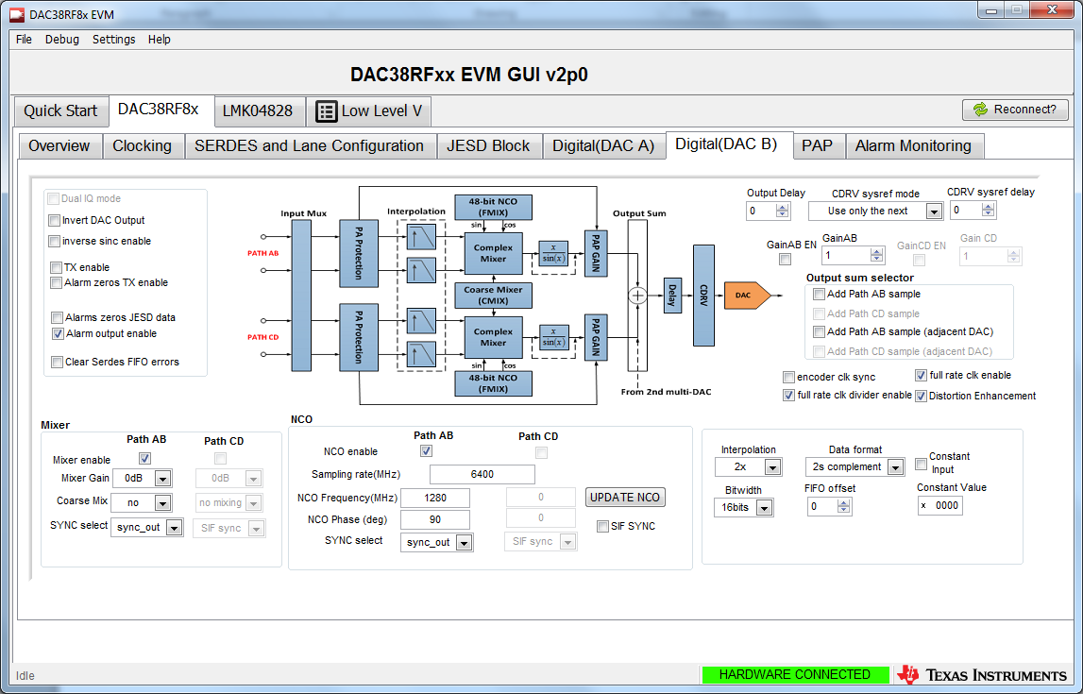
DAC38RFxx EVM GUI Digital DAC B tab

Slide 7
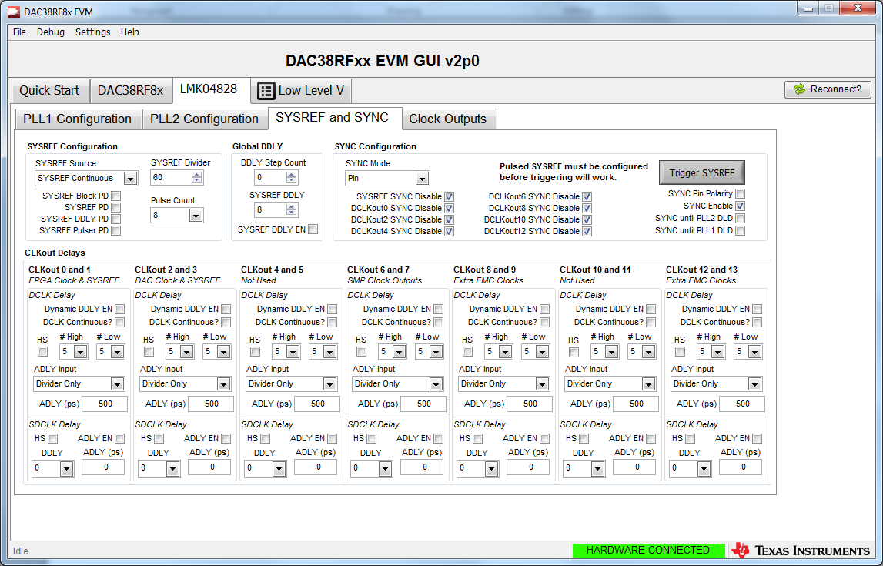
LMK Clocking Settings

Slide 8
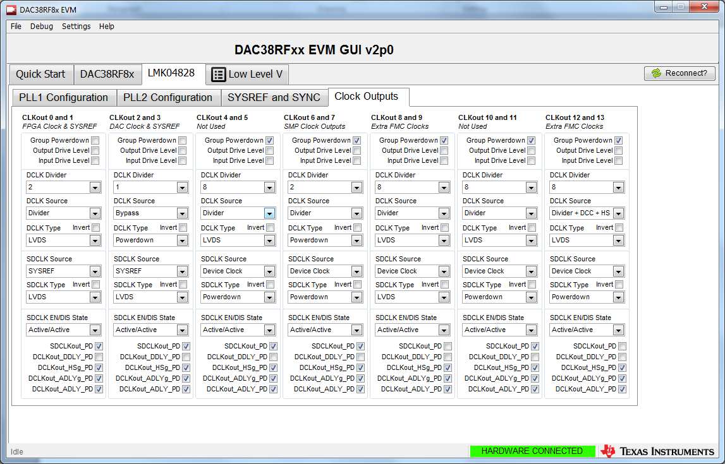
LMK Clocking Settings

Slide 9
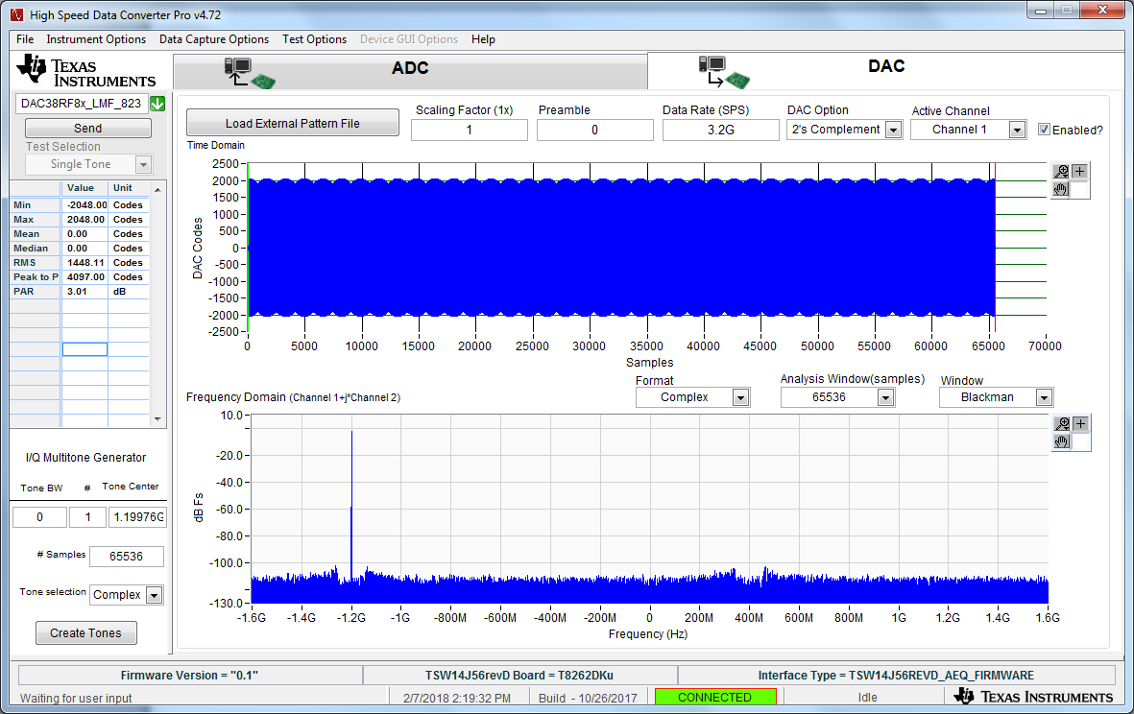
TSW14J56 Settings IF = -1.2GHz

Slide 10
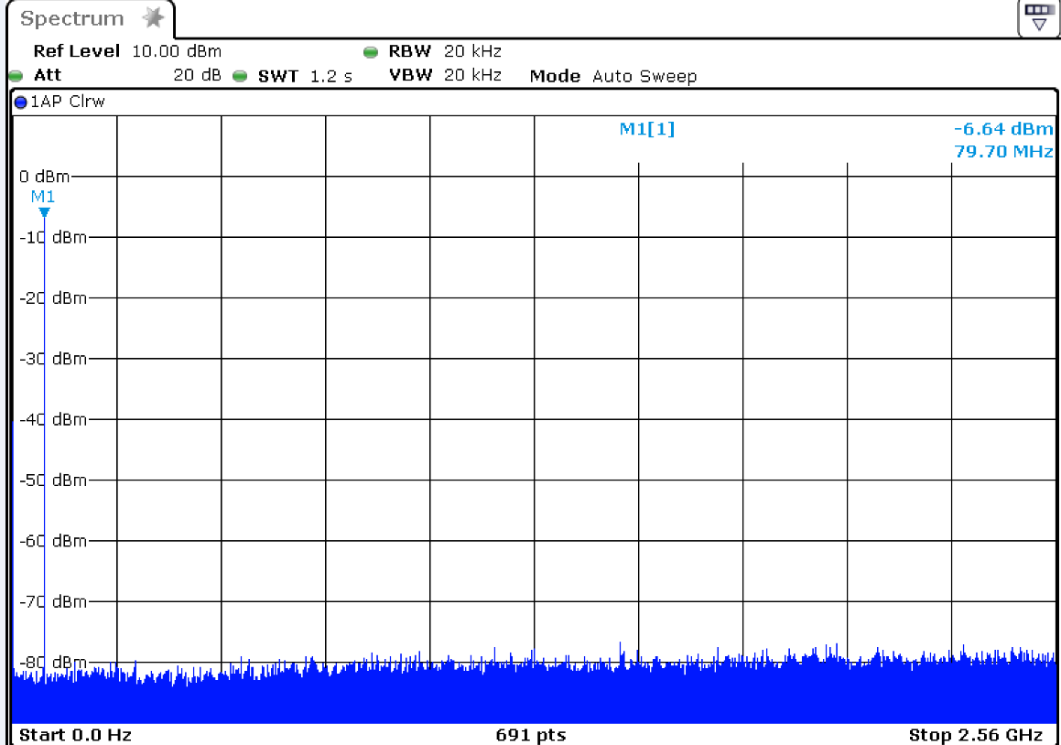
NCO = 1.28G, input = -1.997G, DAC output at 79.7MHz

Slide 11
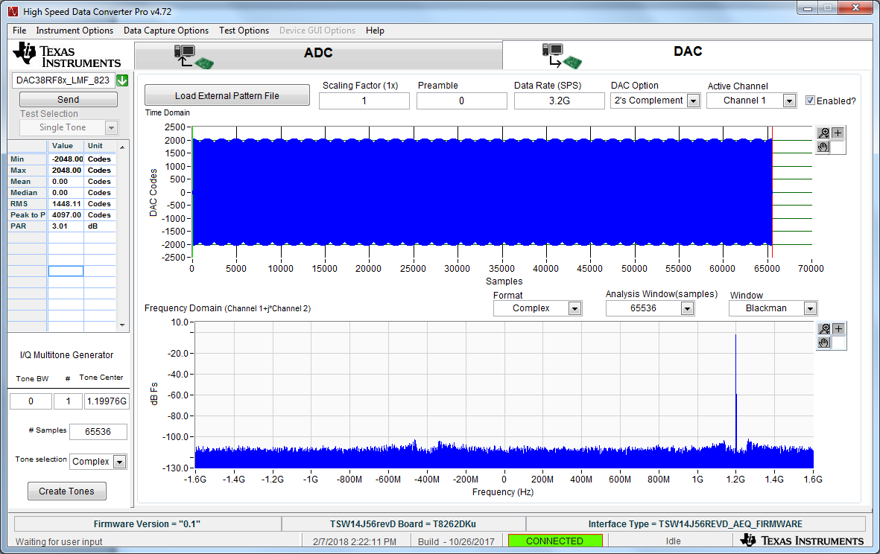
TSW14J56 Settings IF = 1.2GHz

Slide 12
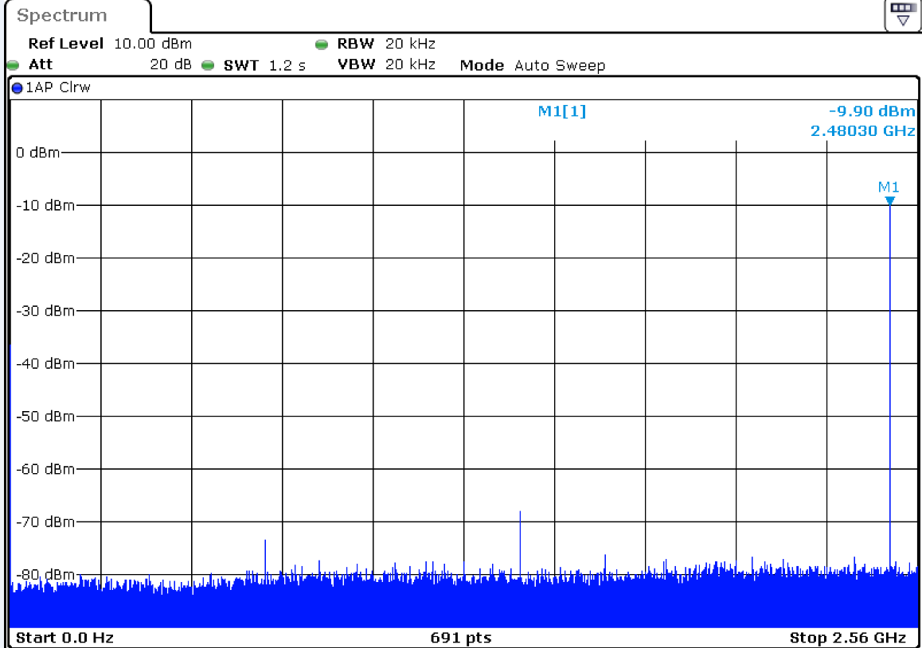
NCO = 1.28G, input = 1.1997G, DAC output at 2.48GHz

