Slide 1
ADC32RF45EVM Test with TSW14J10EVM and ZC706

Slide 2
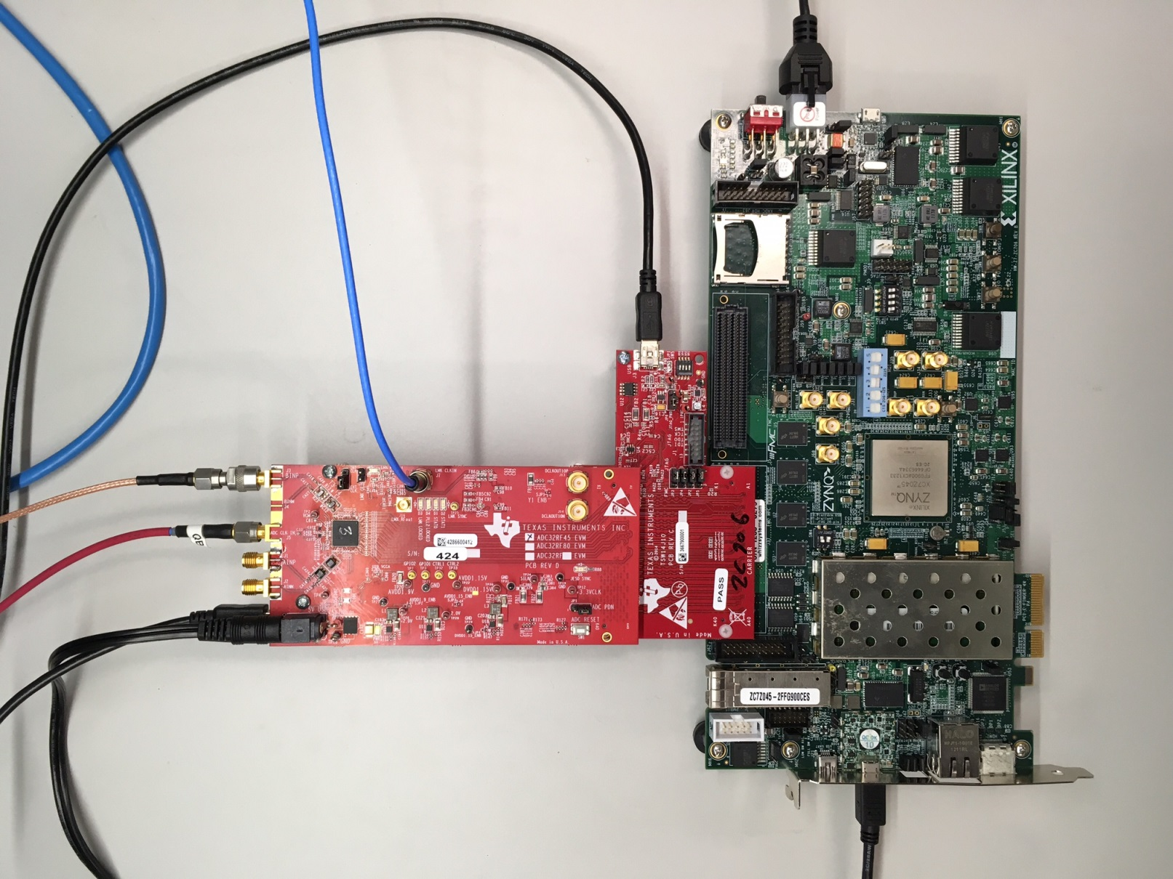
Test Setup:

Slide 3
Hardware Setup:
Connect the three boards as shown in previous slide
Connect power to ZC706 and ADC32RF45EVM
Connect a USB cable between TSW14J10EVM and a host PC.
Connect a mini-USB cable between J1 of the ZC706 and a host computer that has Vivado installed.
Connect a 2GHz,12dBm clock source to J5 (ADC_CLK_IN) of the ADC32RF45EVM. Verify the board is configured for external clock mode.
Connect a 2GHz,12dBm clock source to J7 (LMK_CLKIN) of the ADC32RF45EVM. Verify the two clock sources are synchronized.
Provide a 600MHz, 6dBm tone to either AINM or BINP analog input SMA’s.

Slide 4
Test Setup:
Single tone is given as input to the device. Data captured using HSDC Pro GUI
Test conditions:
Fs = external 2Gbps
LMK = external 2Gsps clock synchronized with Fs clock.
Fin = 600MHz
Mode 8224

Slide 5
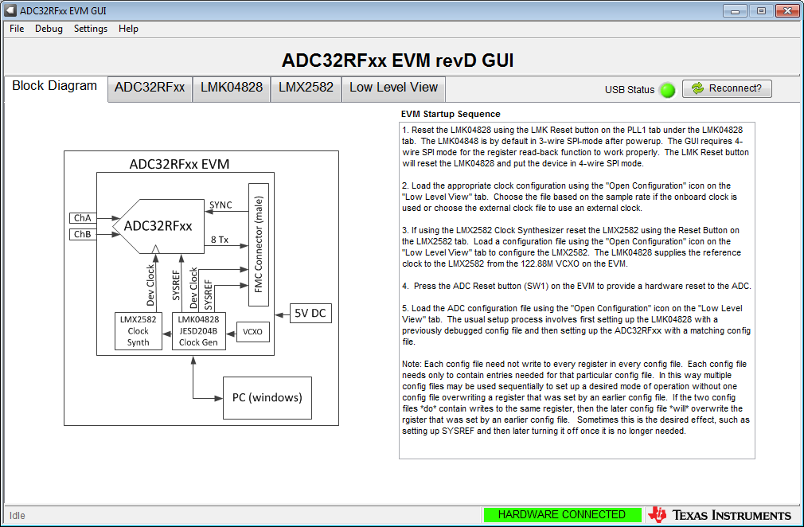
Open ADC32RFxx EVM GUI

Slide 6
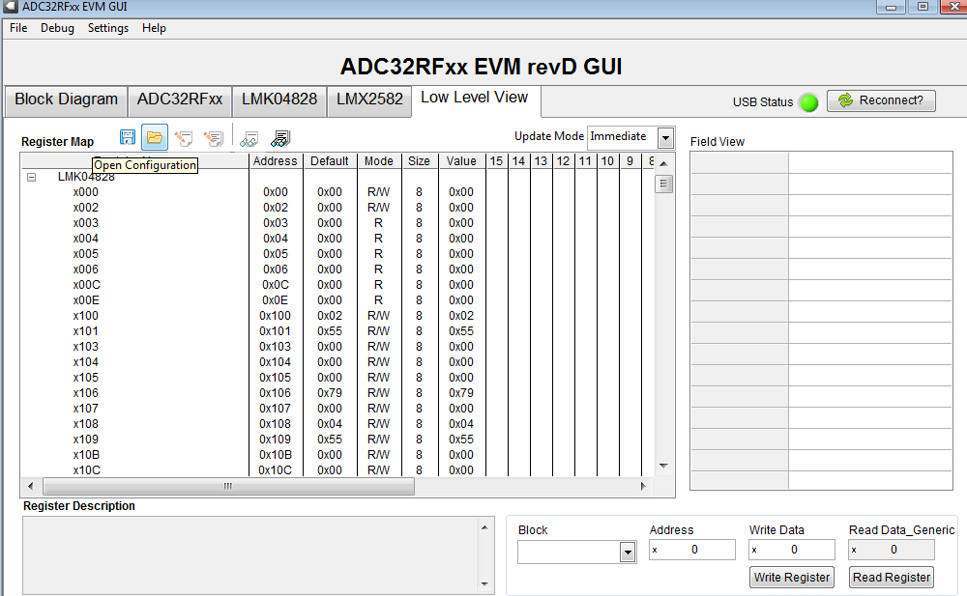
Click on “Low Level View” tab. Click on folder shown below to open configuration files to load.

Slide 7
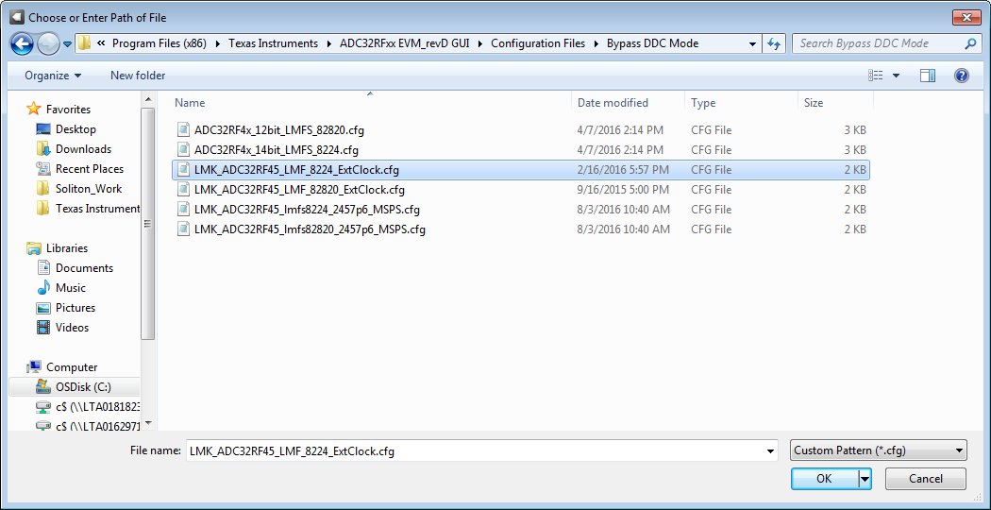
Navigate to “Bypass DDC Mode directory. Select “LMK_ADC32RF45_LMF_8224_ExtClock.cfg”

Slide 8
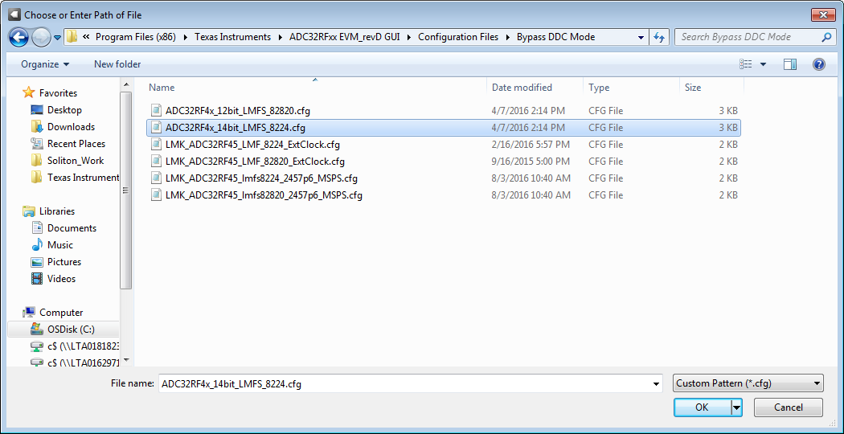
Press board reset switch SW1. In Low Level View tab, navigate to Bypass DDC Mode directory and load file called ADC32RF4x_14bit_LMFS_8224.cfg”

Slide 9
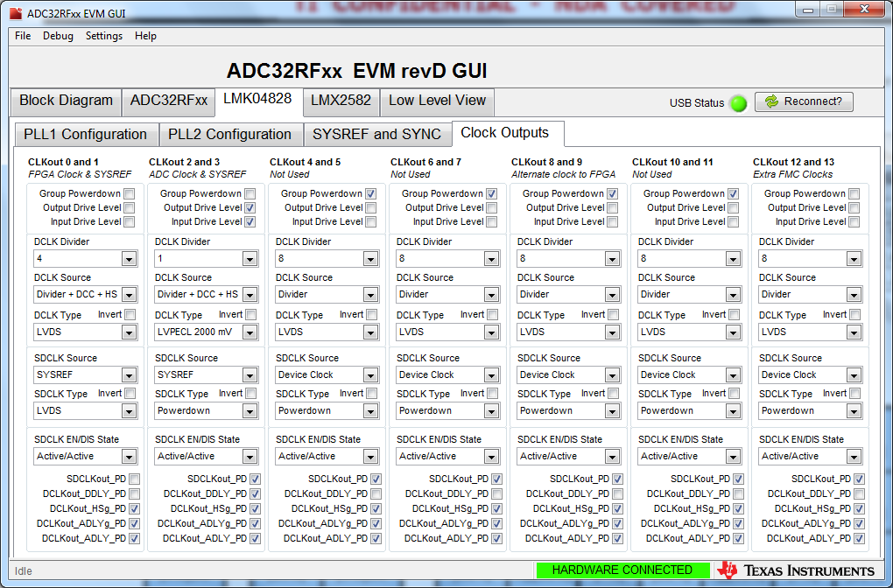
Click on the “LMK04828” tab then the “Clock Outputs” tab. Set CLKout 0 and 1 DCLK Divider to “4”. Unselect “Group Powerdown for CLKout 12 and 13, set the divider to 8 and set the DCLK Type to “LVDS”, as shown below.

Slide 10
Move the file called “TSW14J10_ZC706_v2p8.bit”, located at:
C:\Program Files(86)\Texas Instruments\High Speed Data Converter
Pro\14J10ZC706 Details\Firmware to C:\ on the host computer running Vivado.

Slide 11
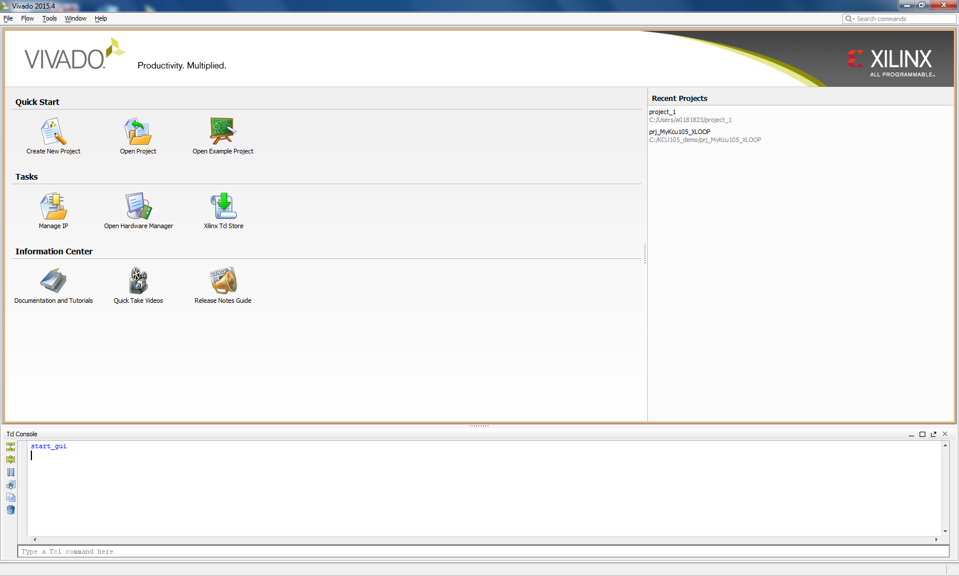
Open Vivado. Click on “Open Hardware Manager”.

Slide 12
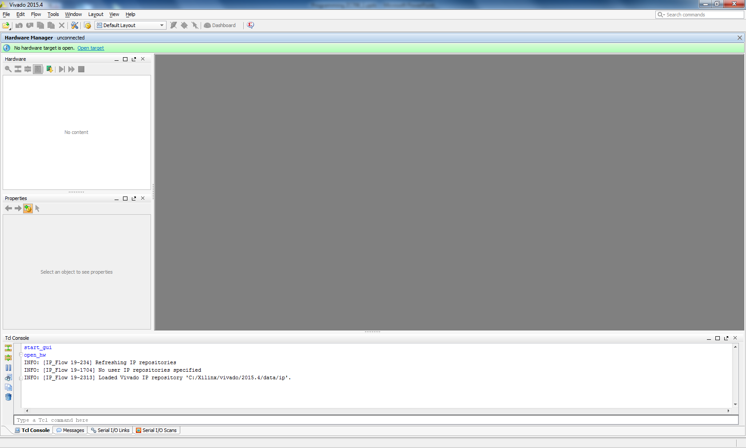
Click on “Open Target”.

Slide 13
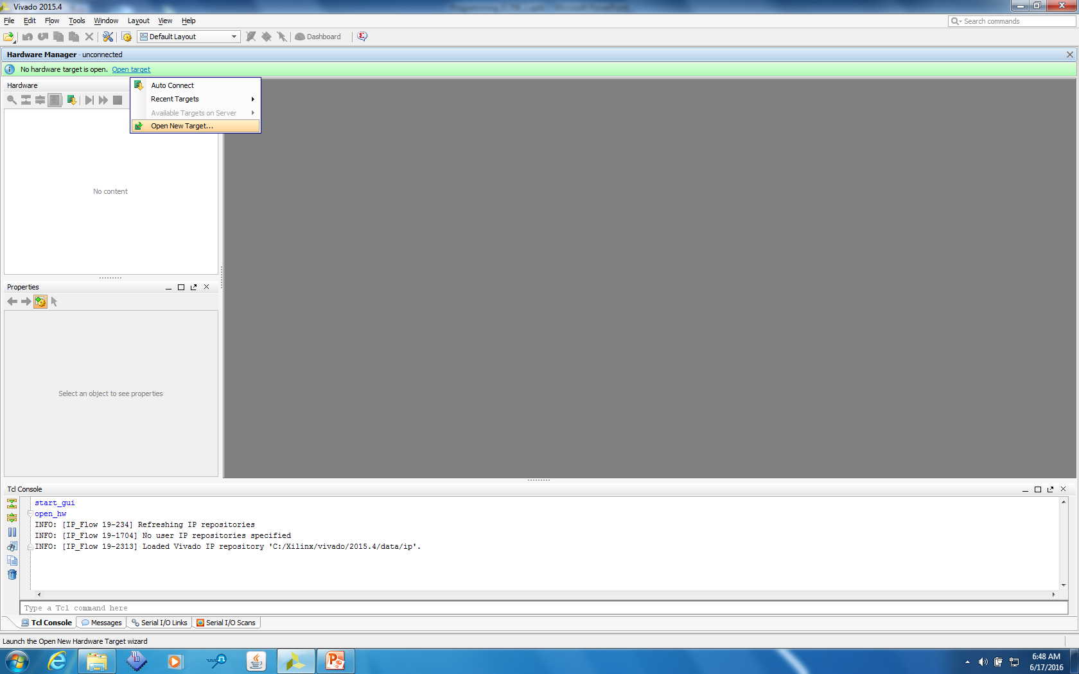
Select “Open New Target”.

Slide 14
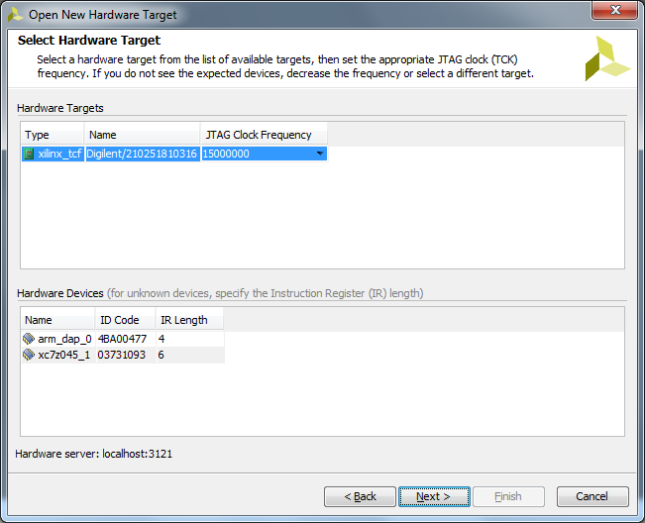
Click on “Next”.

Slide 15
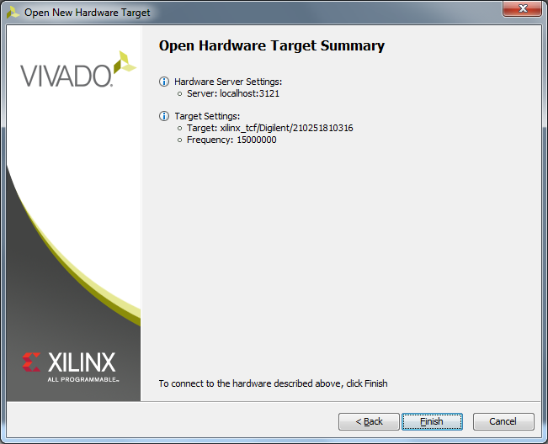
Click on “Finish”.

Slide 16
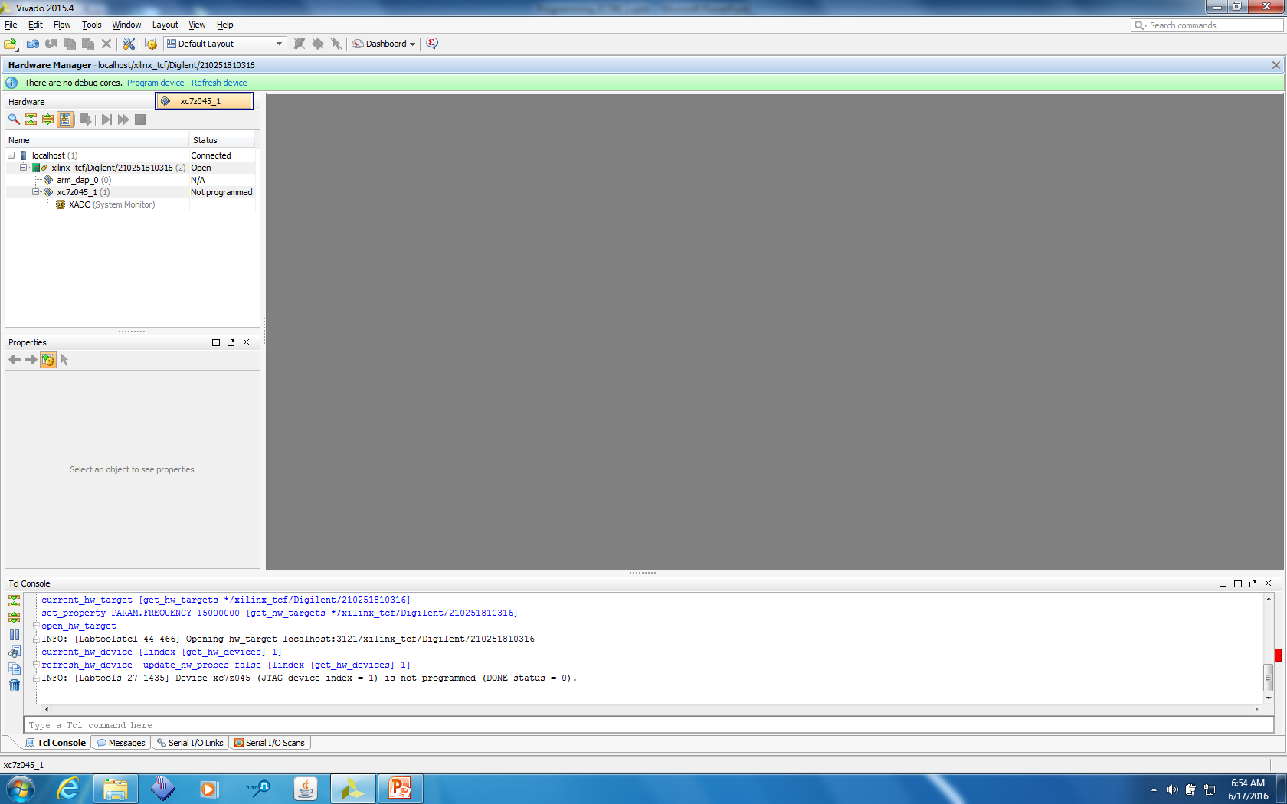
Click on “Program device the select the device that opens as shown below”.

Slide 17
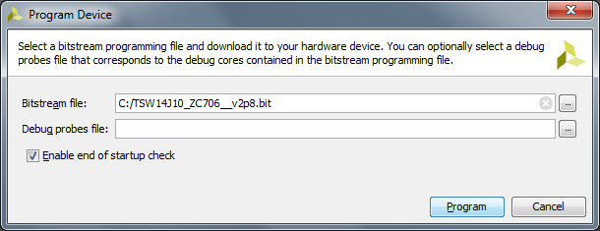
Click on the Bitstream file navigation box and select the file called “C:\TSW14J10_ZC706_2vp8.bit” Click on “Program”

Slide 18
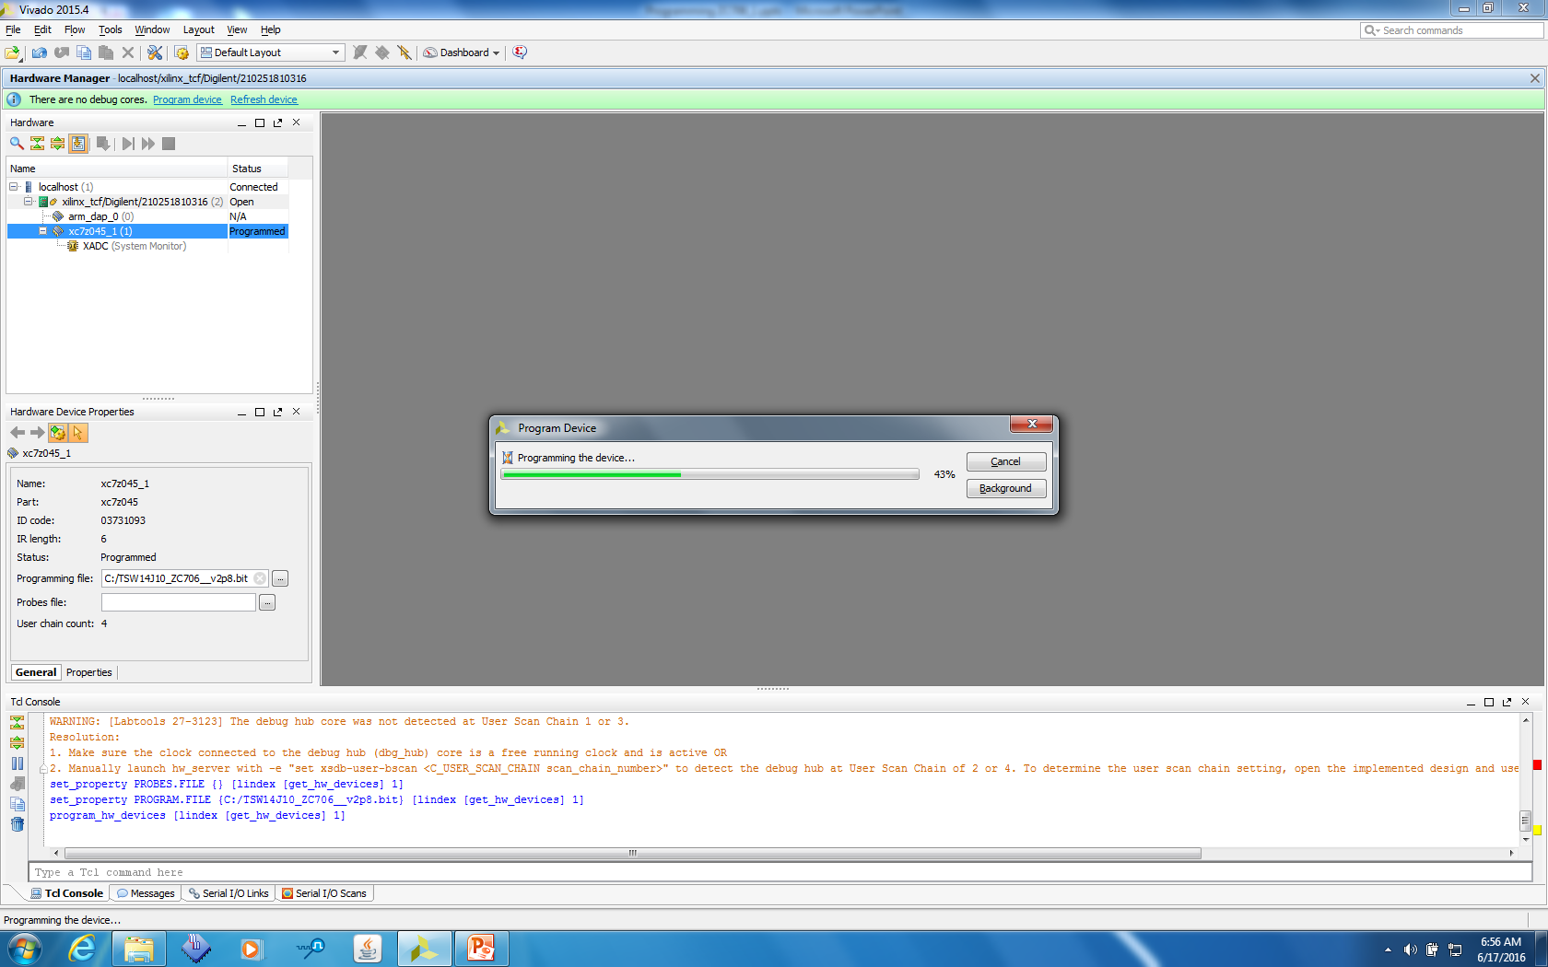
A new window will open showing the status of the programming. Once this reaches 100%, the board is programmed and ready to be used with the HSDC Pro GUI

Slide 19
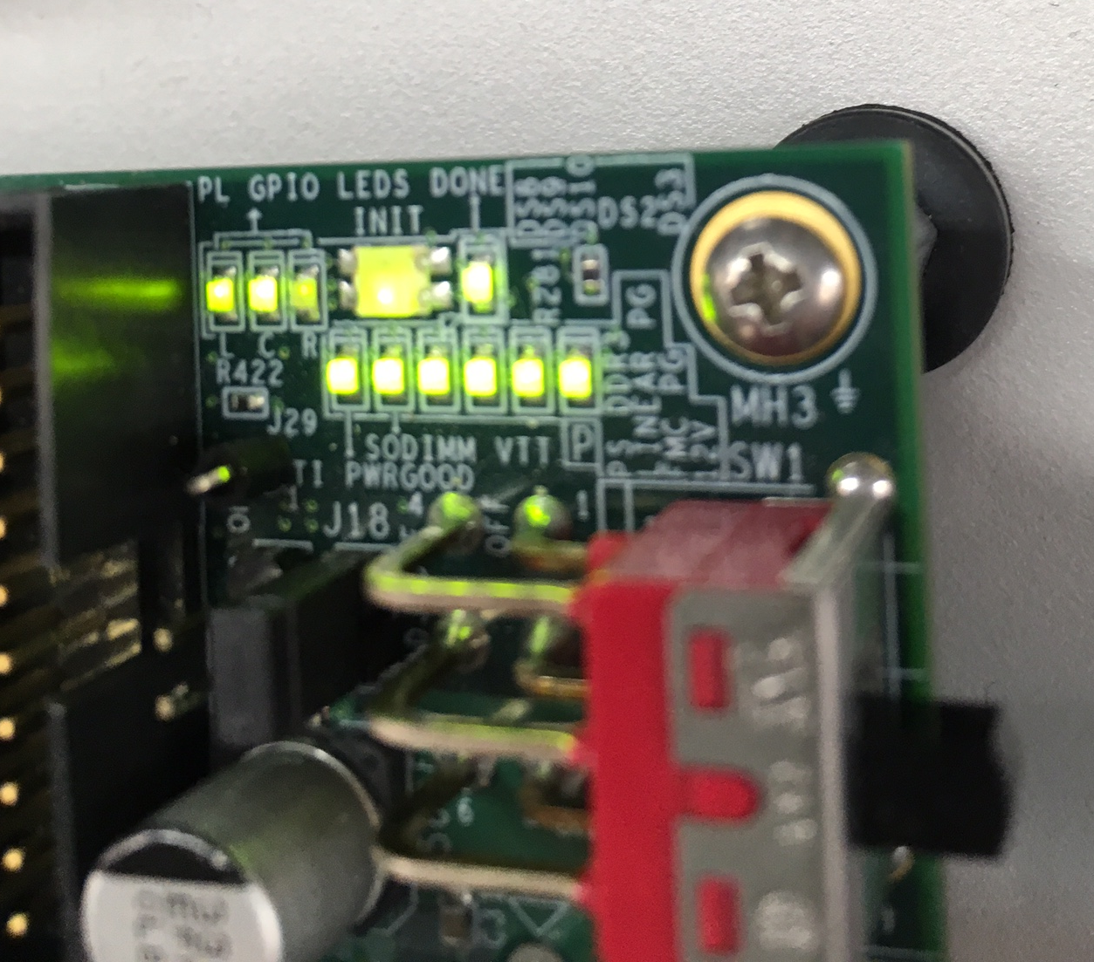
The three status LEDS labeled as “L C R” under the label “PL GPIO LEDS” should all be blinking now. They are located near the board power switch, as shown below.

Slide 20
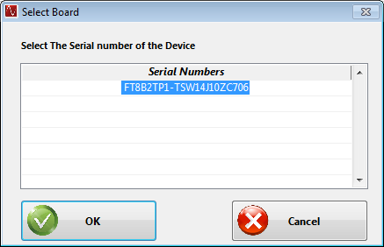
Open HSDC Pro GUI.
Click on “OK” to connect to the ZC706

Slide 21
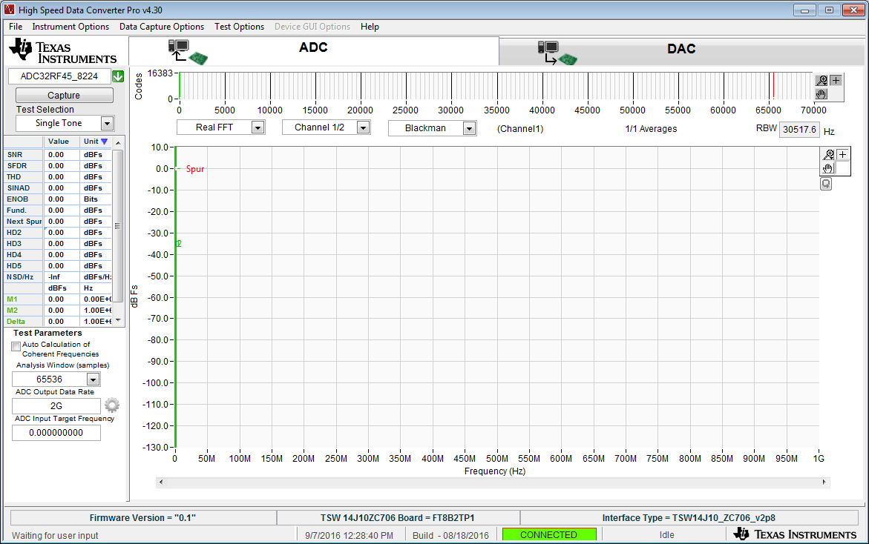
Click on the device drop down arrow and select “ADC32RF45_8224”.
Enter “2G” for the ADC Output Data rate.

Slide 22
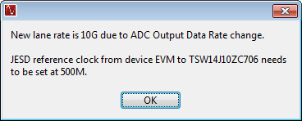
Click on “capture”.
The lane rate will be 10G and the FPGA reference clock will be 500M.

Slide 23
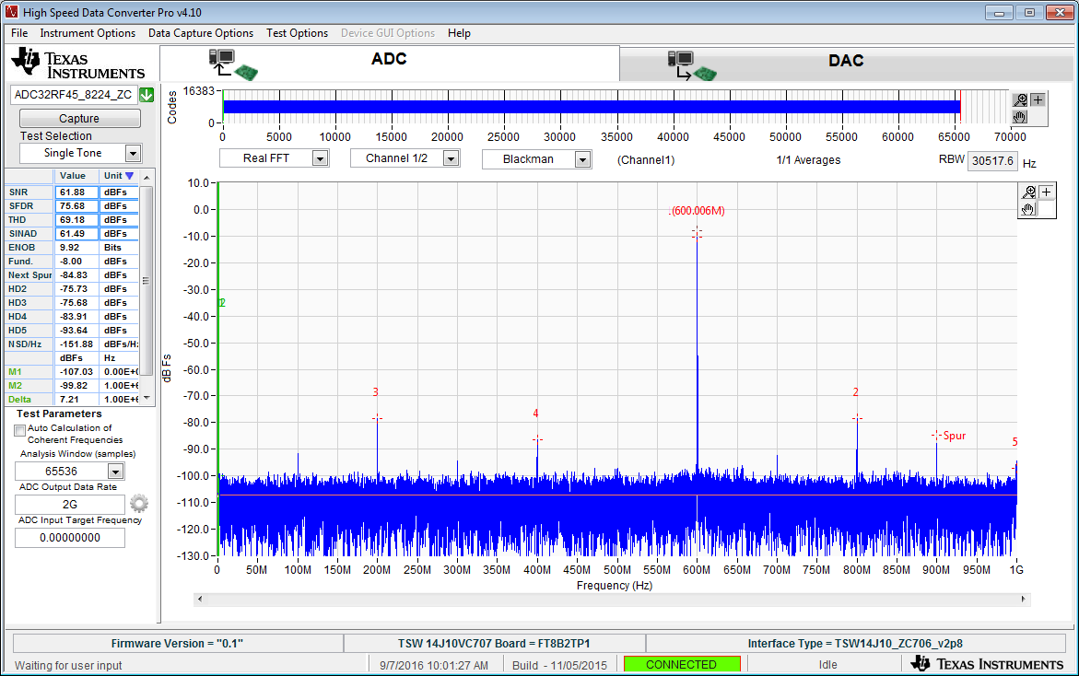
600MHz IF @ CH1

Slide 24
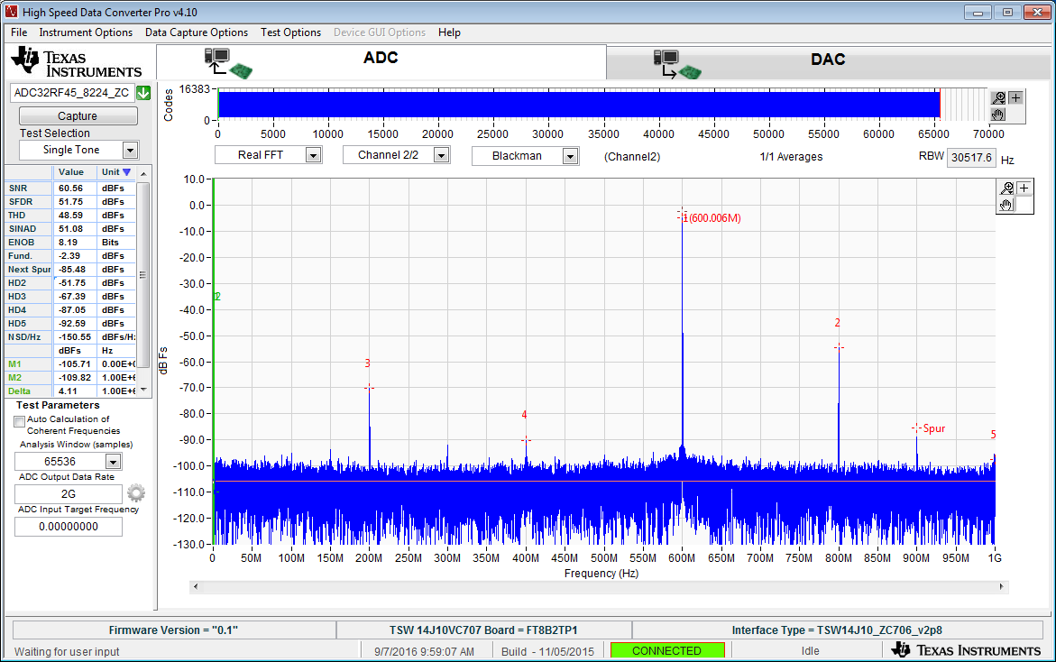
600MHz IF @ CH2

