Slide 1
ADS54J66EVM Test with
TSW14J10EVM and ZC706

Slide 2
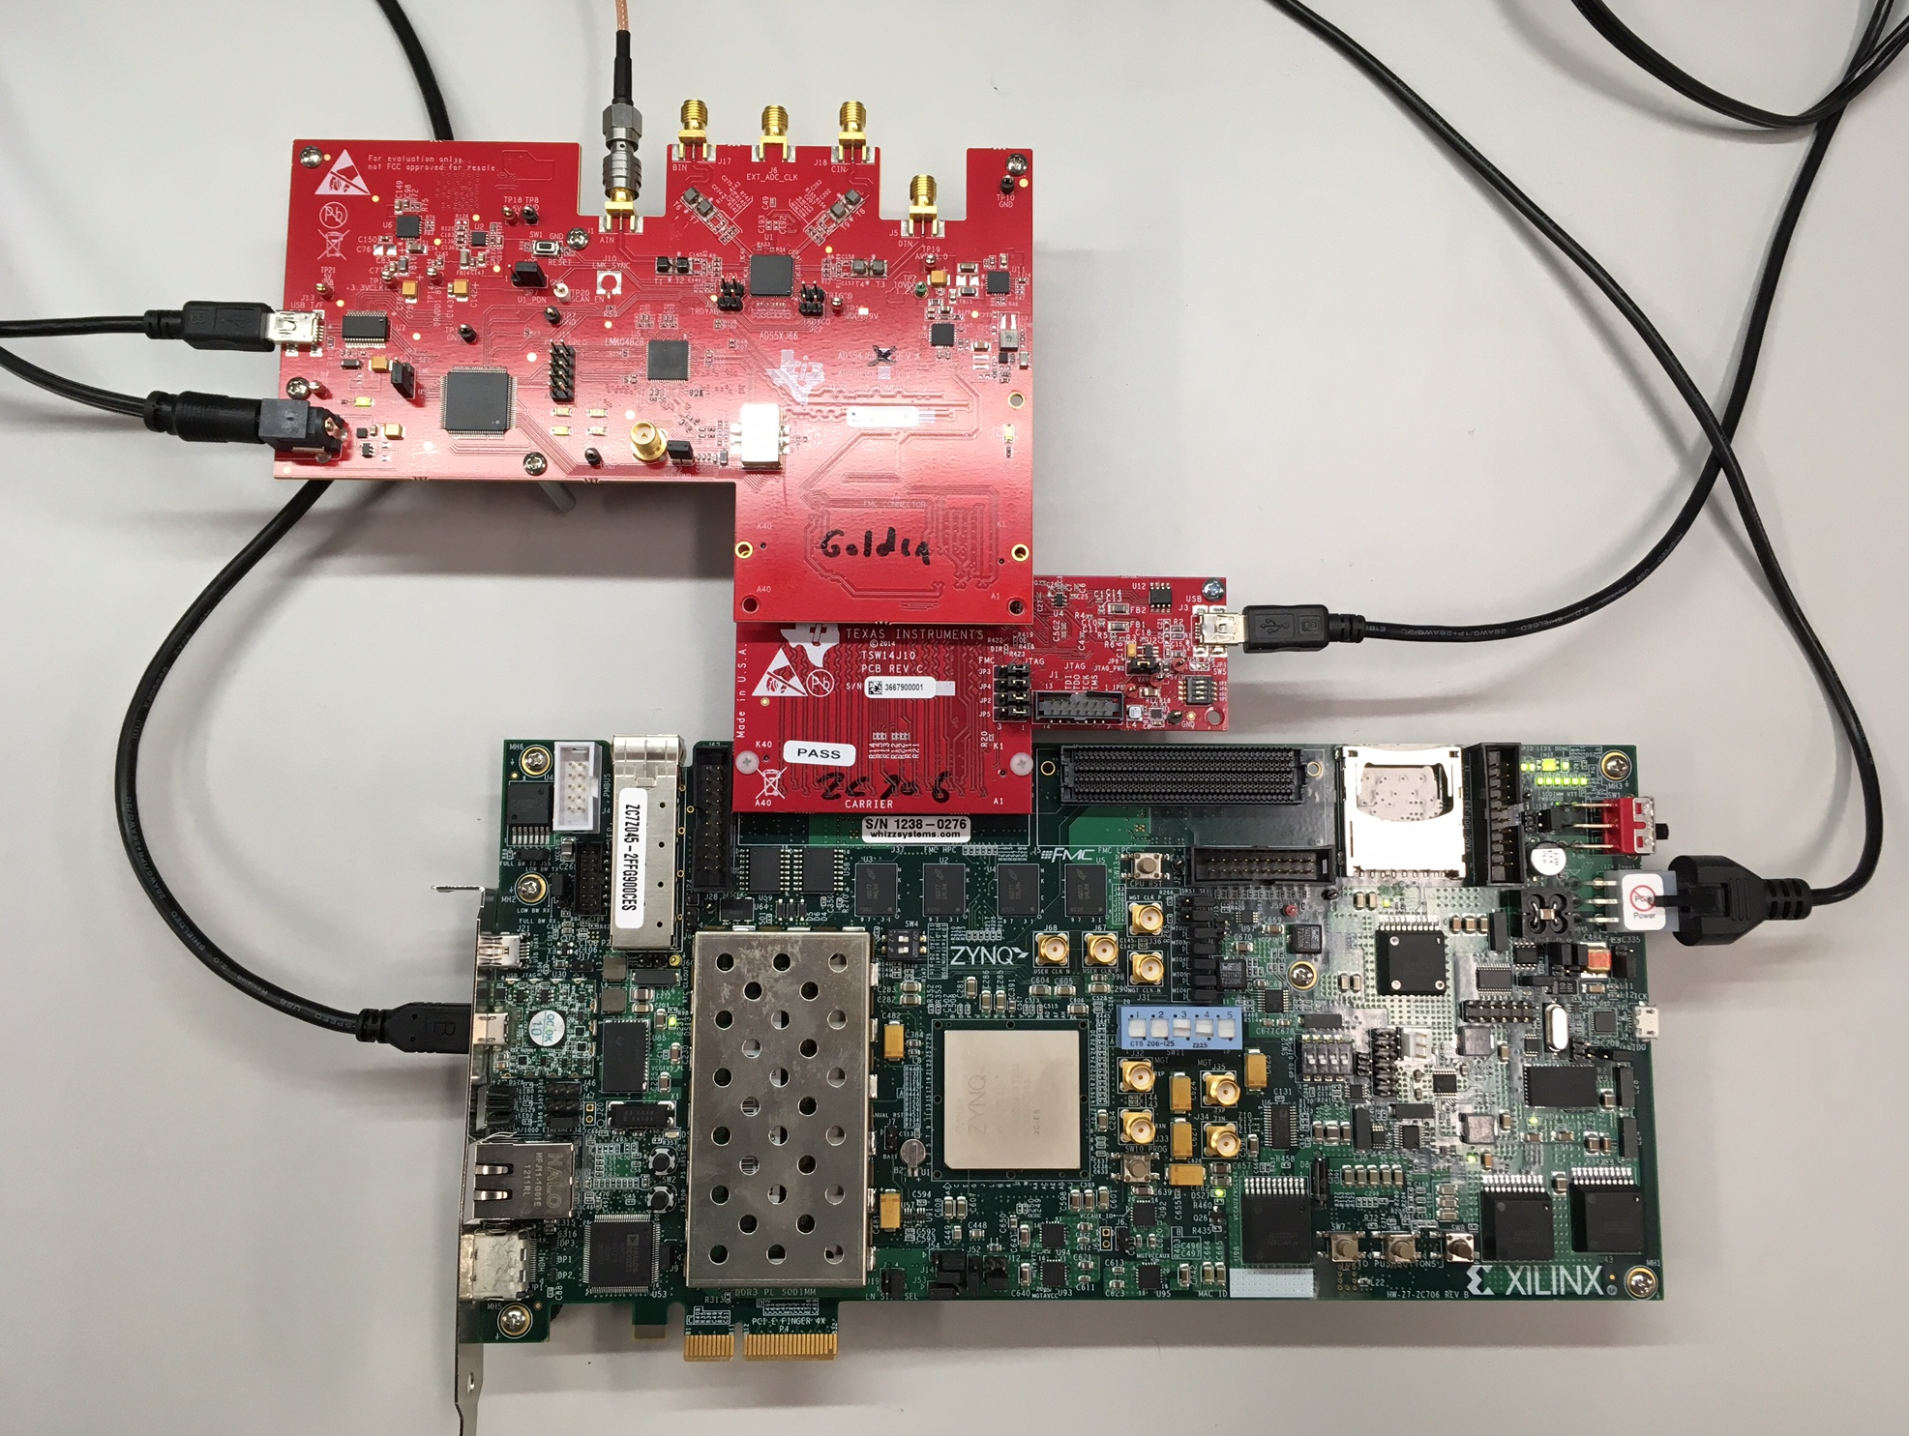
Test Setup:

Slide 3
Hardware Setup:
Connect the three boards as shown in previous slide
Connect power to ZC706 and ADS54J66EVM
Connect a USB cable between TSW14J10EVM and a host PC.
Connect a mini-USB cable between J1 of the ZC706 and a host computer that has Vivado installed.
Provide a 70MHz, 18dBm tone through a bandpass filter to channel AIN SMA connector.

Slide 4
Test Setup:
Single tone is given as input to the device. Data captured using HSDC Pro GUI
Test conditions:
LMK = Providing 491.52Msps Fs clock.
Fin = 70MHz
ADC using Mode 2, LPF with LMFS = 4421

Slide 5
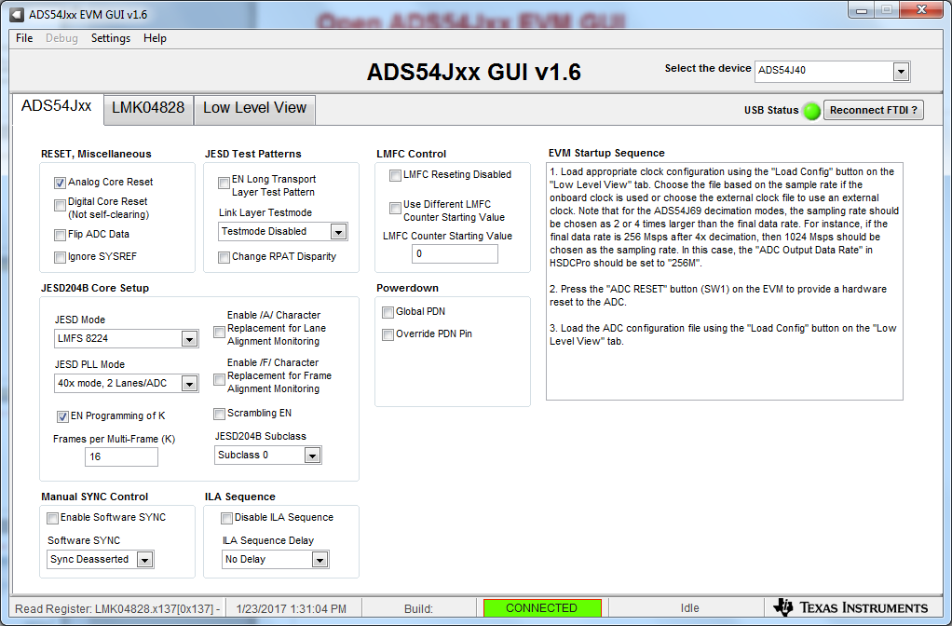
Open ADS54Jxx EVM GUI

Slide 6
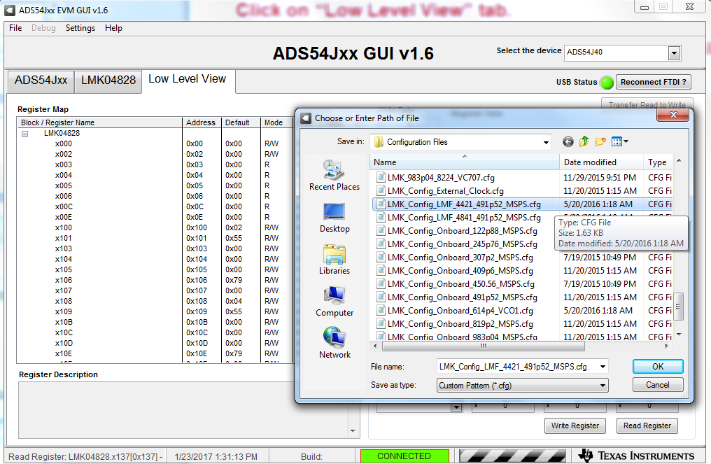
Click on “Low Level View” tab.
Click on folder shown below to open configuration files to load.

Slide 7
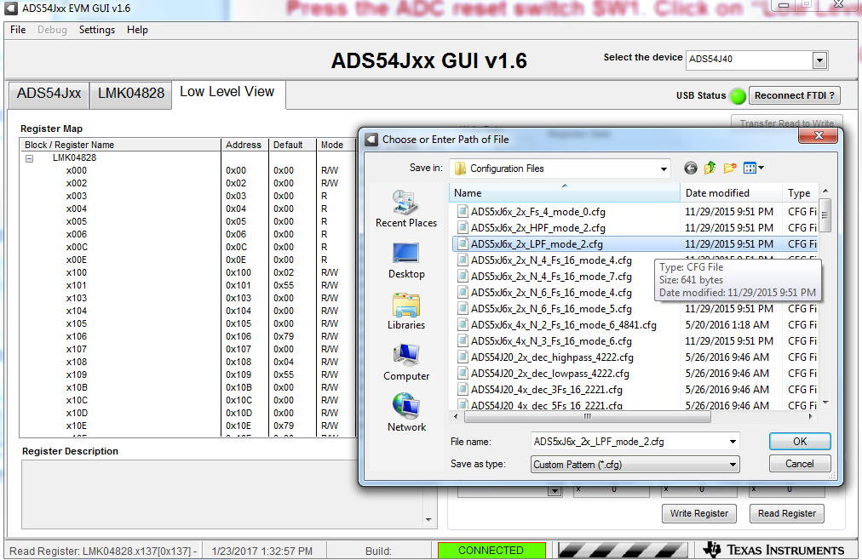
Press the ADC reset switch SW1. Click on “Low Level View” tab.
Click on folder shown below to open configuration files to load.

Slide 8
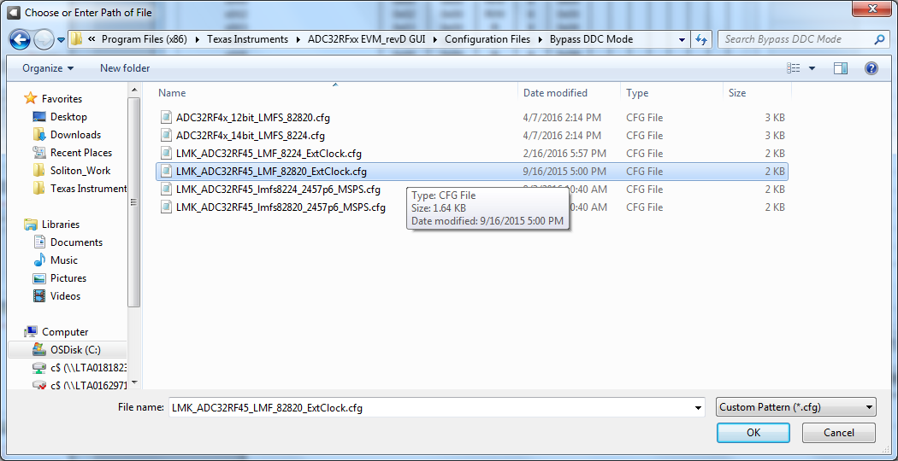
Navigate to “Bypass DDC Mode directory.
Select “LMK_ADC32RF45_LMF_82820_ExtClock.cfg”

Slide 9
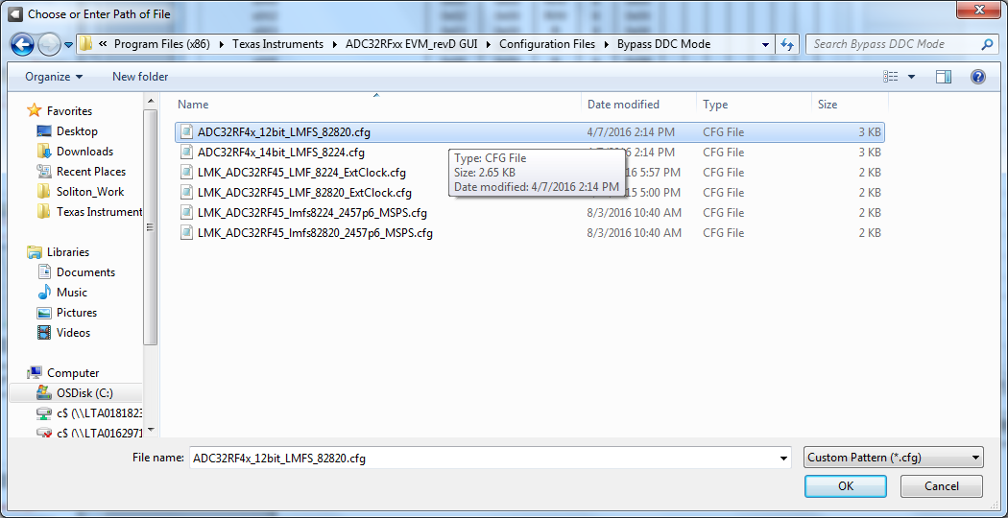
Press board reset switch SW1.
In Low Level View tab, navigate to Bypass DDc Mode directory and load file called ADC32RF4x_12bit_LMFS_82820.cfg”

Slide 10
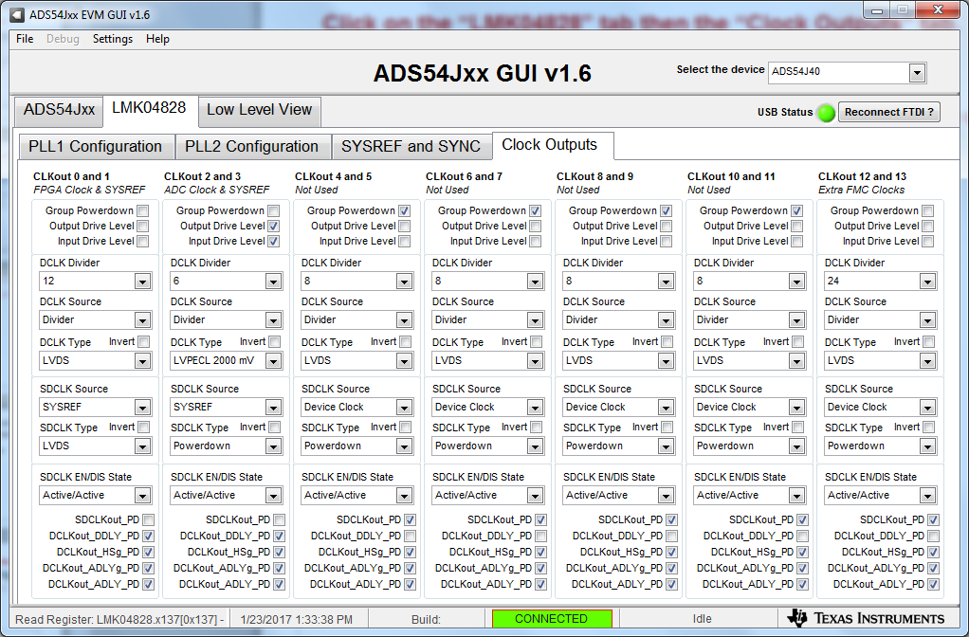
Click on the “LMK04828” tab then the “Clock Outputs” tab.
Set the CLKout 0 and 1 DCLK Divider to “12” to provide a 245.76MHz REFCLK to the ZC706.
Unselect “Group Powerdown for CLKout 12 and 13 and set the divider to 24 to provide a 122.88MHz CORECLK to the ZC706. Set the DCLK Type to “LVDS”, as shown below.

Slide 11
Move the file called “TSW14J10_ZC706_2vp8.bit”, located at:
C:\Program Files(86)\Texas Instruments\High Speed Data Converter
Pro\14J10ZC706 Details\Firmware
to C:\ on the host computer running Vivado.

Slide 12
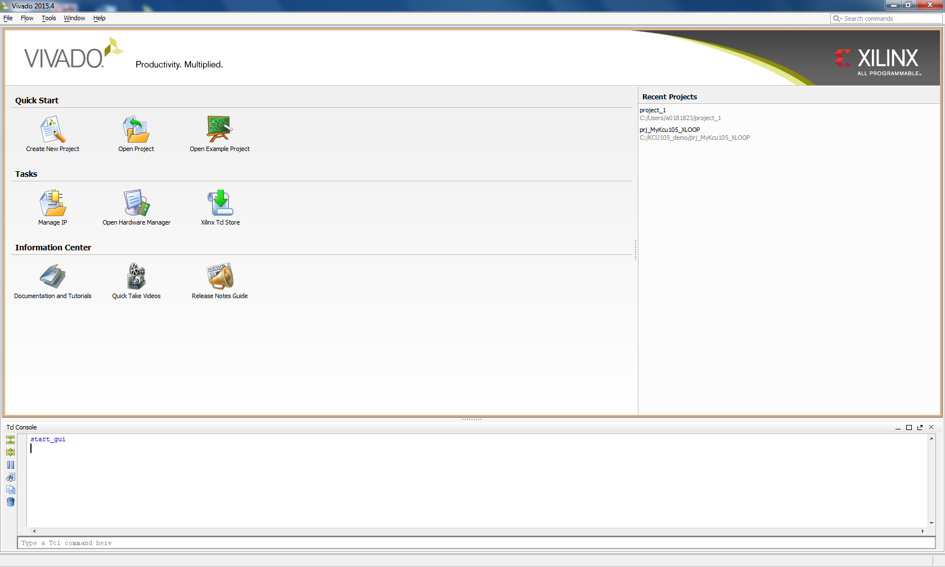
Open Vivado.
Click on “Open Hardware Manager”.

Slide 13
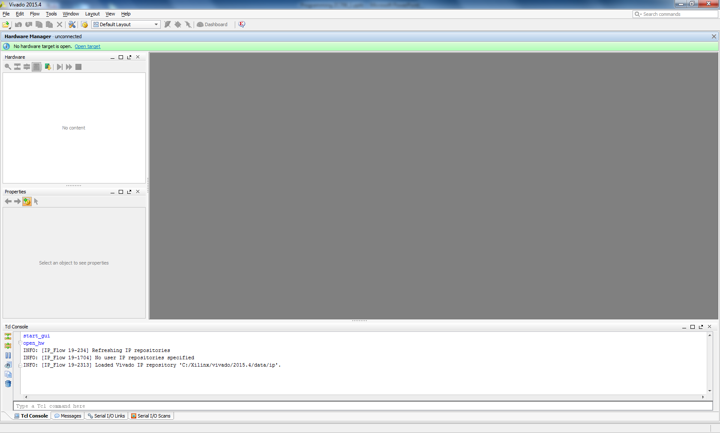
Click on “Open Target”.

Slide 14
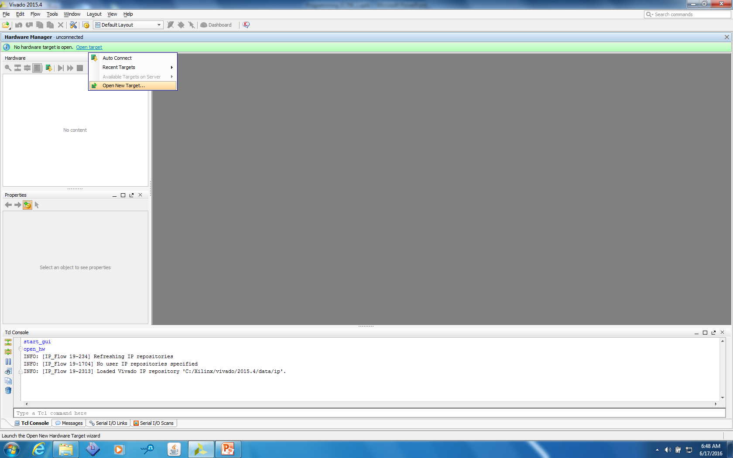
Select “Open New Target”.

Slide 15
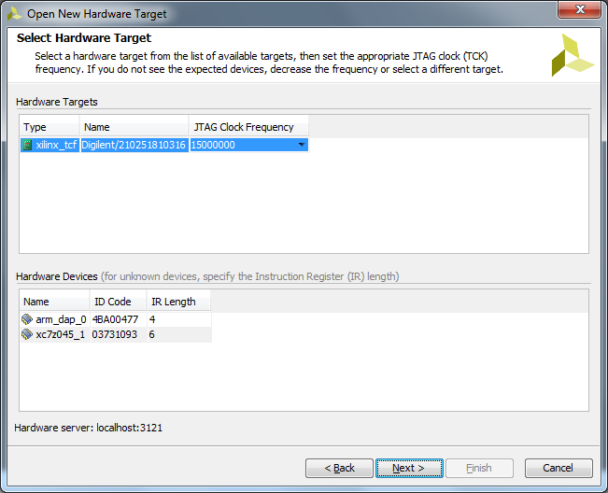
Click on “Next”.

Slide 16
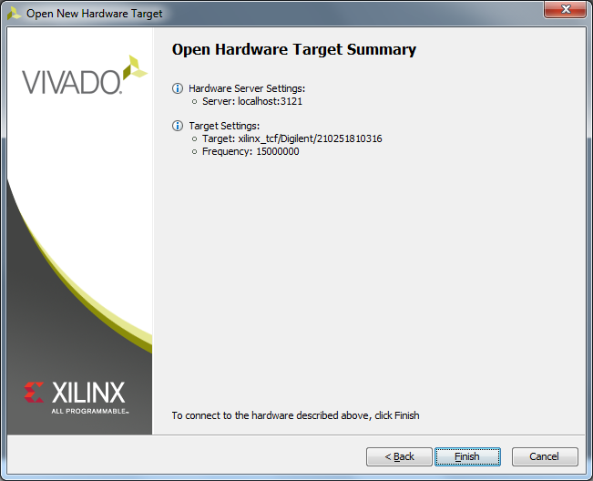
Click on “Finish”.

Slide 17
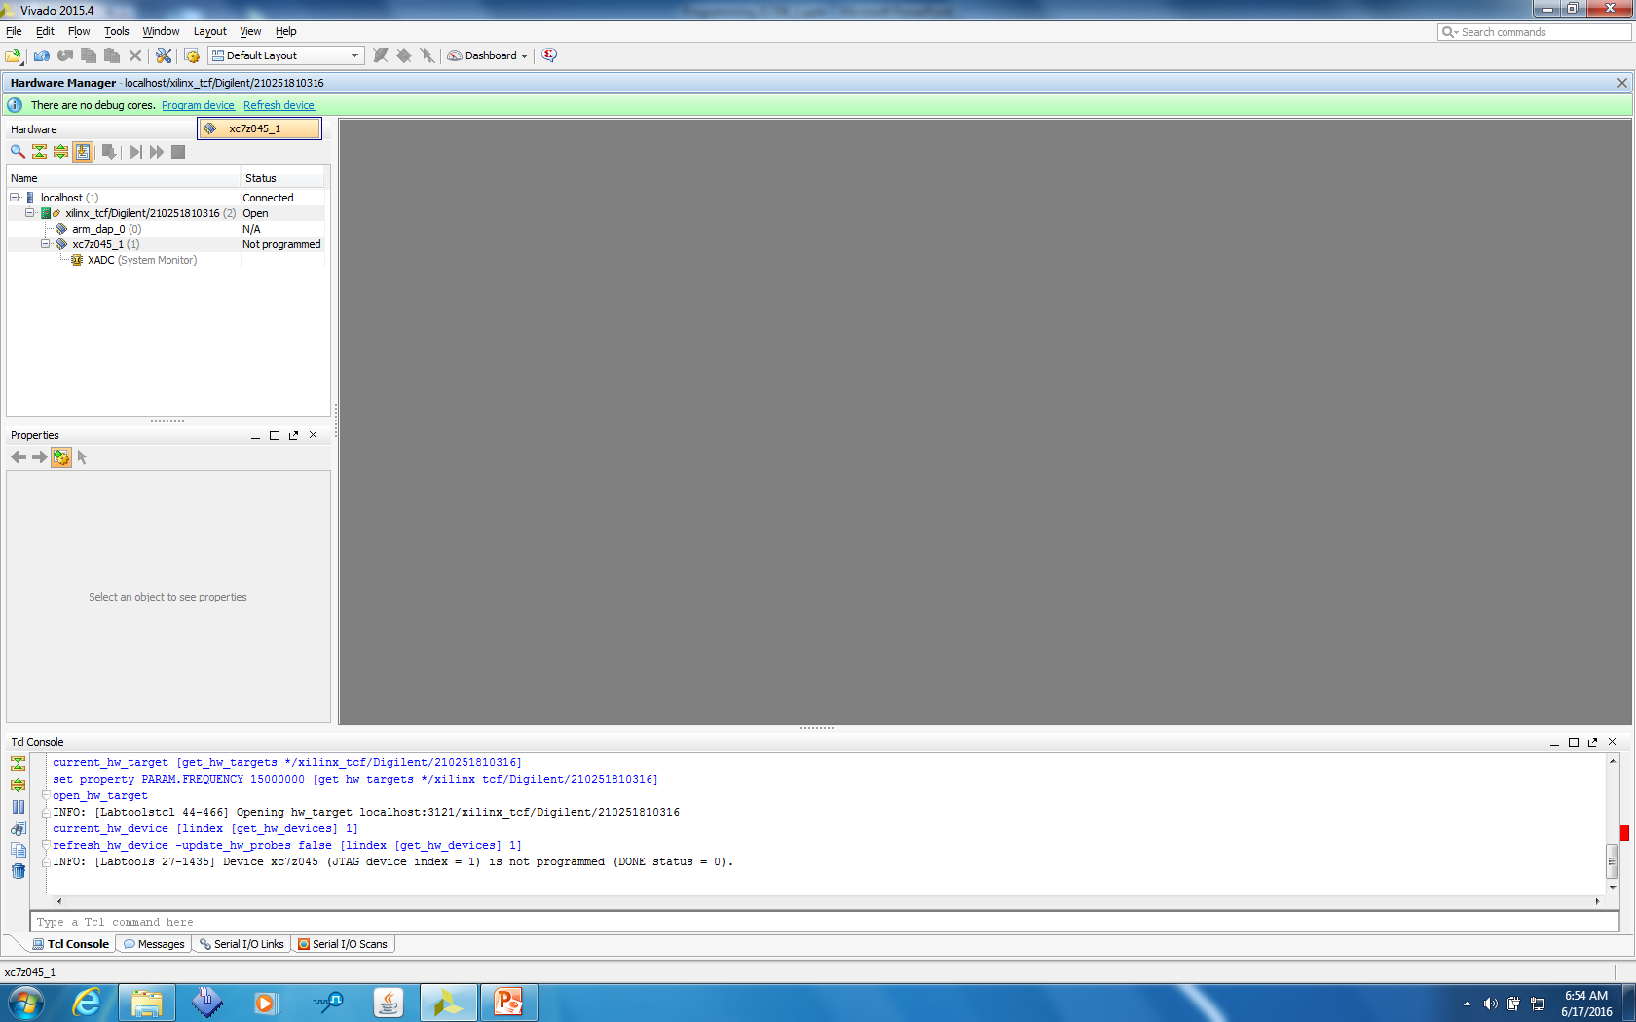
Click on “Program device the select the device that opens as shown below”.

Slide 18
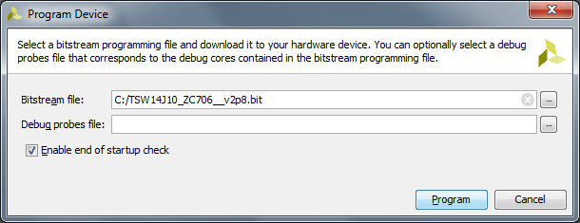
Click on the Bitstream file navigation box and select the file called
“C:\TSW14J10_ZC706_2vp8.bit”
Click on “Program”

Slide 19
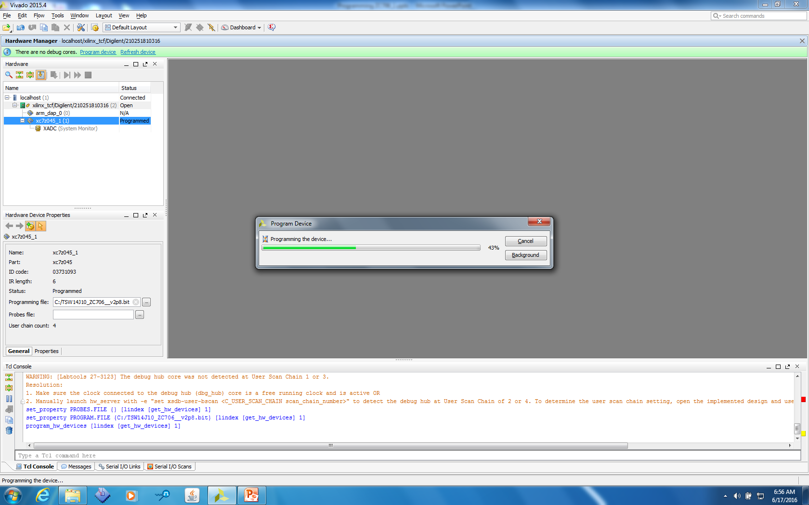
A new window will open showing the status of the programming. Once this reaches 100%, the board is programmed and ready to be used with the HSDC Pro GUI

Slide 20
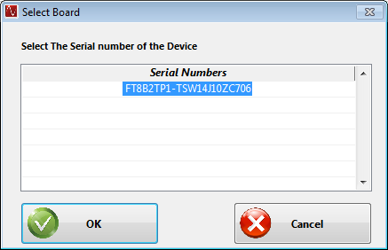
Open HSDC Pro GUI.
Click on “OK” to connect to the ZC706

Slide 21
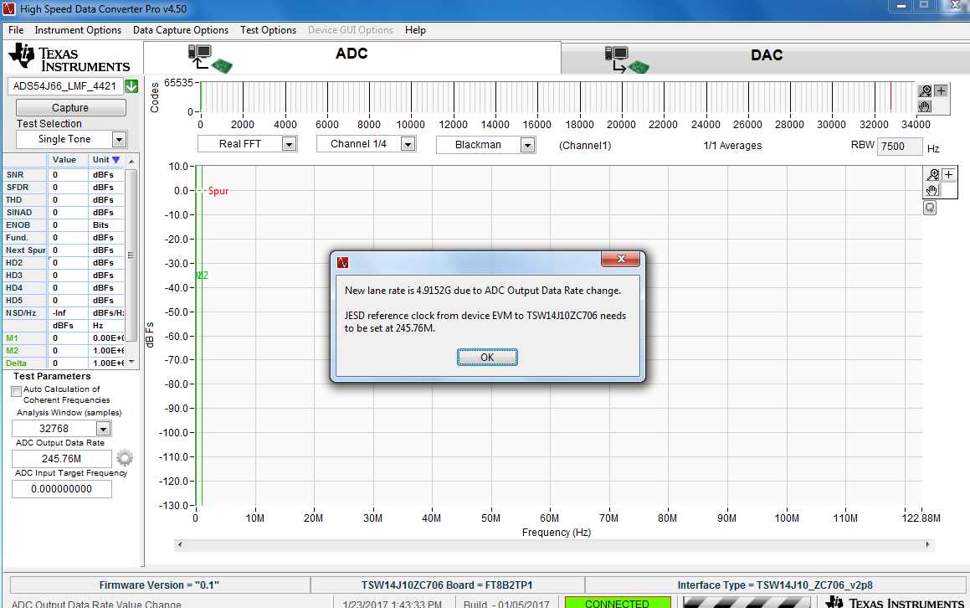
Click on the device drop down arrow and select “ADS54J66_LMF_4421”.
Enter “245.76M” for the ADC Output Data rate. A new window will open showing the lane rate and REFCLK required by the ZC706.

Slide 22
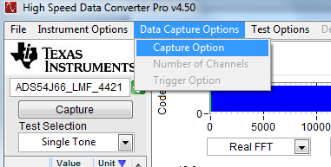
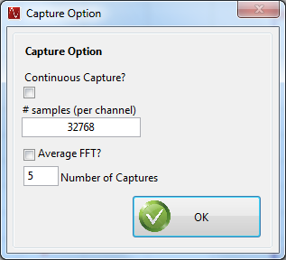
Click on the “Data Capture Options” tab at the top of the GUI, then select “Capture Option”. A new window opens. Set the # samples (per channel) to 32768, as shown below. This is the max sample size that can be used with 4 channels when using the ZC706.

Slide 23
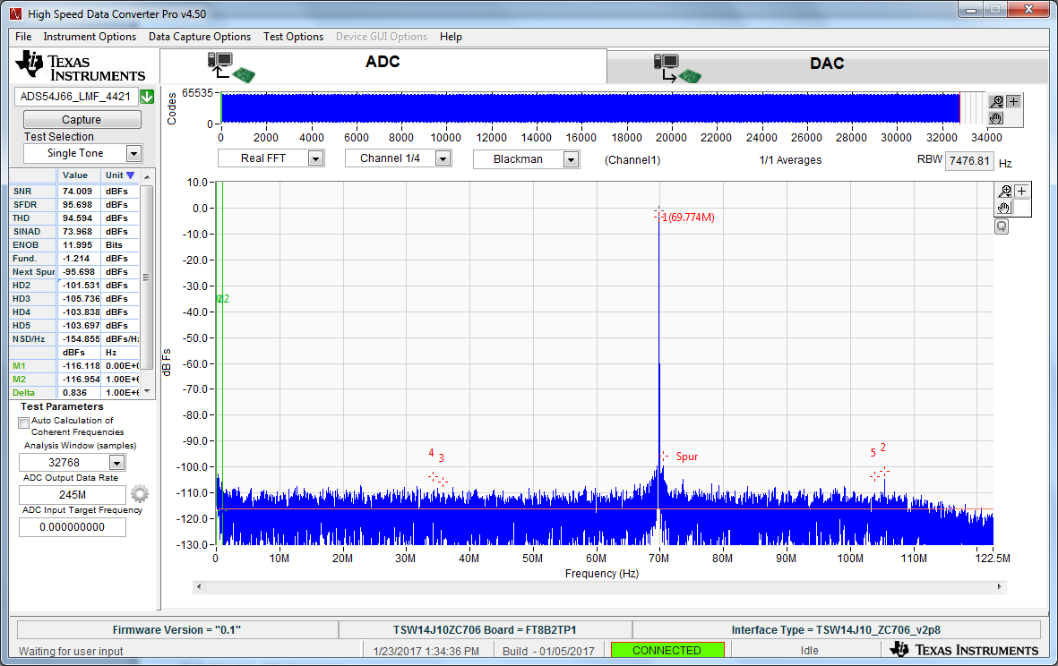
Click on “Capture”. The captured results of a 70MHz IF input at CHA is shown below.

