Slide 1
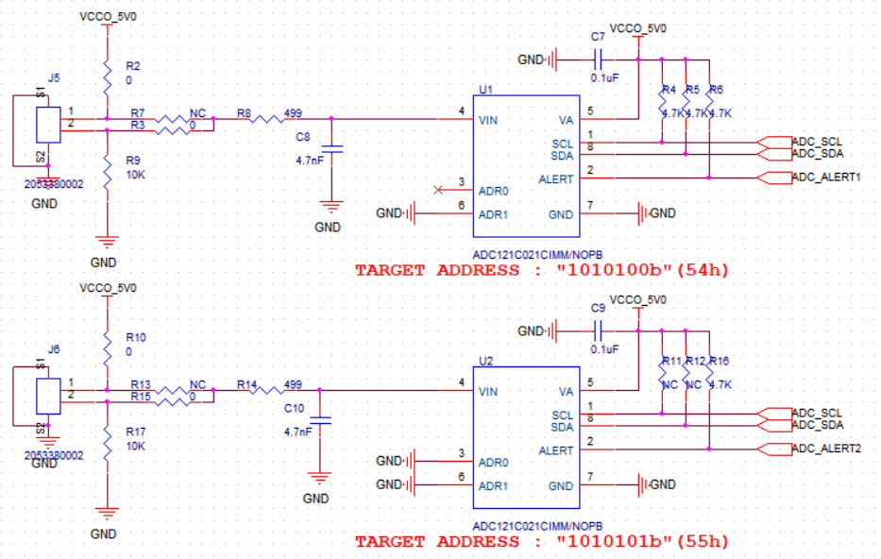
Schematic

Slide 2
Tried to Test
C8 change value
  100nF : there is a noise
  10nF : there is a noise
  3pF : there is a noise
R8 change value
  22ohm : there is a noise
  10Kohm : there is a noise
  100Kohm : there is a noise
C7 change value
  2.2uF : there is a noise
  4.7uF : there is a noise

