Slide 1
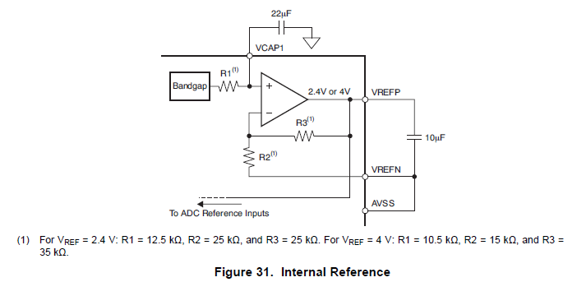
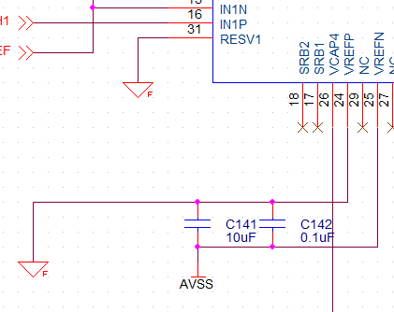
TI’s datasheet
Our schematic
Is this schematic correct?

