Slide 1
Time Synchronization
Keystone 2 Devices

Slide 2
Overview
Introduction
RX-TX 1588 CPTS Time Stamping
Managing CPTS 32-Bit Timer
Small Cell Time Sync Implementation
Q&A

Slide 3
Introduction

Slide 4
Introduction
Keystone 2 Devices support the IEEE 1588v2 standard through the Ethernet sub-systems.
Keystone 2 devices provide two Ethernet sub-systems (1G & 10G).
  Both support Annex D (IPV4), E (IPV6) and F (802.3)
Both Ethernet sub-systems utilize the following modules for 1588 operation.
  CPSW - Common Platform Switch Subsystem
  CPTS - Common Platform Time Sync Module

Slide 5
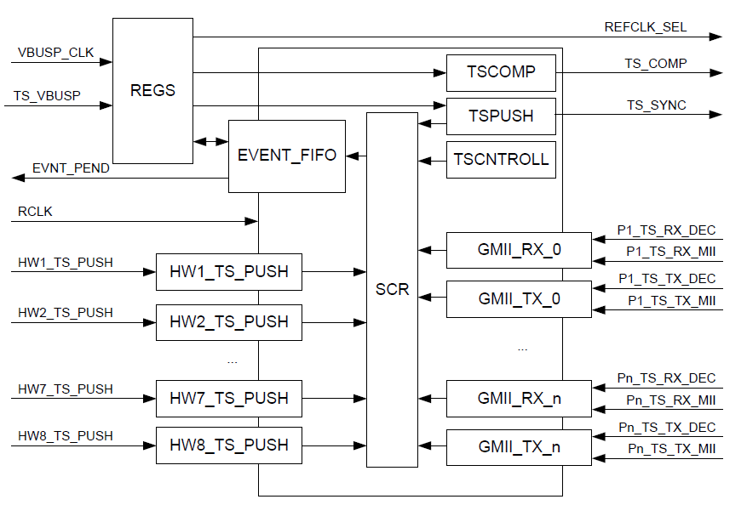
CPTS Block Diagram
CPTS on KS2 devices supports additional time synchronization features such as precisely-timed output pulses (TS_COMP/TS_SYNC). It can also timestamp hard signals such as GPS 1pps (via HW_TS_PUSH).
*KS2 Only

Slide 6
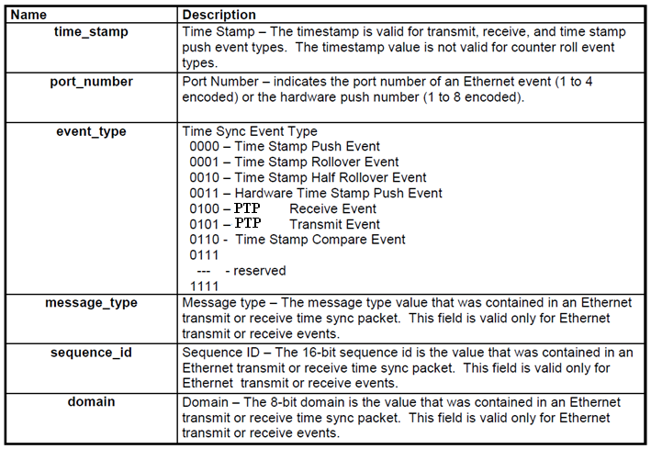
CPTS Events on KS2

Slide 7
NETCP CPTS CONNECTIONS
CPTS Reference Clock
CPTS Hardware Push Events
Note- There is some swapping in events 3-6 when compared with the Kepler Architecture Spec. As this can be handled with software, it is not an issue
Mux Sel Value | Reference Clock Followed
0 | Clk2
1 | Clk3
2 | Timi0
3 | Timi1
8 | Tsrefclk
Event Number | Connection
1 | syncE
2 | XGE sync
3 | Tspushevt1
4 | Tspushevt0
5 | Timi1
6 | Timi0
7 | Reserved
8 | Reserved

Slide 8
NETCP CPTS CONNECTIONS (Contd’)
CPTS syncE rxbclk connections
CPTS TSRXCLKOUT(0/1)(N/P)
Mux Sel Value | Connection
0 | Rxbclk[0]
1 | Rxbclk[1]
2 | Rxbclk[2]
3 | Rxbclk[3]
Mux Sel Value | TSRXCLKOUT0(N/P) | TSRXCLK1(N/P)
00 | Rxbclk[0] | Rxbclk[0]
11 | Rxbclk[1] | Rxbclk[1]
22 | Rxbclk[2] | Rxbclk[2]
33 | Rxbclk[3] | Rxbclk[3]

Slide 9
RX-TX 1588 CPTS Time Stamping

Slide 10
CPTS 1588 RX Time Stamping
CPTS Time Stamps all RX PKTS upon Start of Frame Delimiter (SFD) crossing the MAC interface (on any of the four Ethernet lanes). CPSW 1588 Decoder establishes if it is a valid PTP packet and signals CPTS to push the TS into the Event FIFO
Notes:
SFD – Start of Frame Delimiter

Slide 11
CPTS 1588 TX Time Stamping
CPTS Time Stamps TX PKTS upon SFD crosses CPGMAC. CPSW 1588 Decoder establishes if it is a valid PTP packet and signals CPTS to push the TS into the Event FIFO
Notes:
SFD – Start of Frame Delimiter

Slide 12
Managing CPTS 32-Bit Timer

Slide 13
Rollover Event
The CPTS contains a 32-bit time stamp value (time_stamp[31:0]). The counter upper bits are maintained by host software. The rollover event indicates to software that the time_stamp counter has rolled over from 0xFFFF_FFFF to 0x0000_0000 and that software maintained upper count value should be incremented.
Example for 1588 PTP Time:
CPTS Time Before Rollover Event
CPTS Time After Rollover Event
32-Bit (MSB)
32-Bit (LSB)
0x00000000
PTP_TIMESTAMP
32-Bit (MSB)
32-Bit (LSB)
0x00000001
PTP_TIMESTAMP

Slide 14
Half-Rollover Event
As the 1588 decoder takes some time to validate a packet it can happen that a PTP packet is timestamped just before a rollover event, but the rollover event is pushed into the EVENT FIFO first.
The Half-Rollover event indicates to software that the time_stamp counter has rolled over from 0x7FFF_FFFF to 0x8000_0000.
This allows the software to determine after a rollover event if the following PTP_TS happened after or before the rollover.

Slide 15
Half-Rollover Event - Example
Events on Real Timeline
Events on FIFO

Slide 16
Half-Rollover Event - Example
To solve this issue software checks the MSB of the PTP_TS between a rollover event and a half-rollover event.
  If it is 1, it happened before the rollover event. Thus the upper 32-bit CPTS time needs to be decremented for this timestamp.
  If it is 0 it happened after the rollover event.

Slide 17
Linux System Time and CPTS Time
We have discussed how CPTS 32-bit timer is maintained as a 64-bit clock. But, how to maintain 1588 epoch time? (nanoseconds).
For this, 1588 Stack uses Linux System time. This time is driven in KS2 by the A15 ARM core timer.
To properly convert CPTS tick time to nanoseconds the 1588 stack calibrates system time by computing the offset between the CPTS timer and the A15 timer.
It uses TS_PUSH capability to read the CPTS timer.
  More details on the 1588 stack in the next section.

Slide 18
Small Cell Time Sync Implementation

Slide 19
IEEE 1588 Overview on Keystone 2
A complete 1588 clock sync solution consists of the following blocks.
The network driver matches up PTP packets with the time stamps from the CPTS. Linux socket interface calls are used to retrieve the packet data and the time stamps.
The 1588 stack encodes PTP transmit packets and parses PTP receive packets.

Slide 20
IEEE 1588 Overview on Keystone 2 Platform
The PTP clock sync application performs packet delay variation filtering. It computes the frequency and time offsets between master time server clock and local clock.
  Timestamp data provided in CPTS raw time.
  Annex E and D support at CPTS.
  Linux PTP Socket listens only to CPTS event. No Need for PA.
The system clock sync application uses the computed frequency and time offsets as inputs to a software digital phase locked loop.
That DPLL computes DAC voltage updates to lock the VCXO frequency to the master time server
  SPI write done by ARM.
  No DSP needed.

Slide 21
IEEE 1588 Overview on Keystone 2 SW
During system start up the OCXO will stabilize and clocks will become available to CPTS
At this point the CPTS driver will enable the input clock by writing the chip level register CPTS_RFTCLK_SEL.
  Please refer to your device datasheet for specific value details.
By default the CPTS driver will initialize the ENET Switch and CPTS for Annex D & E unicast support with VLAN ethertype of 0x8100.
  To change default values via SYSF and configurable parameters please refer to attached cpts_driver.txt section A.3
For more details on CPTS driver responsibilities please refer to attached cpts_driver.txt section B and go to http://processors.wiki.ti.com/index.php/MCSDK_UG_Chapter_Exploring#Common_Platform_Time_Sync_.28CPTS.29

Slide 22
IEEE 1588 Overview on Keystone 2 SW
As mentioned in the platform overview the 1588 app (PTP Stack, PTP Clock Sync App, System Clock Sync App) is responsible of adjusting the CPTS reference clock frequency
However, the 1588 must forward the frequency adjustment to the CPTS driver using the clock_adjtime API with a flag ADJ_FREQUENCY
  This is needed for CPTS driver to calculate UCT time correctly.
If any absolute (UCT) time adjustments must be made the 1588 app can use the clock_settime function.
For more details refer to the attached file cpts_driver.txt section C.

Slide 23
IEEE 1588 DPLL Software
Once the clock sync app calibrates CPTS clock it can program CPTS to generate the 1pps to AIF. However, the master Sync packets can be lost for a period of time.
  When this happens the local clock can drift from the master time.
  DPLL software needs to determine if it needs re-synchronization.
Along with the DPLL SW the Clock Sync App needs a state machine to
  perform initial synchronization,
  generate output pulse,
  keep frequency and time locked to master time,
  hold frequency during master signal loss,
  Re-establish synchronization upon signal return.
In the next few slides the state machine and DPLL algorithm will be explained.

Slide 24
IEEE 1588 DPLL Software
The 5 states of the DPLL Software State Machine

Slide 25
IEEE 1588 DPLL SW Initial Lock
During Initial Lock DPLL SW tracks the master time over a period of time.
  Master sync pulses carry the egress time in the PTP packet.
  Sync packets are time stamped on arrival by CPTS.
  Delay_req packets are sent to the Master time server while time stamped at egress.
  Master responds with a Delay_response carrying the arrival time of Delay_req.
  DPLL SW filters these four timestamps for network delay variations and uses them as inputs to output a control voltage step to the DAC through the SPI interface.

Slide 26
IEEE 1588 DPLL SW Sync Output
Once DPLL software has calibrated the local slave clock (i.e. CPTS timer) to the master time server. It can safely determine the absolute time 1 second boundary.
The clock sync application then computes a CPTS time tick value in the future that equates a 1 second period.
  This value is loaded in the compare register of CPTS. When CPTS timer reaches this value it generates the 1pps pulse.
  The process is repeated to maintain a 1pps output pulse to AIF.

Slide 27
IEEE 1588 DPLL SW In-Lock
Once the 1pps has been generated the AIF is synchronized to absolute time with the master time server.
  Software keeps going back to the Sync Output state to load the CPTS compare register with the next value for the 1pps.
The DPLL software needs to keep tracking the master clock to keep the local frequency in lock with the master frequency.
For this the DPLL software needs PTP sync pulses from the master time.
  The slave to master path time can be estimated with enough precision to lock the frequency so delay_req/delay_resp packets are needed less frequently.
To estimate the arrival time the PTP clock sync app filters network impairments due to transit time variations of PTP Sync packets.

Slide 28
IEEE 1588 DPLL SW Holdover
In the holdover state the voltage output to the DAC is held constant.
The PTP capture events are monitored to see if the signal has returned.
When PTP packets are captured DPLL software can determine how much drift has occurred in the local clock.
  If drift is too much re-sync state is entered.
  Else In-Lock state is entered.
In some situations the drift might have caused the antenna to lose absolute time reference.
  Initial Lock is state is entered to re-calibrate CPTS timer and generate another sync pulse to the AIF.

Slide 29
IEEE 1588 DPLL SW Re-Sync
The Re-sync state is entered because the radio frame timing has drifted outside of the specified timing window.
The DPLL algorithm slowly re-calibrates the local clock and locks the frequency to the master clock frequency.

Slide 30
GPS Time Sync
Time synchronization with GPS 1pps signal is almost identical to IEEE 1588 time synchronization.
The primary difference being that CPTS events to the GPS SW are generated by time stamping the 1pps signal through the TS_HW_PUSH events.
The GPS state machine in the clock sync application has the same 5 states as the 1588 state machine.

