Slide 1
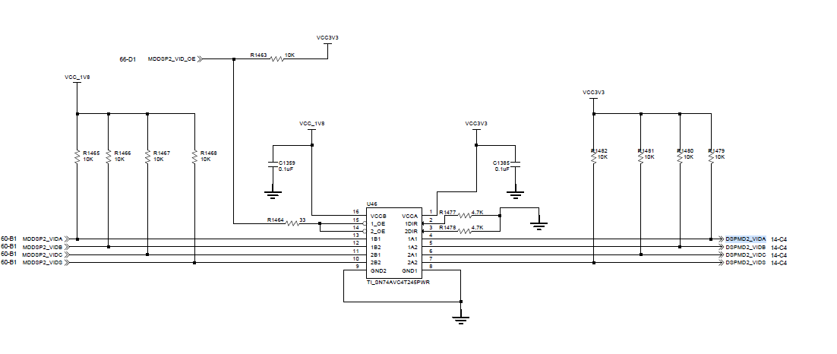
SCOPE

Slide 2
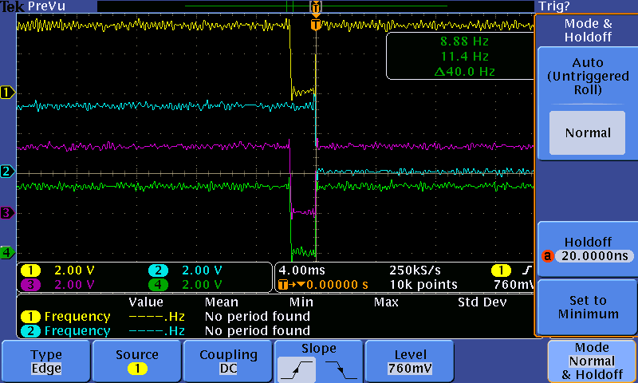
VID1
VID2
VID3
VID4

Slide 3
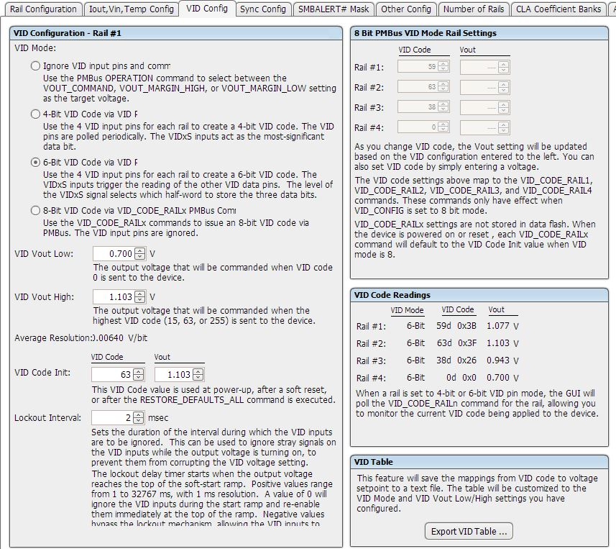

Slide 4
2021.03.02

Slide 5
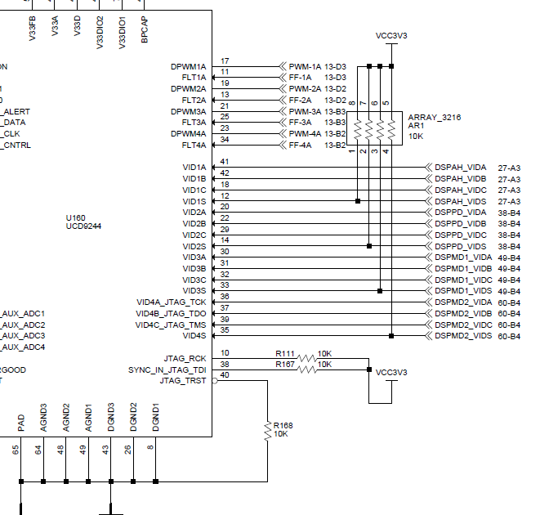

Slide 6
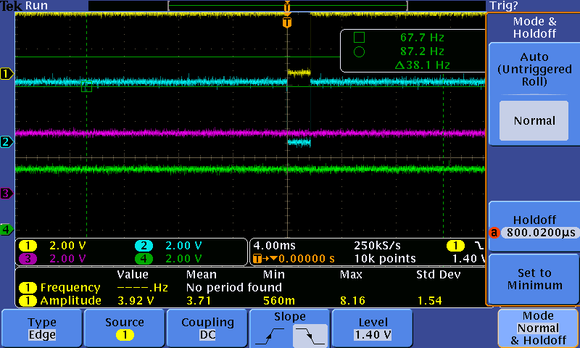
Rail #1(0x3B)
VID1S
VID1C
VID1B
VID1A

Slide 7
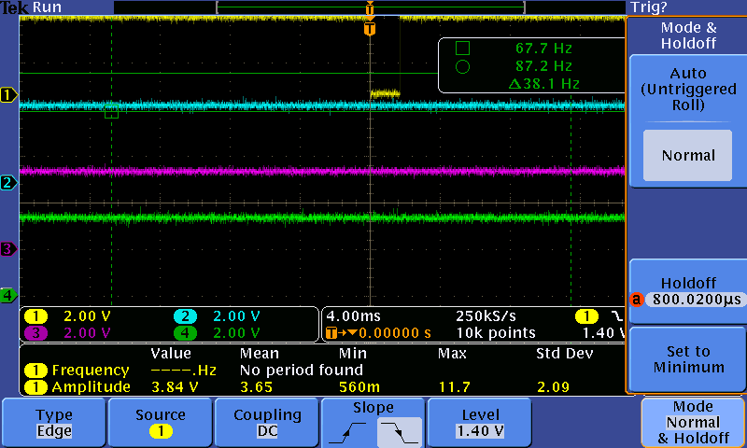
Rail #2(0x3F)
VID1S
VID1C
VID1B
VID1A

Slide 8
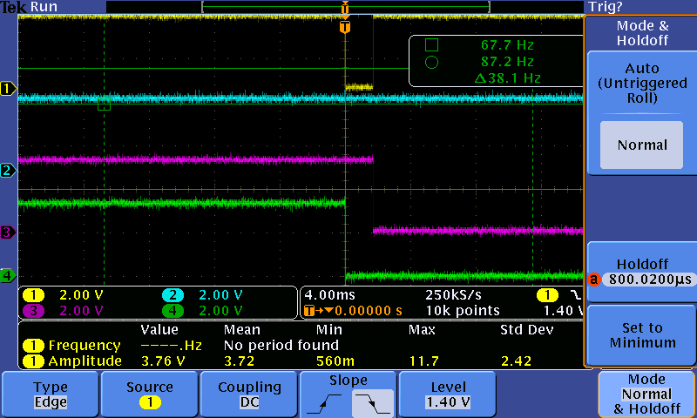
Rail #3(0x26)
VID1S
VID1C
VID1B
VID1A

Slide 9
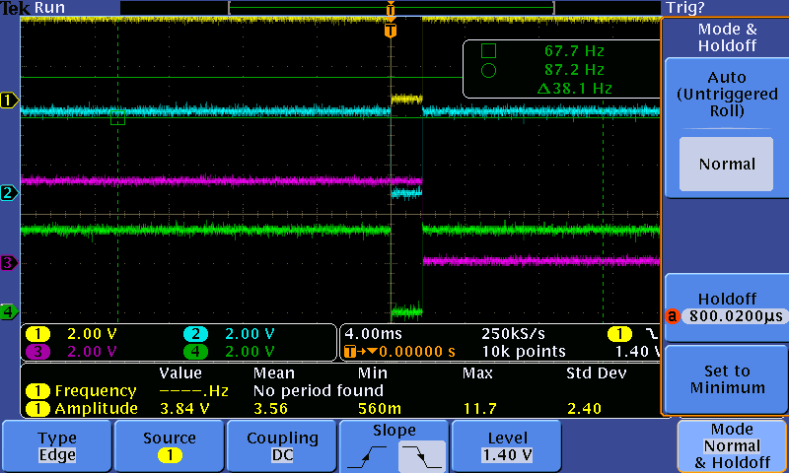
Rail #4(Register 0x00)
VID1S
VID1C
VID1B
VID1A

