Slide 1
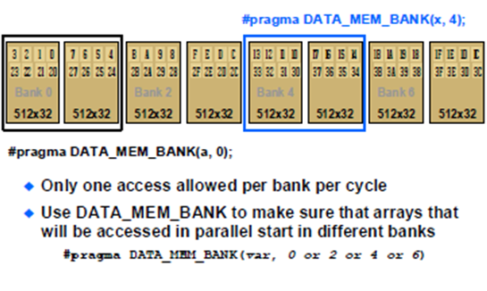
C66x L1 D Memory Banks

Slide 2
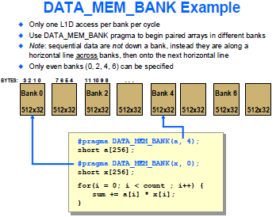
Two Loads Instruction in a Cycle

