Slide 1
CODESYS EtherCAT Performance
AM6442

Slide 2
Running CODESYS without optimization

Slide 3
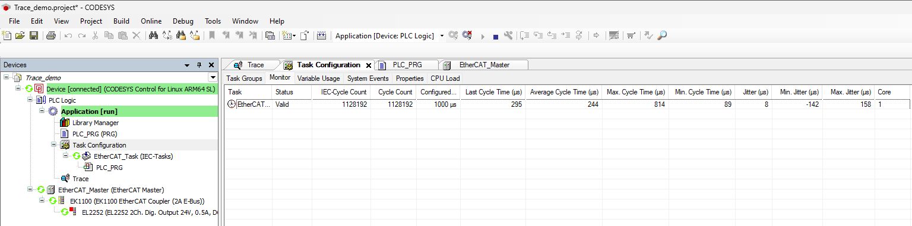
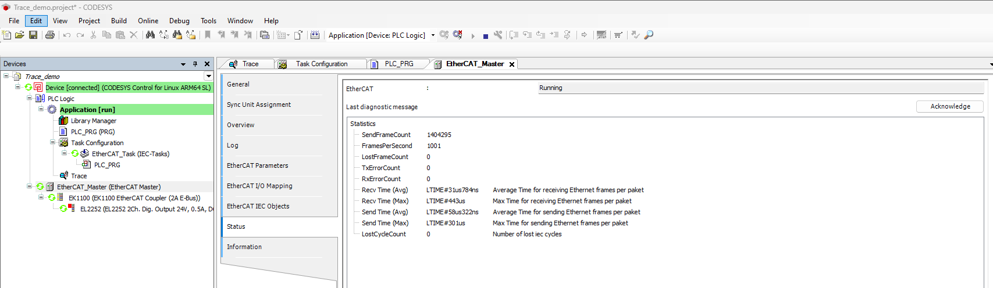

Slide 4
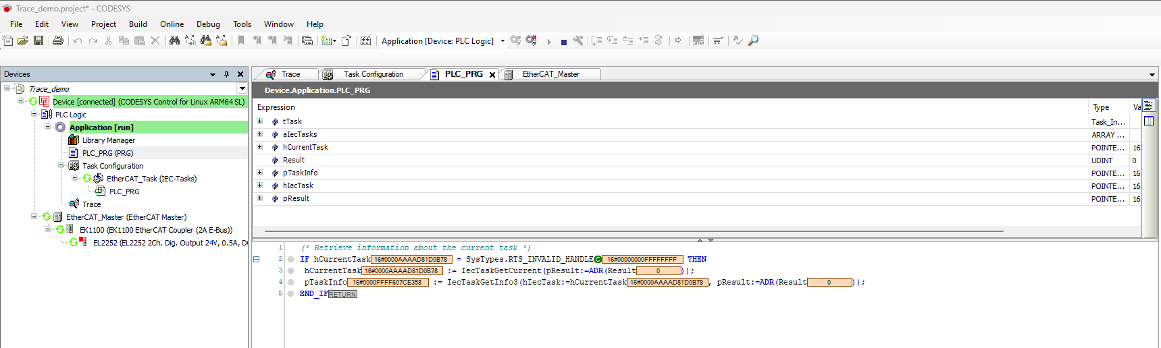
PLC Program for Tracing

Slide 5
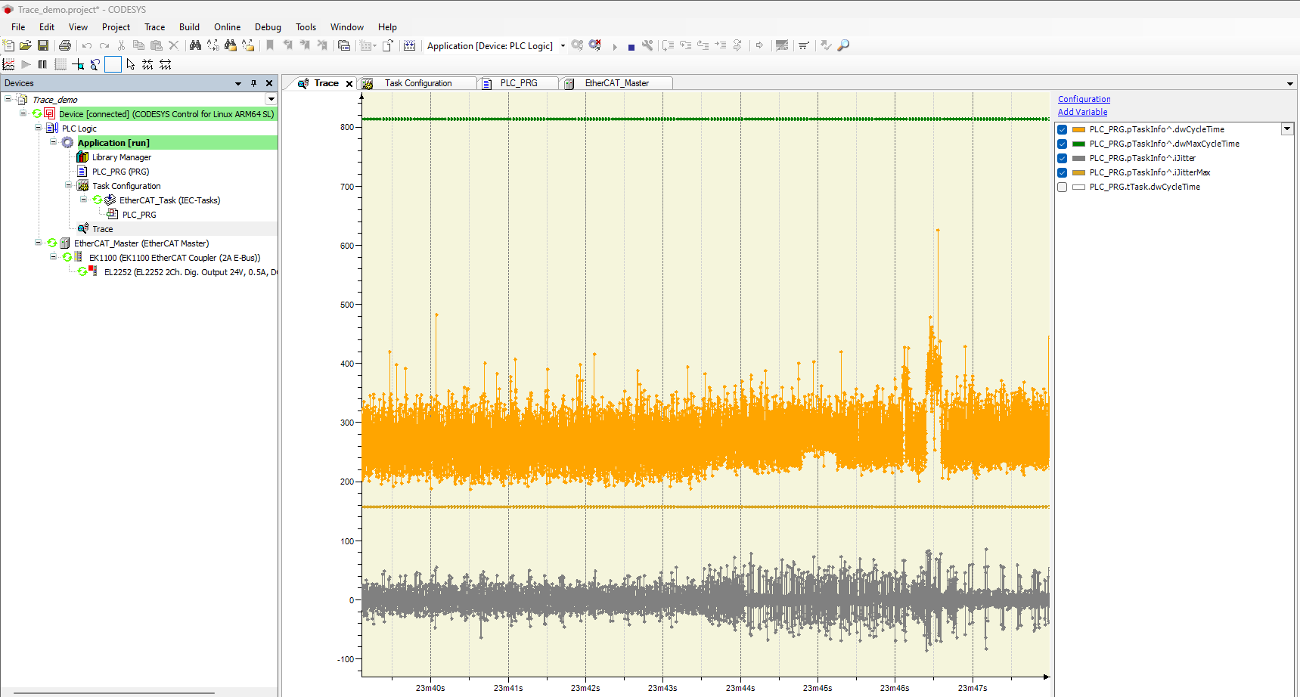

Slide 6
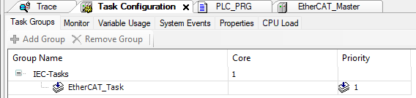
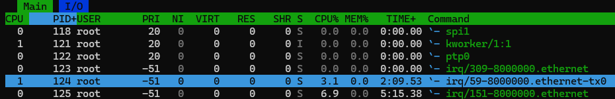
Running CODESYS with optimization
CPU Isolation
isolcpus=1 nohz_full=1 rcu_nocbs=1 irqaffinity=0
Only EtherCAT runs on CPU Core 1
Bind Ethernet interrupts to CPU core 1

Slide 7
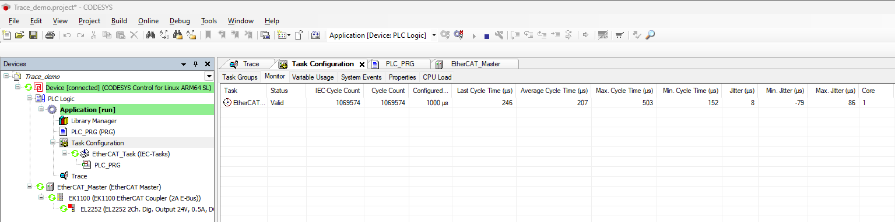
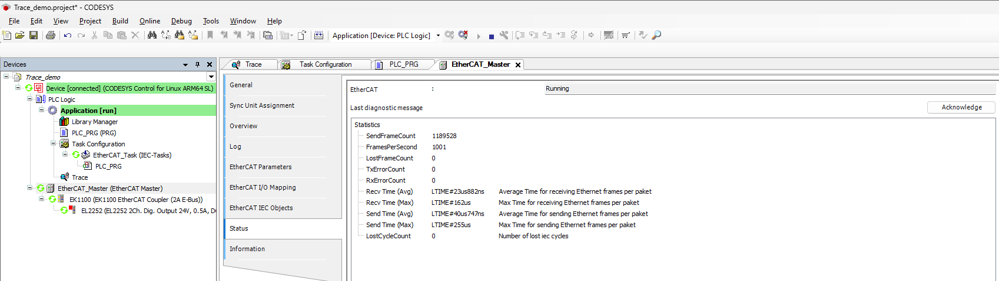

Slide 8
