Slide 1
AM64X : Reset Architecture
Anil, Swargam

Slide 2
Agenda
AM64X SOC Architecture
Why Reset ?
3. The different types of resets on AM64X
4. Reset types and Their impact on Boot sequences and memories
5. How different resets act in Isolation Vs Generic Mode?
6. How to debug when the SOC continuously Resets ?

Slide 3
AM64x SOC Architecture :
MAIN Domain : 2 A53 cores and
4 R5F cores , MAIN MMR, MAIN Peripheral set and MAIN PLL
MCU Domain : M4F core, MCU MMR, MCU Peripheral set and MCU PLL
Generic Mode : When a user configures M4F as a generic processor,
Then Reset is propagated through both the MAIN and MCU domains.
​Isolation Mode : When the user configures M4F core as a Safety Processor, Then the Reset is propagated through the only MAIN domain and not propagated through the MCU core.
AM64x
16nmFF
Application Cores
2MB Shared SRAM
PRU-ICSS-Gb
Industrial Ethernet
Supported Protocols: TSN, EtherCAT, PROFINET, EtherNet/IP, PROFIBUS, SERCOS 3 and more…
PRU-ICSS-Gb
Motor control / Industrial Ethernet
9x SigmaDelta decimation filters
3x abolute encoder interfaces
Supported encoders:
Hiperface DSL, EnDat 2.2, Tamagawa, BiSS C etc
Arm®
Cortex A53
Arm®
Cortex A53
256KB L2$
Real-time Core
Arm®
Cortex R5F
Arm®
Cortex R5F
128KB TCM
MCU with FFI
Real-time Core
Cortex M4F
Arm®
Cortex R5F
Arm®
Cortex R5F
Security Acceleration
Crypto: AES, 3DES, SHA, PKA, RNG,
128KB TCM
256KB RAM
16b DDR4/LPDDR4
w/ ECC
Hardware Security Module
Diagnostic toolkit: ECC, ESM, BIST, DCC, CRC
Cortex M3
128KB SRAM
GPIO
2x I2C
2x SPI
2x UART
Power
Manager
System Services
DMA
System
Monitor
Debug
Firewall
IPC
Timers
Secure Boot
DCC ESM ECC
General Connectivity & IO
Control Peripherals
Analog
Memory/Flash
High-speed interfaces
SPI
x5
GPIO
eQEP
x3
FSI
x8
ADC
x1
GPMC
2-port Gb Ethernet
w/1588 & TSN
UART
x7
I2C
x4
eCAP
x3
OSPI
x1
1x PCIe (1L) Gen2*
CAN-FD
x2
ePWM
x9
MMC/SD
x2
1x USB 3.1/2.0*
* PCIe and USB 3.0 share the same SERDES

Slide 4
What is Reset?
A Reset refers to a mechanism or signal that allows the entire system or specific components within the SOC to be reset to a known initial state.
Why do we need to use Reset ?
Resetting an SOC ensures that all its components start in a known state.
If an SOC or any of its components encounter an error or malfunction, a reset can be initiated to bring the system back to a stable and known state. This can help resolve issues caused by software bugs, hardware faults, or other unexpected conditions.

Slide 5
Types of Resets are available on AM64X ?
There are two types of Resets:
Warm reset
Power-on reset (POR).

Slide 6
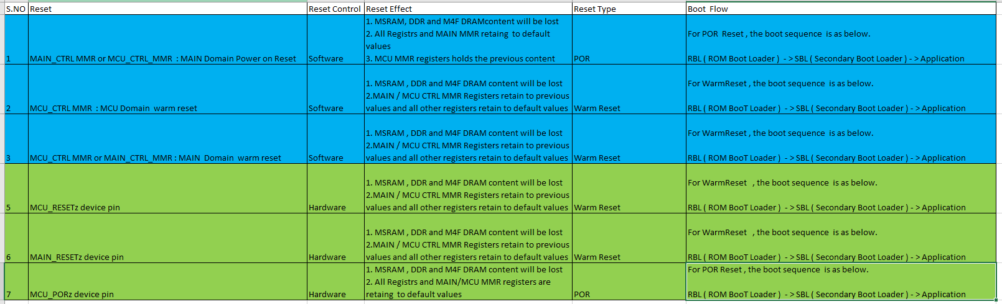
Reset Types and Their impact on boot sequences and memories

Slide 7
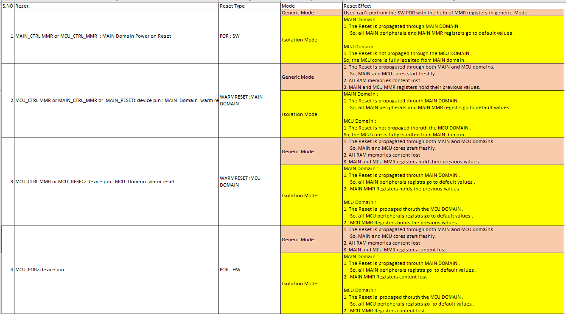
How different resets act in Isolation Vs Generic Mode?

Slide 8
How to debug when the SOC continuously Resets ?
If the SOC undergoes any reset , whether through software, hardware, the ESM, or the TIFS/DM core, then each reset status should be reflected in the RST status register. Therefore, we should first monitor the following register.
If this register shows zero and the MCU_PORz hardware output pin transitions from high to low, it indicates that the SOC has gone through a Power-On Reset (POR). For all other reset reasons, reason will be captured in the RST SRC register. Based on the reset reason, we need to investigate the source of the reset.
For example, if the device is continuously experiencing a Reset and the RST SRC register indicates that the device is going through a WarmReset due to the MAIN_WARMRESET pin. So, we should then monitor the status of the MAIN_WARMRESET pin. If this pin changes from high to low, it confirms that the SOC is resetting due to the MAIN_WARMRESET pin.

Slide 9
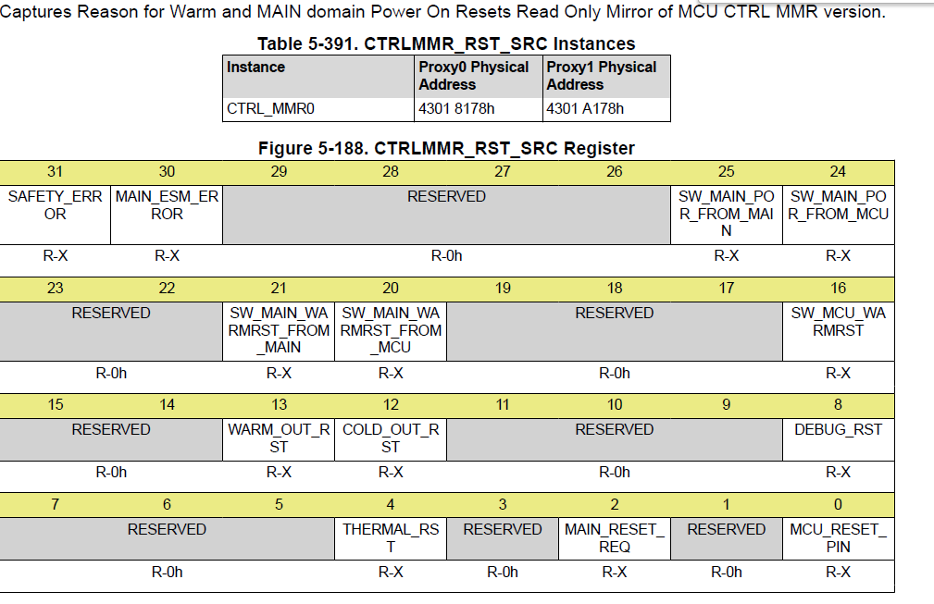
RST SRC Register details

