Slide 1
Direct Cache Structure

Slide 2
Direct Cache Structure
Assume cache line 256 bytes (8 bits), block size 256 (8 bits) and tag 16 bits
Address 81230000 index 0, tag 8123
Address 87650100 Index 1 tag 8765
Address 891a00bc Index 0 tag 891a – Overwrite (trash) the first value
(even though the cache is almost empty)

Slide 3
Two Ways Association
Assume cache line 256 bytes (8 bits), block size 256 (8 bits) and tag 16 bits
Address 81230000 index 0, tag 8123
Address 87650100 Index 1 tag 8765
Address 891a00bc Index 0 tag 891a – second block

Slide 4
FOUR Ways Association

Slide 5
Maximum Cache Sizes and More
Cache | Maximum Size | Line Size | Ways | Coherency | Memory Banks
L1p | 32K Bytes | 32Bytes | One | No hardware coherency | NA
L1D | 32K Bytes | 64Bytes | Two | Coherent with L2 | 8 banks, each 32 bit
L2 | 512K Bytes | 128Bytes | Four | User must maintain coherency with external world invalidate write-back write-back invalidate | 2 banks, 128 bit

Slide 6
Cache Optimization: L1 P
Avoid conflict misses by ensuring that parent/child functions don’t share cache lines

Slide 7
Cache Optimization: L1 D
Similar to L1P, avoid conflict misses by ensuring that functions with three pointers …
i.e., addVector (*p1_in, *p2_in, *P3_out)
… don’t step on each other.
Keep cache size in mind when designing your code:

Slide 8
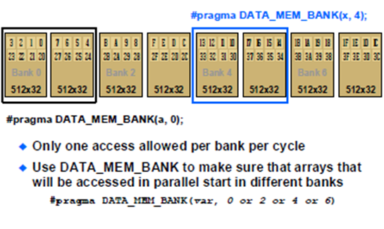
C66x L1 D Memory Banks

Slide 9
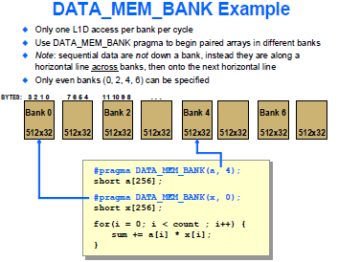
Two Loads Instruction in a Cycle

