Slide 1
AM3352 pixel clock question
Attached is a picture (06) of a measurement of the pixel clk coming from the AM3352 on a design I am working on. It is a very sinusoidal signal. I would have expected it to be a square wave. I do have a 33 ohm resistor in series, but I shorted it out in the 07 image. All that did was make it more sinusoidal. I am also concerned that the signal isn’t reaching either 0V or 3.3V.
Do either of you have any thoughts on this topic? Is there any sort of drive strength control on this chip?

Slide 2
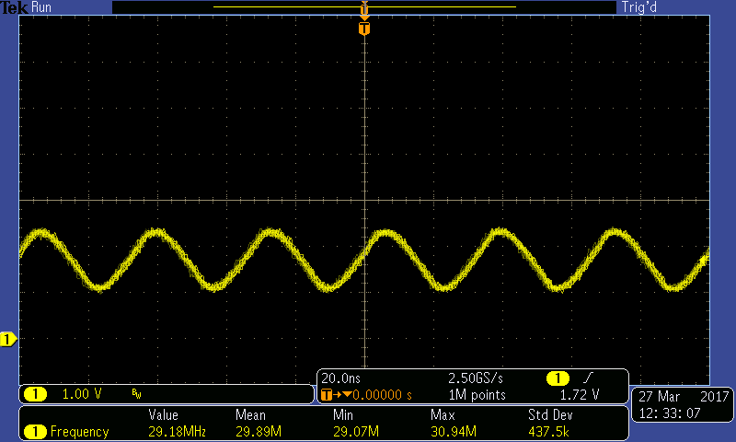
AM3352 pixel clock question
Picture #6, 33 ohm resistor in series

Slide 3
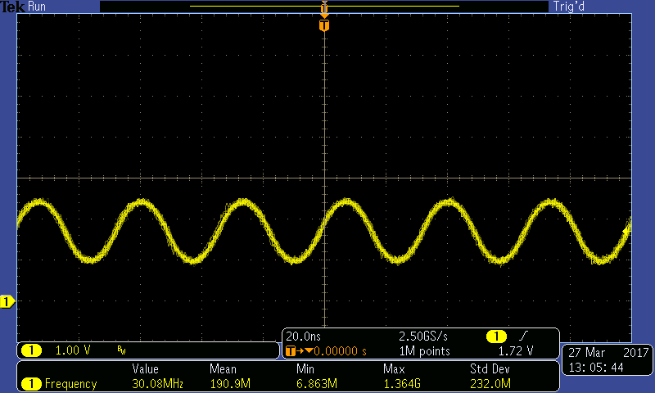
AM3352 pixel clock question
Picture #7, 33 ohm resistor shorted

