Slide 1

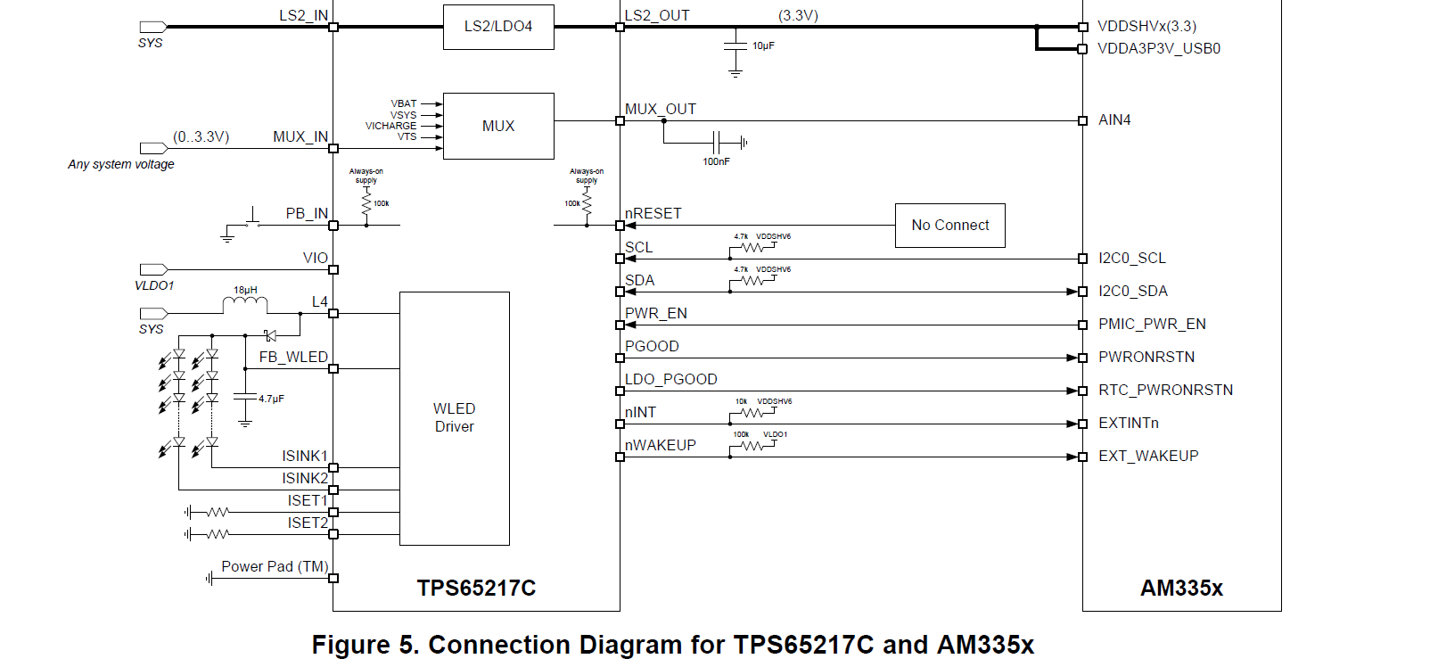
Page8
http://www.ti.com/lit/ug/slvu551i/slvu551i.pdf

Slide 2
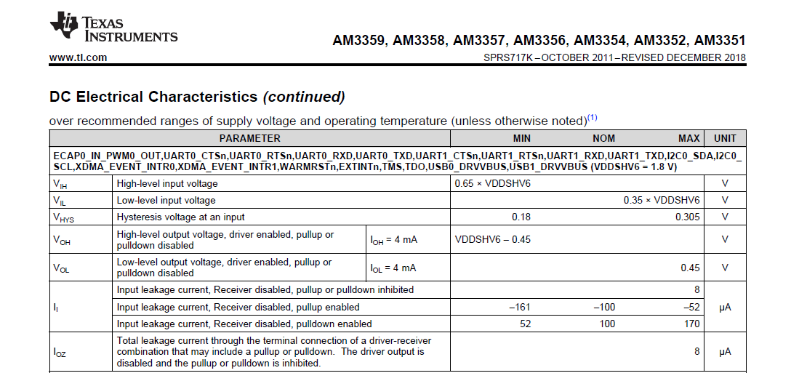

Slide 3

