Slide 1
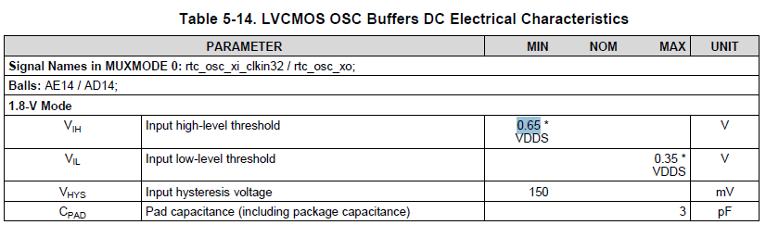
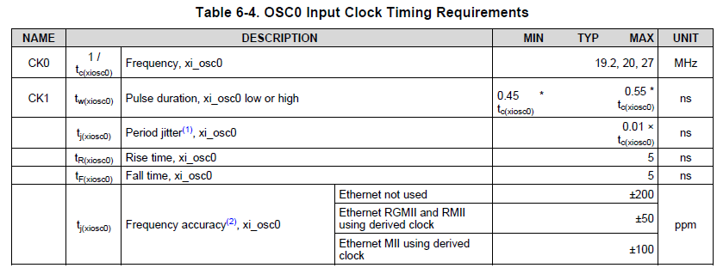
1.8V
90%
VIH 65%
VIL 35%
10%
0V
1.Rise Time = 5ns?
2.Rise Time = 5ns?
3.Rise Time = 5ns?
I want to know the detail of OSC rise/falling time written in datasheet.
It only mention the time. I want to know in which range the datasheet specified the rise/falling time 5ns.
Is it 1.[0%-100%], 2.[35%-65%], or 3.[10%-90%]?

