Slide 1
Scalability from AM62A to TDA4VEntry/AM67

Slide 2
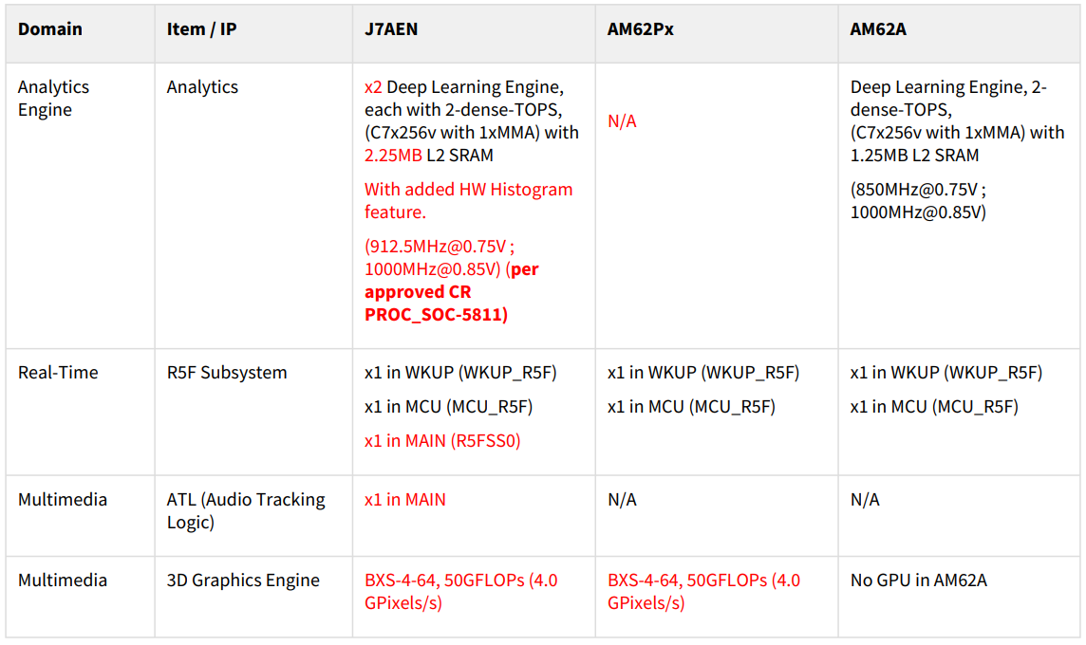
J7AEN IP Comparison with AM62P and AM62A – 1/3

Slide 3
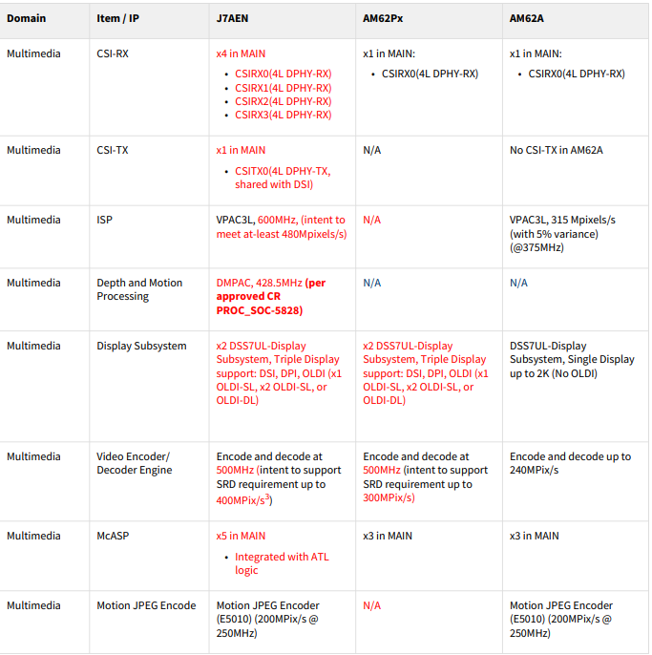
J7AEN IP Comparison with AM62P and AM62A – 2/3

Slide 4
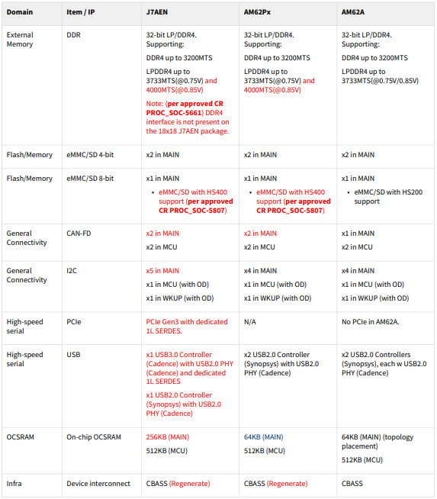
J7AEN IP Comparison with AM62P and AM62A – 3/3

Slide 5
AM62A | Software architecture (Linux + RTOS)
Security subsystem
MCU subsystem
Main Domain
HSM Vendor
Customer AUTOSAR Application
CV Algorithm Vendors
Customer HLOS Application
DMS Demo
DMS/OMS Algos
Customer
MCU Application
Application
Analytics + vision algo
3P Vendor
Customer Programming interface
AUTOSAR
Gstreamer
DL Runtime C APIs
TI SDK
OpenVX
OpenVX
OpenVX offload to VPAC
GST nodes for Storage, USB, Networking, MM camera, display
Analytics Runtime – TfLite, ONNx, TVM (TIDL acceleration)
AutoSar (BSW, RTE)
VPAC
IPC
Analytics + vision algo
OpenVX
OpenVX
Capture/
Display
TIDL
Networking
MCAL
IPC CDD
RM/PM services
Bootloader
IPC
IPC
Encode
openGLES
Foundational
security
HSM SHE Stack
AutoSar OS
FreeRTOS
Free RTOS
Linux
M4F
Core 0
M4F
Core 1
MCU R5F
Core
R5F
(DM) Core 0
C7x + MMA
Cortex-A53
Core 1
Cortex-A53
Core 1
Cortex-A53
Core 4

Slide 6
AM67/TDA4VEntry | Software Architecture (Linux + RTOS)
SDK Reuse: Security Subsystem
SDK Reuse: MCU Subsystem
Main SS
SMS
Customer SW
Analytics Processing
Analytics Processing
Applications
HSM Vendor
Customer AUTOSAR Application
Analytics, Viewing, Fusion Algorithms
MCU Application
Abstract SW/HW Layer
AUTOSAR
OpenVX
OpenVX
AutoSar (BSW, RTE)
ISP
OpenVX
OpenVX
OpenGL
DM
Capture Display
TIDL
TIDL
Storage / Networking
MCAL
IPC CDD
IPC
IPC
IPC
IPC
IPC
Foundational
security
HSM SHE Stack
AutoSar OS
Free RTOS
Free RTOS
Free RTOS
Free RTOS
HLOS
M4F
Core 0
M4F
Core 1
MCU R5F
Core
DM R5F0
Main R5F0 Core
C7x +MMA
256
C7x +MMA
256
A72
A53
3P Vendor
TI SDK
HLOS Vendor
Customer
SMP
Not supported on AM62A
New on TDA4VEntry
6

