Slide 1
Linux timer issue

Slide 2
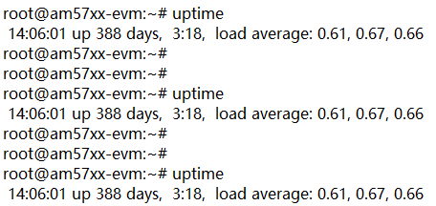
SDK version:
ti-processor-sdk-linux-rt-am57xx-evm-02.00.02.11
The device will no response after runing 388day 3 hours and 18 minutes.
And use ssh can access the device, use uptime like below:

Slide 3
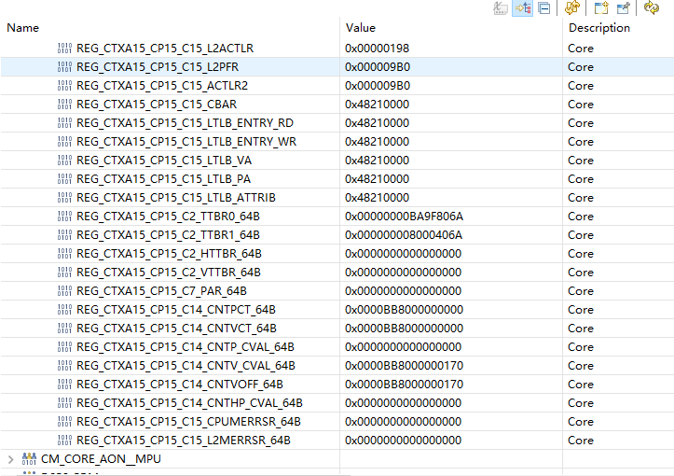
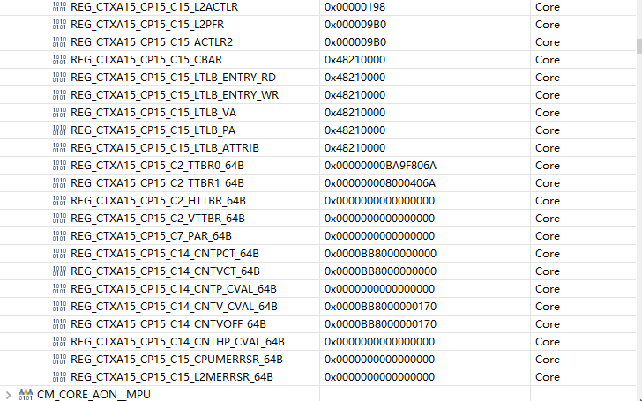
Deep analysis:
Am5726 system counter is 48bit and will not update after full.
We have use jtag tool to read the register twice, the second one read 1 minutes after first one. REG_CTXA15_CP15_C14_CNTVCT_64B always 0xBB8000000000.

Slide 4
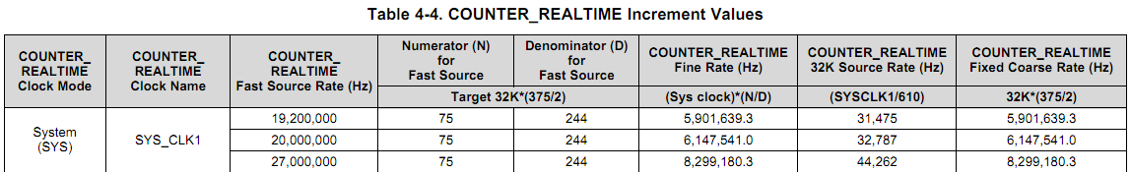
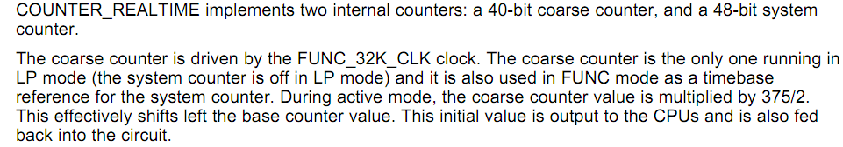
Check am5726 datasheet , when extern crystal is 20MHZ the system counter frequency is 6147541HZ . So we convert 0xBB8000000000 the timer is 33535104s(388 days 3 hours and 18.72 minutes).
The SOC have 2 independent timer counter:
40Bit coarse counter, frequency 32KHZ, full time the 388.138days.
48Bit system counter, frequency 6.14MHZ, full timer 527.7days.
When coarse counter full and turn to 0, the system counter always no change, this cause the issue.

