Slide 1
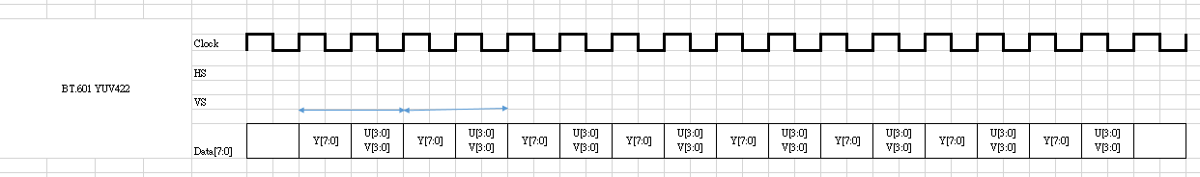
Current
TDA2
DS913
BT656- YUV422 8bit
BT656- YUV422 8bit
CPLD
BT601- YUV422 8bit
Pixcel clock *2

Slide 2
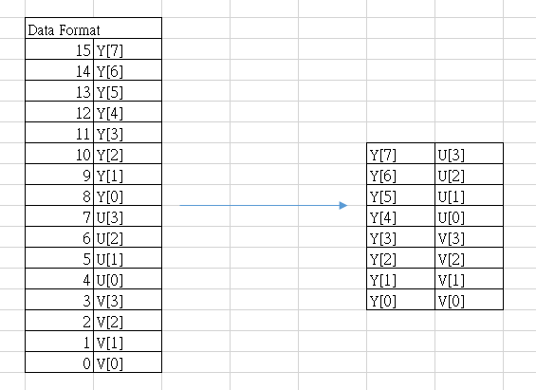
Test Scenario (Without CPLD, output BT.601 YUV directly)
TDA2x
BT656 - YUV422 8bit
Capture
Display
YUV422 16bit
SYSTEM_DF_RAW16 or SYSTEM_DF_YUV422P or SYSTEM_DF_YUV422
16bit down to 8bit and bypass colors pace transfer

Slide 3
Pixcel clock must be 2
We use VOUT3
➔
DISPC_VP3_CONTROL.TDMENABLE = 0x1 // TDM enabled
DISPC_VP3_CONTROL. TDMPARALLELMODE = 0x0 //8-bit parallel output interface selected
DISPC_VP3_CONTROL. TDMCYCLEFORMAT = 0x1 //2 cycles for 1 pixel
DISPC_DATA3_CYCLE1 = 0x8 //8 bit for 1st cycle
DISPC_DATA3_CYCLE2 = 0x8 //8 bit for 2nd cycle
DISPC_DATA3_CYCLE3 = 0x0 //8 bit for 3rd cycle
DISPC_VID3_ATTRIBUTES.FORMAT = 0x6
DISPC_VID3_ATTRIBUTES.RESIZEENABLE = 0x0 //Disable both horizontal and vertical resize
processing
DISPC_VID3_SIZE.SIZEX == DISPC_VID3_PICTURE_SIZE.MEMSIZEX
DISPC_VID3_SIZE.SIZEY == DISPC_VID3_PICTURE_SIZE.MEMSIZEY
DISPC_CONFIG3.TCKLCDENABLE = 0 //Disable the transparency color key for the LCD
DISPC_CONFIG3.CPR = 0 //Color Phase Rotation Disabled

