Slide 1
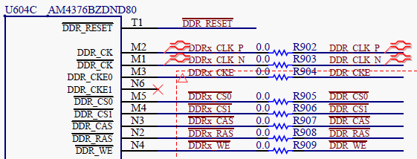
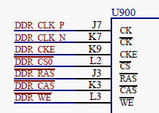
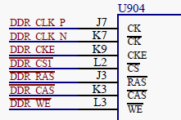
DRAM Chip Select schematic clips
2x DRAM ICs
MT41K256M16TW-107 XIT:P

