Slide 1
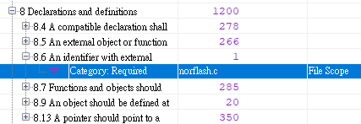
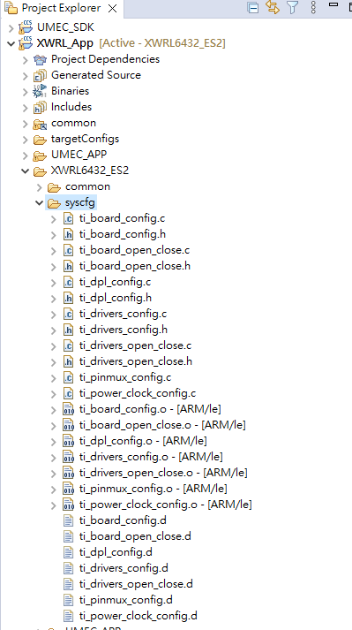
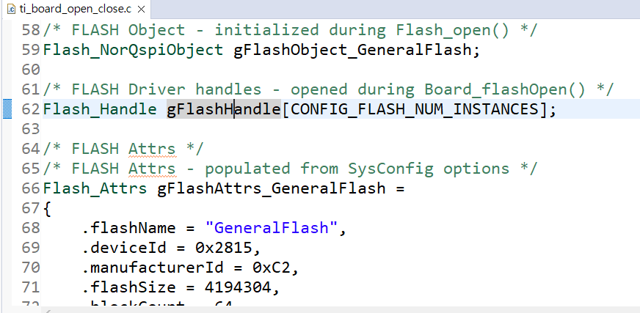
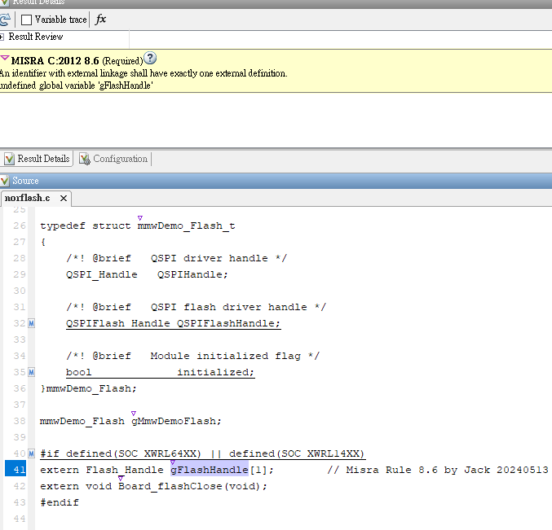
MISRA C 2012 Problem
This folder is automatically generated during compilation.
This folder will be automatically deleted and created during compilation.
Can this problem be solved?
This is the message of MISRA Rule 8.6.
Questions are as follows:
MISRA Rule 8.6 tells me that the global variable “gFlashHandle” is undefined.
This variable is defined in “ti_board_open_close.c”.
This folder will be automatically deleted and created during compilation.
Even if we modify the content of “ti_board_open_close.c”, once the compilation is executed. It will be set to the system settings, so MISRA Rule 8.6 cannot be solved.
This variable is defined in “ti_board_open_close.c”.
Can this problem be solved?
2024/5/21

