Slide 1
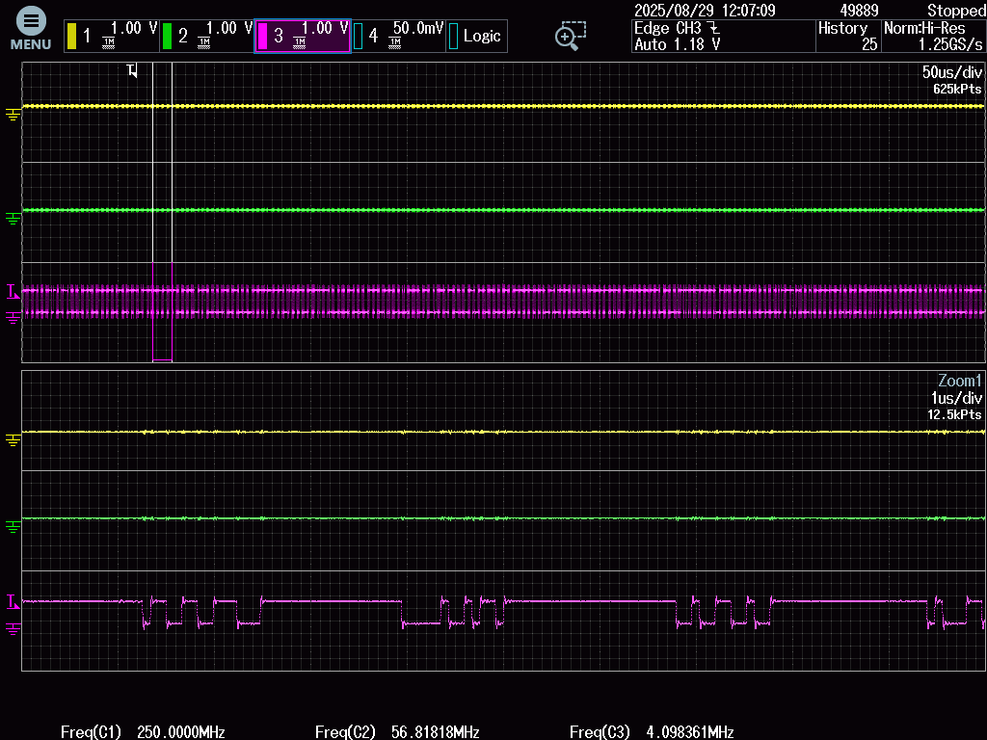
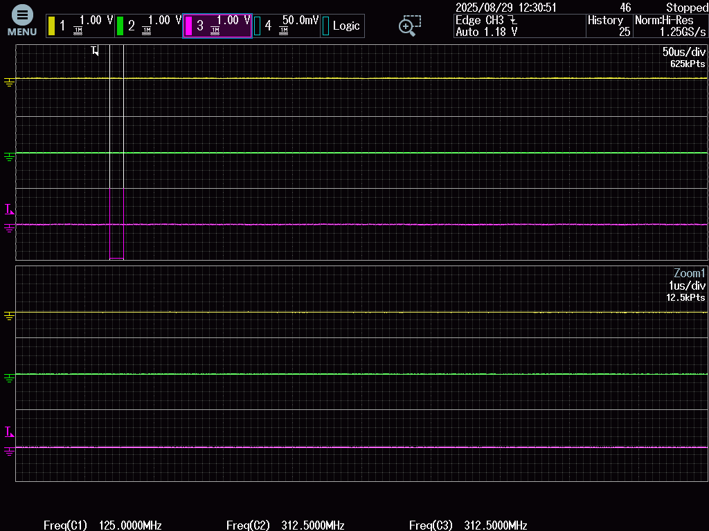
AM275-AWE-SDK_11.01.16.06
Multi-Zone Audio without AVB
AM275-AWE-SDK_11.01.16.06
Multi-Zone Audio with AVB
Bottom half is a zoom view.
Bottom half is a zoom view.
MCASP0_ACLKX/N19
MCASP0_ACLKX/N19
MCASP0_AFSX/M19
MCASP0_AFSX/M19
MCASP0_AXR0/N17
MCASP0_AXR0/N17

