Slide 1
Summary Description
・Summary Description
As a customer's product specification, it is necessary to send 320KB to PC in 25msec cycle by TCP/IP communication.
When we conducted a test in the following environment, it took 37.5msec to send the data, which does not meet our specifications.
As a result of capturing the communication data with wireshark and checking it, we have three questions.
Please answer our questions.
・Test Environment
EVM:TMDSEVM572X(https://www.tij.co.jp/tool/jp/TMDSEVM572X)
EVM Software:
This is a customized versionbased on NIMU_FtpExample_idkAM574x_armExampleproject().
Major changes:
1: Program to send 64kBx5 (=320kB) when accessed from PC
{
bytes = send(ioh->socket, (void*)0x90000000, 8192*8, 0);
bytes = send(ioh->socket, (void*)0x90000000, 8192*8, 0);
bytes = send(ioh->socket, (void*)0x90000000, 8192*8, 0);
bytes = send(ioh->socket, (void*)0x90000000, 8192*8, 0);
bytes = send(ioh->socket, (void*)0x90000000, 8192*8, 0);
}
0x9000 0000-0x9001 0000 (Stores values between 0 and 1)
2:Change Send Buffer from 16384 to 65536 （ Set by cfg file ）
nimu_idk.cfg Tcp.transmitBufSize=65536
Software on PC : Original software created in C#
Connection form: TMDSEVM572X <-> PC (direct connection)

Slide 2
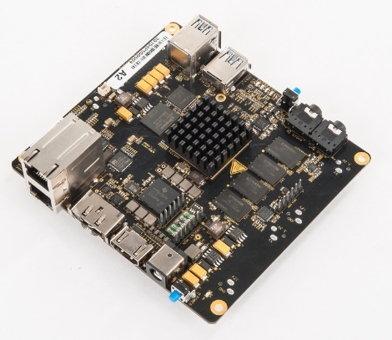
Summary Description
・Test Environment
IP:192.168.2.4
PC windows10
Giga ethernet
IP:192.168.2.2
Captured by Wireshark
Access
320kB
bios:bios_6_76_03_01
sdk:processor_sdk_rtos_am57xx_6_03_00_106
ndk:ndk_3_61_01_01
pdk:pdk_am57xx_1_0_17

Slide 3
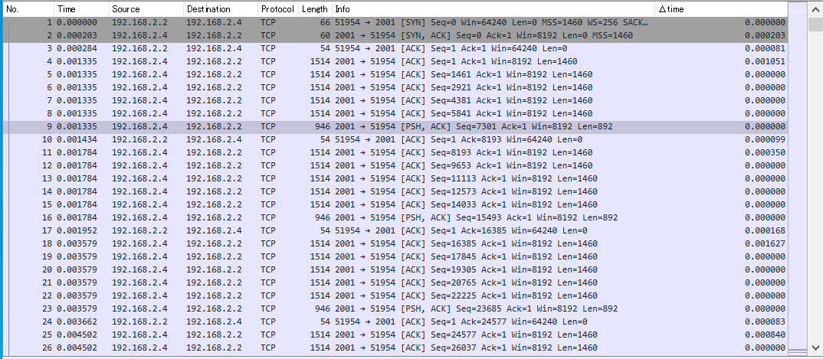
Wireshark
・ TMDSEVM572X:192.168.2.4 PC:192.168.2.2
PC WindowSize:64240
Differential Time
Len=Total 8192
0.35ms
1.62ms
0.84ms

Slide 4
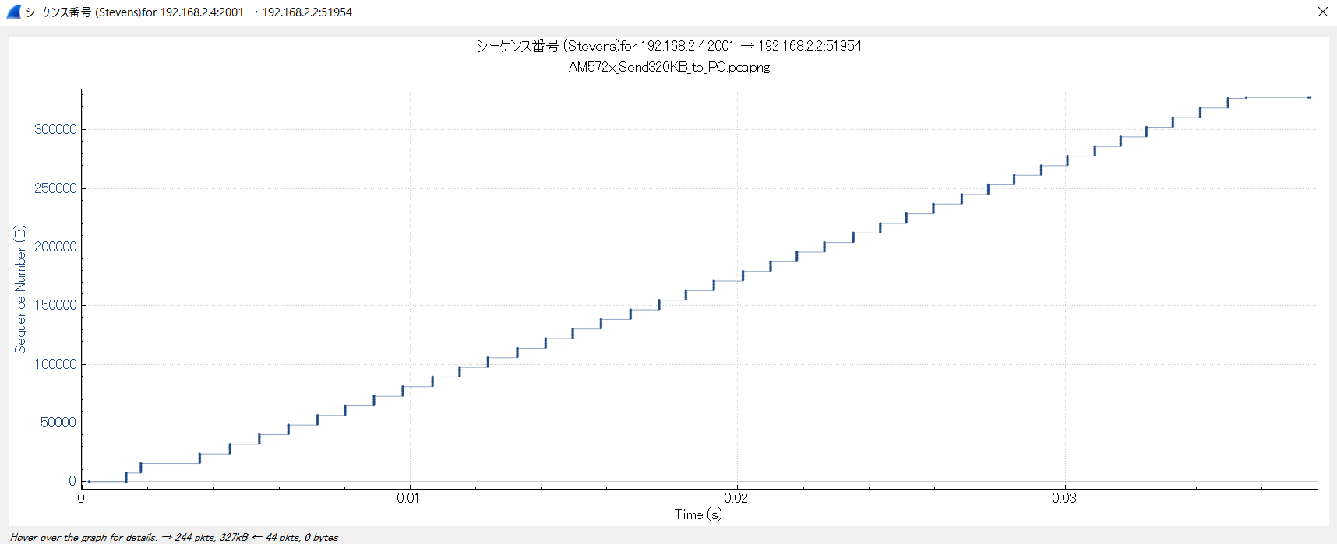
Wireshark
Sending data: 8k
3way handshake
37.5msec
Fin

Slide 5
Wireshark
・ Communication
TMDSEVM572X :
192.168.2.４
PC :
192.168.2.2
WindowSize:64240
[ACK] len=1460
Questions
1: Why is the window size of the PC side 64240?
Why does it send the data in units of 8192 bytes with PSH=1?
Can you make it every 16384?
For example, is it possible to make it every 16384 bytes?
After receiving the ACK signal from the PC, the time until the next data transmission
starts is very long (about 1.0msec on average).
2: What is the purpose of this time?
3: Is it possible to change this time to a shorter time (e.g., half) or to a fixed time?
We believe that if this time is not shortened, we will not be able to meet the specifications.
If there is another way, please let me know.
[ACK] len=1460
[ACK] len=1460
[ACK] len=1460
[ACK] len=1460
[PSH ACK] len=892 Total Len=8192
[ACK]
0.08～0.01msec
PC side is sending an ACK signal because it is being sent with PSH=1 (guess).
0.3 to 1.6 msec
(Average of about 1.0 msec)
[ACK] len=1460
[ACK] len=1460
[ACK] len=1460
[ACK] len=1460
[ACK] len=1460
[PSH ACK] len=892

