Slide 1
TI DSP
Basic Optimization
FAE Summit 2015
Ran Katzur
EP Application Team

Slide 2
Agenda
C6000 VLIW architecture
Pipeline
Software pipeline optimization
Estimate performances
Using CCS to optimize code
Software pipeline issues
Lab - Optimize FIR filter

Slide 3
C6000 DSP Core Architecture
Memory
A0
.D1
.D2
B0
VLIW (Very Large Instruction Word) architecture:
Two (almost independent) sides, A and B
8 functional units: M, L, S, D
Up to 8 instructions sustained dispatch rate
.S1
.S2
MACs
.M1
.M2
. .
.L1
.L2
. .
A31
B31
Controller/Decoder

Slide 4
C6000 Cross-Path
Register File A
Register File B
A0
B0
A1
B1
A2
B2
A3
B3
A4
B4
. . .
. . .
A
B
.D1
.D1
A31
.S1
.S1
B31
.M1
.M1
.L1
.L1

Slide 5


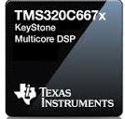
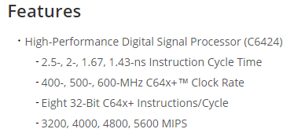
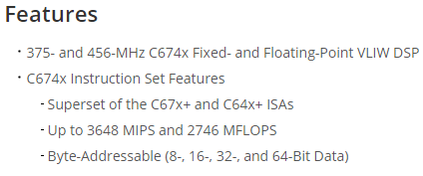
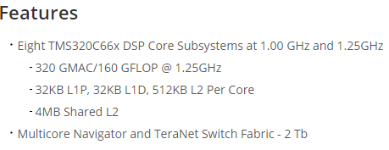
Some C6000 Family Members
TMS320C6424
TMS320C6748
TMS320C6678

Slide 6
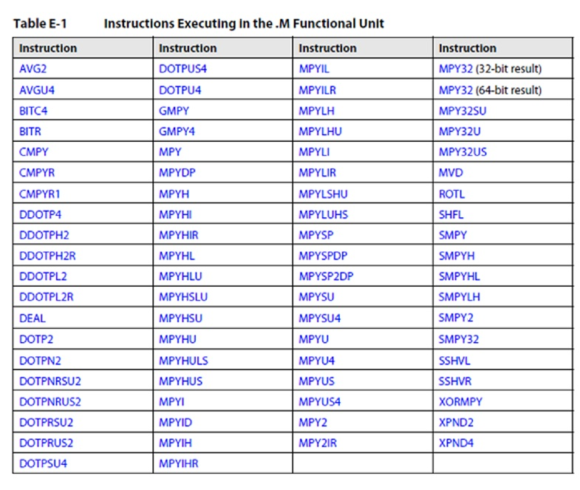
Partial List of .M Instructions

Slide 7
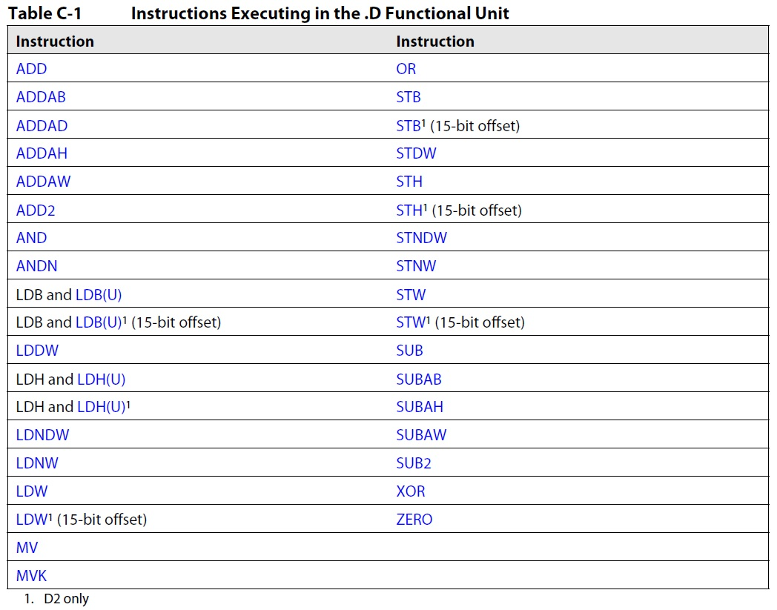
Partial List of .D Instructions

Slide 8
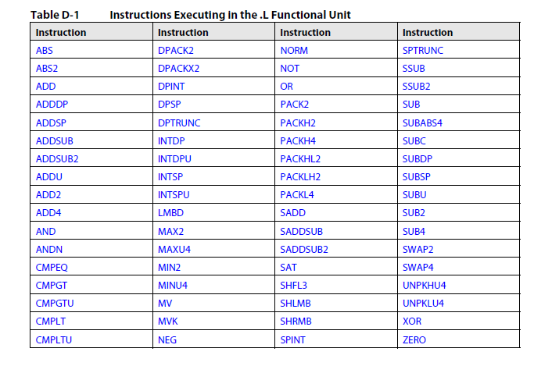
Partial List of .L Instructions

Slide 9
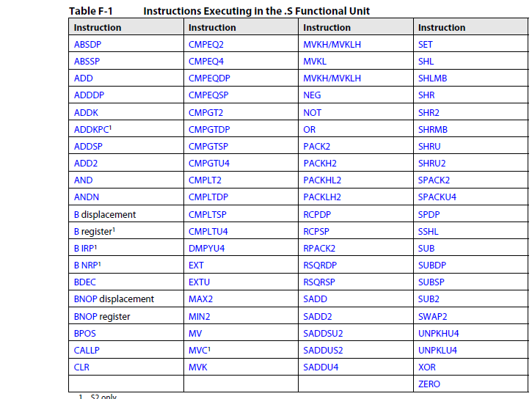
Partial List of .S Instructions

Slide 10
Agenda
C6000 VLIW architecture
Pipeline
Software pipeline optimization
Estimate performances
Using CCS to optimize code
Software pipeline issues
Lab - Optimize FIR filter

Slide 11
Non-Pipelined vs. Pipelined CPU
Clock Cycles
CPU Type
1 2 3 4 5 6 7 8 9
Non-Pipelined
F₁ D₁ E₁
F₂ D₂ E₂
F₃ D₃ E₃
Pipelined
F₁ D₁ E₁
F₂ D₂ E₂
F₃ D₃ E₃
Stage | Pipeline Function
F Fetch | Generate program fetch address Read opcode
D Decode | Route opcode to functional units Decode instructions
E Execute | Execute instructions
Pipeline full
Now look at the C66x pipeline.

Slide 12
Program Fetch Phases
Phase | Description
PG | Generate fetch address
PS | Send address to memory
PW | Wait for data ready
PR | Read opcode
C66x Core
Functional
Units
PR
Memory
PG
PS
PW

Slide 13
Pipeline Phases: Review
Program Fetch
Decode
Execute
PG PS PW PR D E
PG PS PW PR D E
PG PS PW PR D E
PG PS PW PR D E
PG PS PW PR D E
PG PS PW PR D E
Single-cycle performance is not affected by adding three program fetch phases.
That is, there is still an execute every cycle.
How about decode? Is it only one cycle?

Slide 14
Decode Phases
Decode Phase | Description
DP | Intelligently routes instruction to functional unit (dispatch)
DC | Instruction decoded at functional unit (decode)
C66x Core
Functional
Units
PR
DP
DC
Memory
PG
PS
PW

Slide 15
Pipeline Phases
Program Fetch
Decode
Execute
PG PS PW PR DP DC E1
PG PS PW PR DP DC E1
PG PS PW PR DP DC E1
PG PS PW PR DP DC E1
PG PS PW PR DP DC E1
PG PS PW PR DP DC E1
PG PS PW PR DP DC E1
Pipeline Full
How many cycles does it take to execute an instruction?
Notes:
Should the EXECUTEs be sequential here? E1, E2. E3, etc.

Slide 16
Instruction Delays
All C66x instructions require only one cycle to execute, but some results are delayed.
Description | Instruction Example | Delay
Single Cycle | All instructions except | 0
Integer multiplication and new floating point | MPY, FMPYSP | 1
Legacy floating point multiplication | MPYSP | 2
Load | LDW | 4
Branch | B | 5

Slide 17
Agenda
C6000 VLIW architecture
Pipeline
Software pipeline optimization
Estimate performances
Using CCS to optimize code
Software pipeline issues
Lab - Optimize FIR filter

Slide 18
Software Pipeline Example
Void example(float *in, float*out, int N, float V)
{
sum = 1.0 ;
for (i=0; i<N; i++)
{
x = *in++ * V ;
sum = sum + x ;
*out++ = sum ;
}
}
How many cycles would it take to perform the loop five times?

Slide 19
Non Pipeline example
Implementation of the loop in the following code:
Void example(float *in, float*out, int N, float V)
{
sum = 1.0 ;
for (i=0; i<N; i++)
{
x = *in++ * V ;
sum = sum + x ;
*out++ = sum ;
}
}
Notes:
Indicate here how many cycles this code processing will require (40 cycles)

Slide 20
Software Pipeline example
Implementation of the loop in the following code:
Void example(float *in, float*out, int N, float V)
{
sum = 1.0 ;
for (i=0; i<N; i++)
{
x = *in++ * V ;
sum = sum + x ;
*out++ = sum ;
}
}
The compiler knows all the delays and is smart enough to build the correct software pipeline

Slide 21
Software Pipeline Support
The compiler is smart enough to schedule instructions efficiently.
Software pipeline is the major speed-up mechanism for VLIW architecture.
Software pipeline requires deterministic execution:
Not if, branch, and call
No interrupts
No dependencies

Slide 22
Software Pipeline example Interrupt
Implementation of the loop in the following code:
Void example(float *in, float*out, int N, float V)
{
sum = 1.0 ;
for (i=0; i<N; i++)
{
x = *in++ * V ;
sum = sum + x ;
*out++ = sum ;
}
}

Slide 23
Software Pipeline example - SPLOOP
Implementation of the loop in the following code:
Void example(float *in, float*out, int N, float V)
{
sum = 1.0 ;
for (i=0; i<N; i++)
{
x = *in++ * V ;
sum = sum + x ;
*out++ = sum ;
}
}

Slide 24
SPLOOP: Advantages & Limitations
SPLOOP Advantages:
Enables interrupts during software pipeline
Saves memory
Saves power
Implicit loop counter - saves a unit
Nested loops are supported
Scheduled by the compiler
SPLOOP Limitations
Limits number of executable packets (14)
Limits on the usage and location of some instructions (see the documentations)
NOTE: The compiler is not always smart enough to schedule SPLOOP, especially if the minimum number of iterations is not known (to the compiler).

Slide 25
Code Development
Code Generation Tools can build executables from different code types:
Generic C or C++ code
C with intrinsic
Linear Assembly
Assembly (DETAI)
Optimization is performed:
In the front end
Using the intrinsic
Resource allocation and software pipeline search in optimized linear assembly
To understand the quality of the optimization of a loop, compare the theoretical iteration interval (II: The actual number of cycles between two results of the loop) to the result of the assembler/optimizer.
Was the software pipeline successful (if not, why)?
Is the usage balanced between the two sides (if not, can it be improved)?
What are the bottlenecks and how to mitigate them?
To keep the assembly file, set the –k option

Slide 26
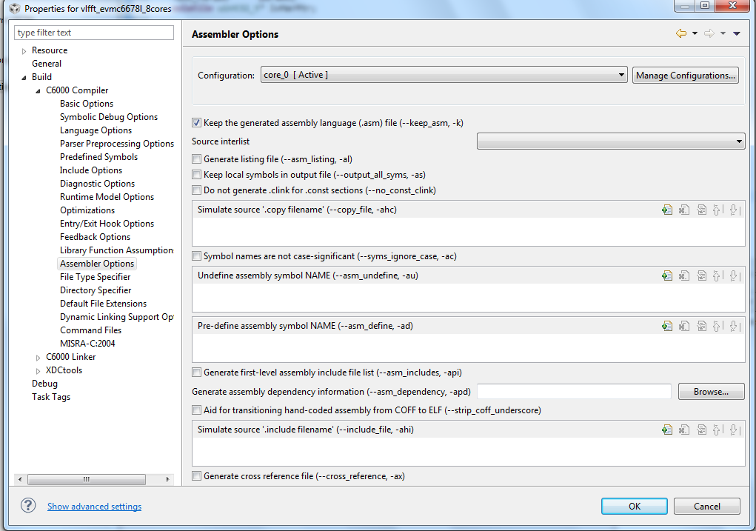
Keep Generated Assembly file

Slide 27
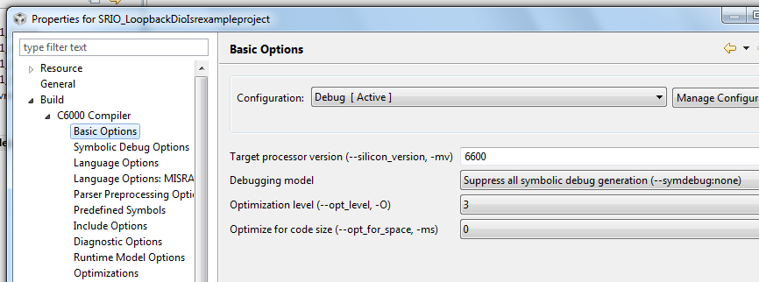
Build Options – Optimization and Debug

Slide 28
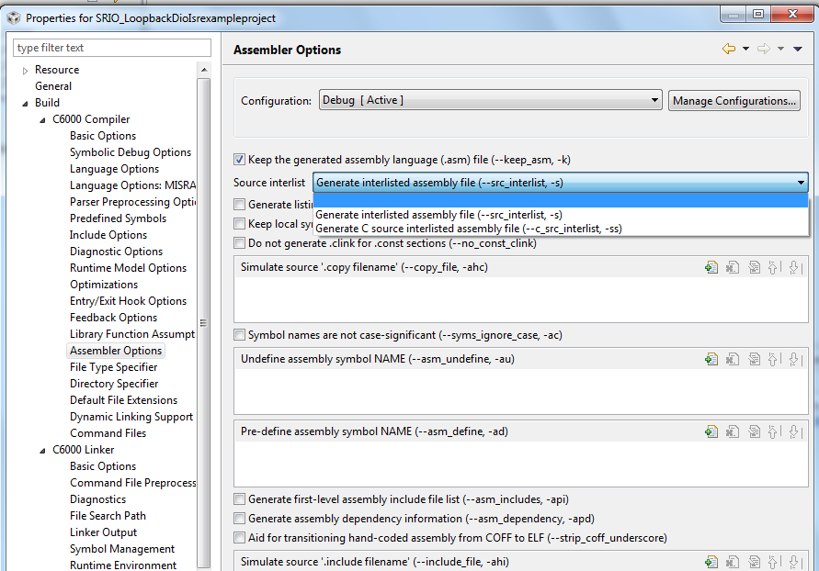
-S and -MW Setting

Slide 29
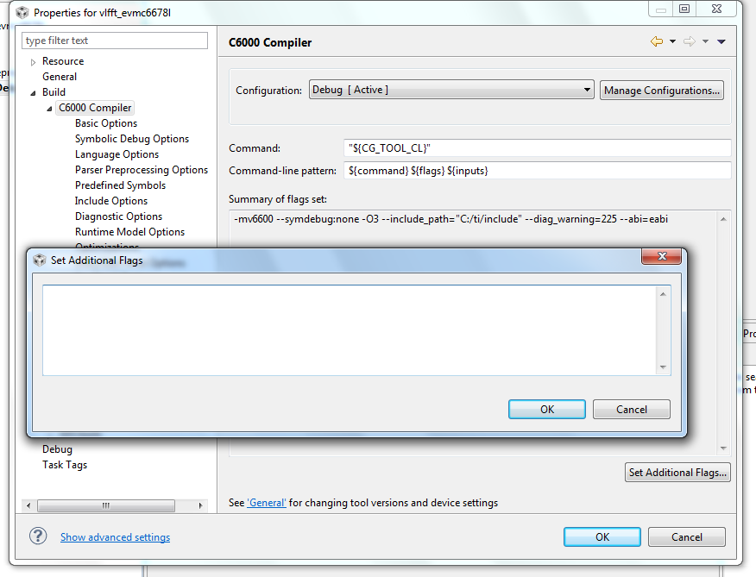
And if You Don’t Find the GUI?

Slide 30
Dependencies –
What if out = in + 1?
In that case the code cannot start loading the next input before the previous output is ready
Unless the compiler knows otherwise, the compiler assumes dependencies
Implementation of the loop in the following code:
Void example(float *in, float*out, int N, float V)
{
sum = 1.0 ;
for (i=0; i<N; i++)
{
x = *in++ * V ;
sum = sum + x ;
*out++ = sum ;
}
}

Slide 31
Dependencies
The compiler knows that there is no dependencies in the following cases:
It can understand it from the code (the calling function is in the same file as the routine)
The code use the restrict keyword
Using compiler switch that tells the compiler that there is no overlay between vector pointers (-mt)

Slide 32
IF and Conditional execution
All assembly instructions are conditional instructions
In conditional instruction the functional unit executes the instruction but the result is written to the output register ONLY if the condition is true
The condition should be known ONLY the cycle before the result is written to the output register
Condition execution can replace if statements as follows:
if (x < 1000.0) sum = sum + x --> [x <1000.0] sum=sum+x
The compiler is smart enough to convert “simple” if statements into conditional execution
The result of x < 1000.0 should known just one cycle before the last step of execution

Slide 33
Function Calls
Void example(float *in, float*out, int N, float V)
{
sum = 1.0 ;
for (i=0; i<N; i++)
{
x = *in++ * V ;
sum = sum + f(x) ;
*out++ = sum ;
}
}
function call prevents the compiler from generating software pipeline
Inline the function removes this limitation
The compiler does not inline function (unless it is told to), it is up to the user

Slide 34
Software Pipeline Example
void copyFunction(int *p1, int *p2, int N)
{
int i ;
for (i=0; i<N;i++)
{
*p2++ = *p1++ ;
}
return ;
}

Slide 35
Software Pipeline Example - reminder
;*----------------------------------------------------------------------------*
;* SOFTWARE PIPELINE INFORMATION
;*
;* Loop found in file : ../utility.c
;* Loop source line : 12
;* Loop opening brace source line : 13
;* Loop closing brace source line : 15
;* Known Minimum Trip Count : 1
;* Known Max Trip Count Factor : 1
;* Loop Carried Dependency Bound(^) : 6
;* Unpartitioned Resource Bound : 1
;* Partitioned Resource Bound(*) : 2
;* Resource Partition:
;* A-side B-side
;* .L units 0 0
;* .S units 0 0
;* .D units 0 2*
;* .M units 0 0
;* .X cross paths 0 0
;* .T address paths 0 2*
;* Long read paths 0 0
;* Long write paths 0 0
;* Logical ops (.LS) 0 0 (.L or .S unit)
;* Addition ops (.LSD) 0 0 (.L or .S or .D unit)
;* Bound(.L .S .LS) 0 0
;* Bound(.L .S .D .LS .LSD) 0 1
;*
;* Searching for software pipeline schedule at ...
;* ii = 6 Schedule found with 2 iterations in parallel
;* Done
;*
;* Loop will be splooped

Slide 36
Restrict Qualifiers
Loop iterations cannot be overlapped unless input and output are independent (do not reference the same memory locations).
Most users write their loops so that loads and stores do not overlap.
Compiler does not know this unless the compiler sees all callers or user tells compiler.
Use restrict qualifiers to notify compiler.
Restrict tells the compiler that any location addressed by the following pointer WILL NOT be accessed by any other vector.
void copyFunction(int *restrict p1, int *p2, int N)
{
int i ;
for (i=0; i<N;i++)
{
*p2++ = *p1++ ;
}
return ;
}

Slide 37
;*----------------------------------------------------------------------------*
;* SOFTWARE PIPELINE INFORMATION
;*
;* Loop found in file : ../utility.c
;* Loop source line : 12
;* Loop opening brace source line : 13
;* Loop closing brace source line : 15
;* Known Minimum Trip Count : 1
;* Known Max Trip Count Factor : 1
;* Loop Carried Dependency Bound(^) : 0
;* Unpartitioned Resource Bound : 1
;* Partitioned Resource Bound(*) : 1
;* Resource Partition:
;* A-side B-side
;* .L units 0 0
;* .S units 0 0
;* .D units 1* 1*
;* .M units 0 0
;* .X cross paths 0 1*
;* .T address paths 1* 1*
;* Long read paths 0 0
;* Long write paths 0 0
;* Logical ops (.LS) 0 0 (.L or .S unit)
;* Addition ops (.LSD) 0 1 (.L or .S or .D unit)
;* Bound(.L .S .LS) 0 0
;* Bound(.L .S .D .LS .LSD) 1* 1*
;*
;* Searching for software pipeline schedule at ...
;* ii = 1 Schedule found with 7 iterations in parallel
;* Done
;*
;* Loop will be splooped

Slide 38
Agenda
C6000 VLIW architecture
Pipeline
Software pipeline optimization
Estimate performances
Using CCS to optimize code
Software pipeline issues
Lab - Optimize FIR filter

Slide 39
DSP Lab Instructions

