Slide 1
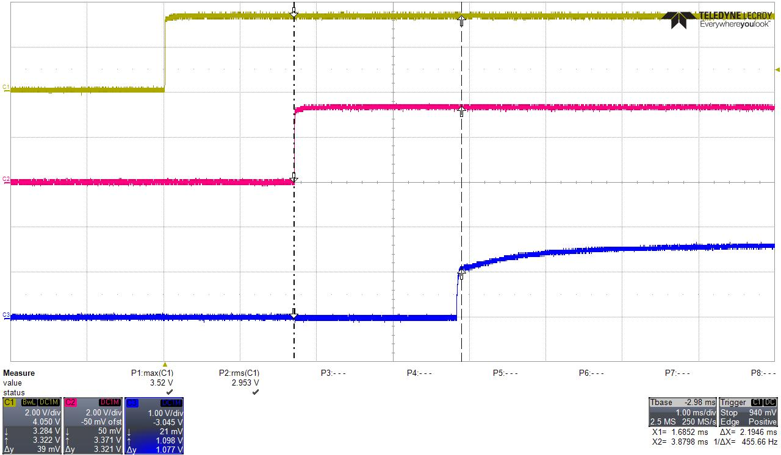
RESETn(TDA2 IN)
PORz(TDA2 IN)
RSTOUTN(TDA2 OUT)
If RESETn is released before PORz, RSTOUTn outputs 2ms after PORz.

Slide 2
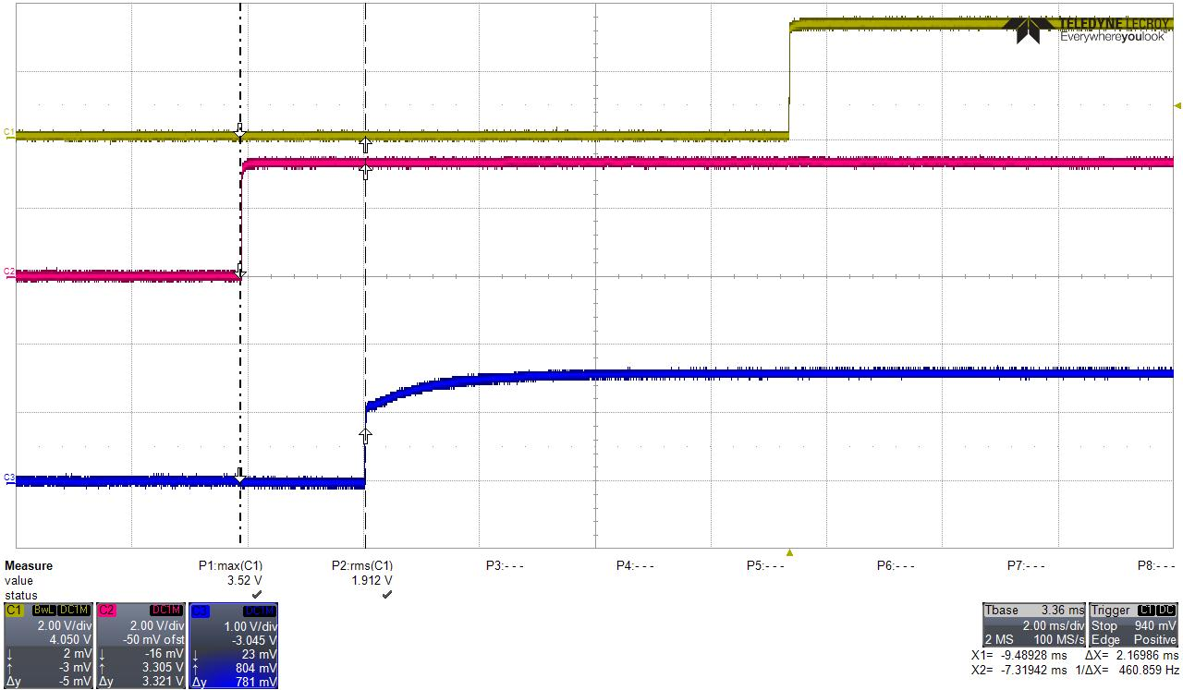
RESETn(TDA2 IN)
PORz(TDA2 IN)
RSTOUTN(TDA2 OUT)
If RESETn is released after PORz, RSTOUTn outputs 2ms after PORz not RSTOUTn.

Slide 3
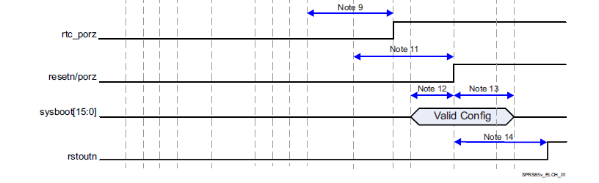

Question: According to the power up sequence in TDA2 data manual, RESETn to RSTOUTn delay is 2ms. But based on observation, RSTOUTn comes after PORz not RESETn.
Please make clear which one between RESETn and PORz will make RSTOUTn release during power-up.

