Slide 1
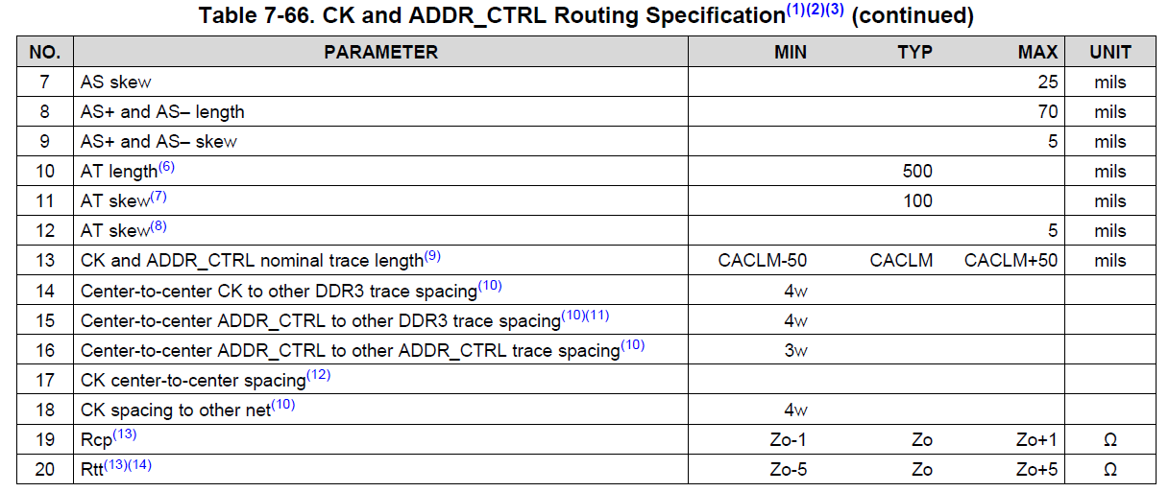
CK
Other DDR3
Does that mean a minimum of 4w from the center of the CK line to the center of the Other DDR3 line?
4w

