Slide 1
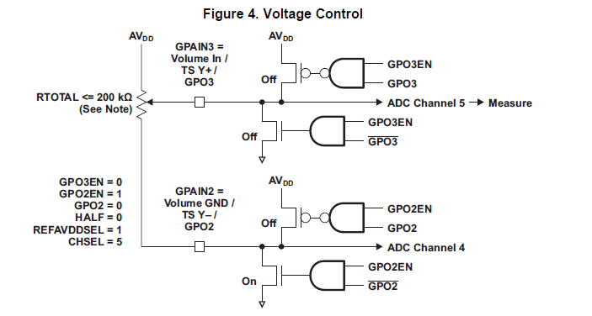
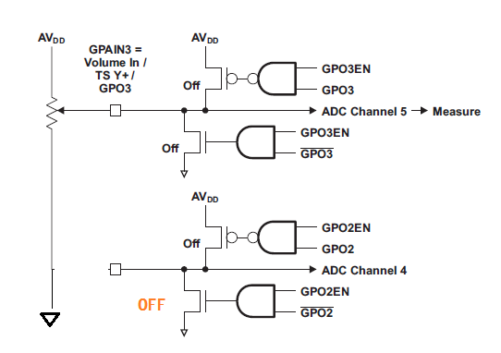
Case1 ( follow page 13 fig4)
ADC’s Vref+ : VDD_ANA
use external LDO as NOTE on Page13
If Vref was 1.024V,
and input on GPAIN3 was 1.024V,
ADC output is 1111111111b
More primitive way
Case2 ( just use one port: GPAIN3 only )
ADC’s Vref+ : VDD_ANA
use external LDO as NOTE on Page13
If Vref was 1.024V,
and input on GPAIN3 was 1.024V,
ADC output is also 1111111111b same
as case1 , isn’t it?
So, what is advantage to use Fig4 scheme (Case1)?

