Slide 1
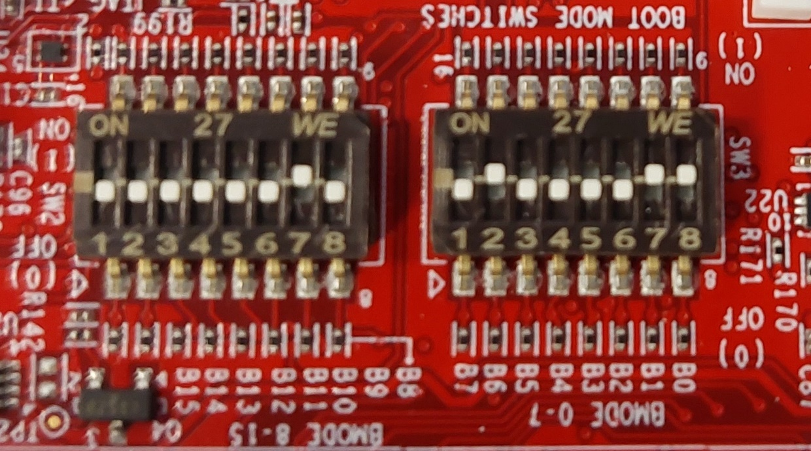
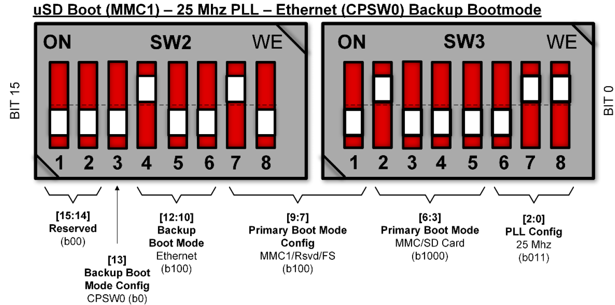
Why are these 2 “SD BOOT MODE” not identical??
Answer: in the user guide, the backup bootmode is set to Ethernet on SW2.4
SK-AM64B EVM BOOTMODE SWITCH SETTINGS (out of the box) SD BOOT MODE
SPRUIY9b page 10 top half of figure 4-4

Slide 2
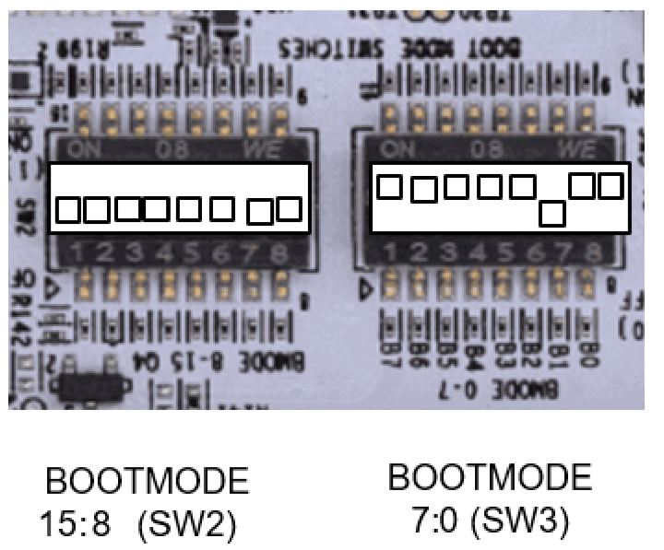
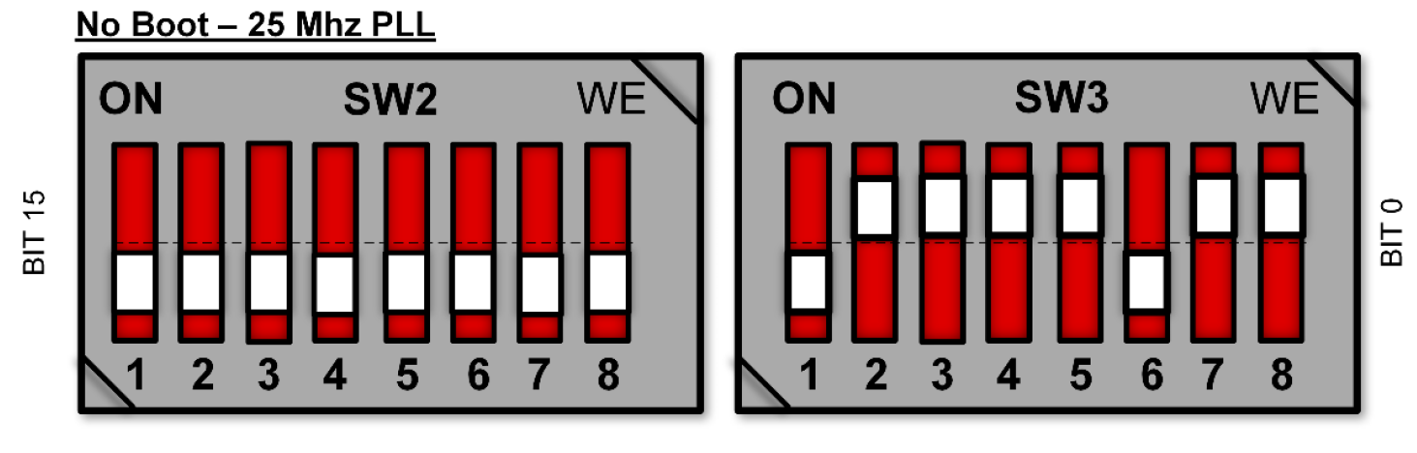
Why are these 2 “NO BOOT MODE” not identical??
Note the SW3.1 setting difference
AM64X MCU+ SDK 09.01.00 >GettingStarted>EVM Setup> Additional Details>SOC Initialization>SOC Initialization Using CCS Scripting>Run the SOC Initialization Script>AM64X-SK NO BOOT MODE
SPRUIY9b page 10 bottom half of figure 4-4

