Slide 1
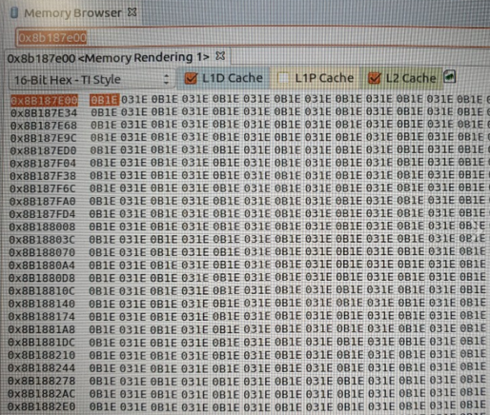

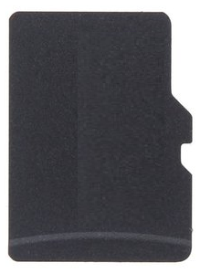
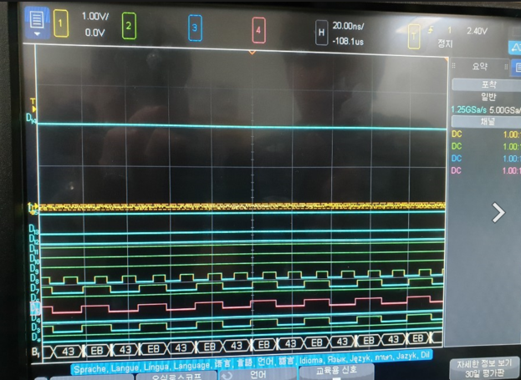

Block Diagram
3.3V
PMIC
SPI
1.35/0.75V
UART RX
RS-232
SN65C3221
EMIF1
32bit
DDR3L
MT41K256M16HA
2EA
TDA2HV
VISION SUPERSET
UART TX
UART TX
0x0B03
3.3V
3.3V
UART RX
CAM
Enable
VIP
GPMC
QSPI
QSPI
S25FL256SAGM
CAMERA
1
FAKRA
Left Des’
MAX9276Ⅰ
YUV422 16bit
VIN6A[15:0]
3.3V
0xEB43
MMC(7)
SD Card
SD
Card
Micro
SD Card
CAM
3.3V
3.3/1.8V
CAMERA
2
FAKRA
Right Des’
MAX9276Ⅱ
YUV422 16bit
VIN2A[15:0]
VOUT1[15:0]
RGB565
Ser’
MAX9275Ⅰ
FAKRA
MONITOR
1
CAM
3.3V
3.3/1.8V
CAMERA
3
FAKRA
Des’
MAX9276Ⅲ
YUV422 16bit
VIN5A[15:0]
VOUT2[15:0]
RGB565
Ser’
MAX9275Ⅱ
FAKRA
MONITOR
2
CAM
3.3V
VIN1A[15:0]
VOUT3[15:0]
3.3/1.8V
CAMERA
4
FAKRA
Des’
MAX9276Ⅳ
YUV422 16bit
RGB565
Ser’
MAX9275Ⅲ
FAKRA
MONITOR 3
20MHz
22.579MHz
32.768MHz

