Slide 1
TI DDR issue
2019/10/25

Slide 2
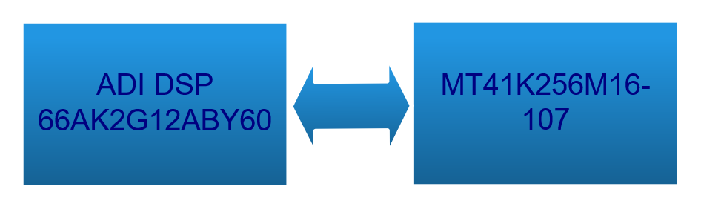
DDR Issue
8bit Data Write&Read, the Data became garbled .
16bit Data write and Read, it is OK.

Slide 3
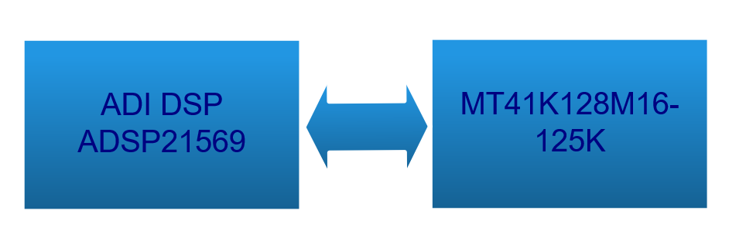
ADI solutions
8bit and 16bit Data write and read, both are OK.

Slide 4
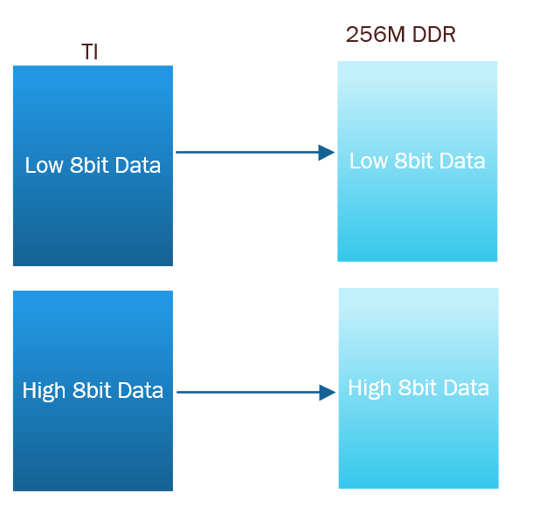
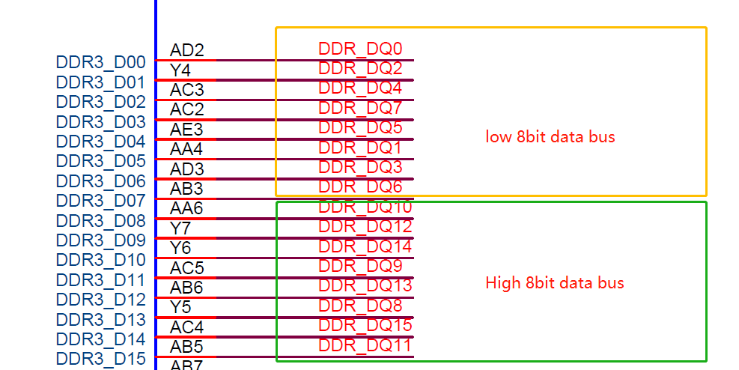
WE-10000 schematic :
DDR Data Bus did some exchange, but it is not exchange between low 8bit data and High 8bit Data, so it should be OK

Slide 5
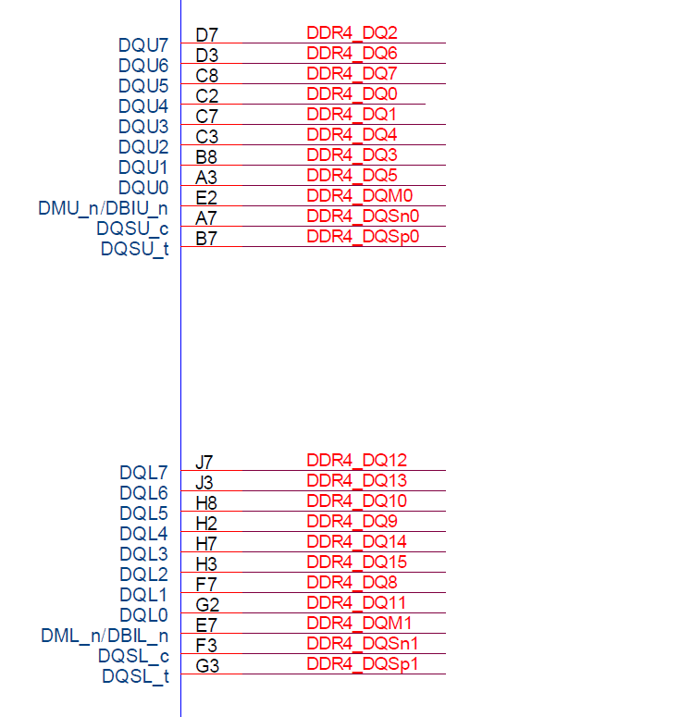
Checked Amlogic schematic , also did some exchange in Data bus

Slide 6
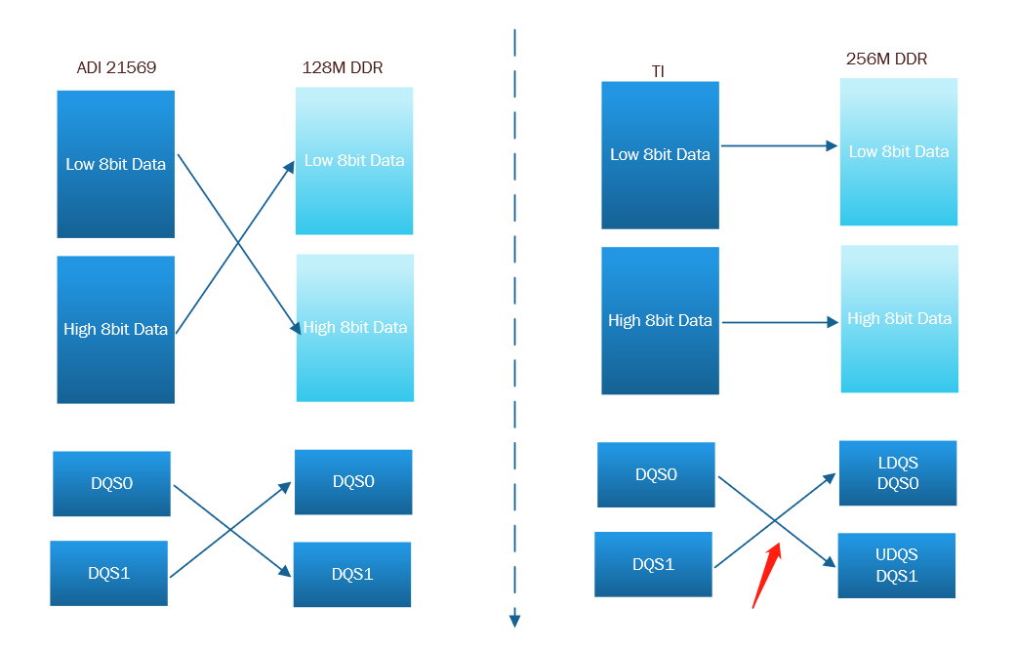
ADI and TI compare
The DQS is different. maybe it is root cause ,but not quite sure.
I think that low 8bit data write &read is using the DQS0 for data strobe
High 8bit data is using the DQS1 for data strobe.

Slide 7
Proposal
exchange the DQS on ES1 board by HW change
Exchange the DQS functions by TI DSP MMU via sw.

