Slide 1
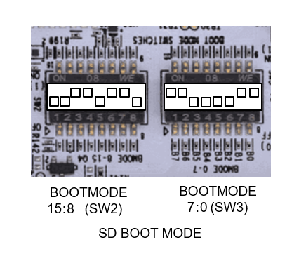
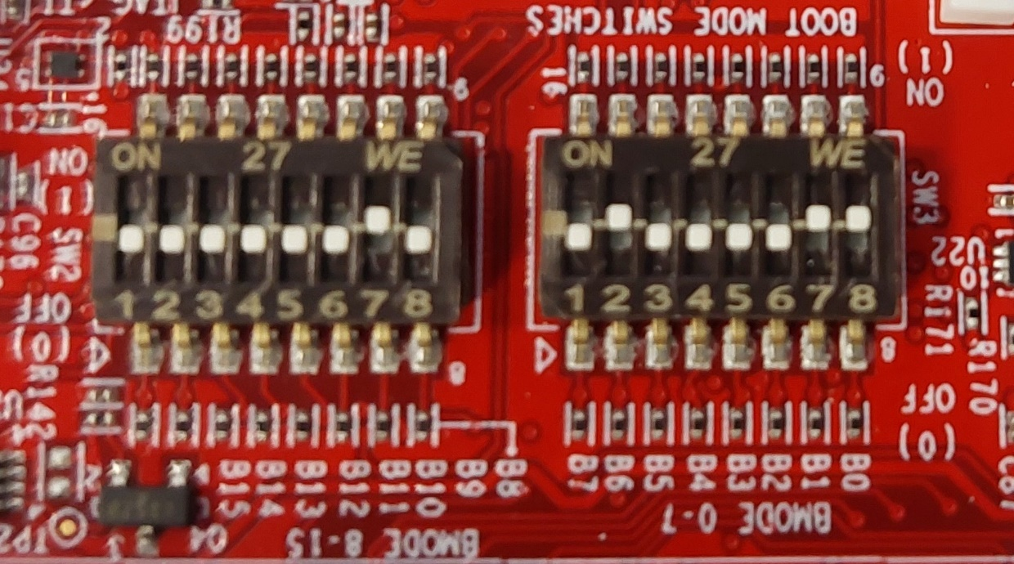
Why are these 2 “SD BOOT MODE” not identical??
https://dev.ti.com/tirex/content/mcu_plus_sdk_am64x_09_01_00_41/docs/api_guide_am64x/EVM_SETUP_PAGE.html
SK-AM64B EVM BOOTMODE SWITCH SETTINGS (out of the box) SD BOOT MODE

