Slide 1
Packet flow for capturing data
LEADER
….
Capture Image
LEADER ; 44 bytes
→First packet to indicate data format and size
PAYLOAD(1-5067) ; 1372 bytes
→Capture data packet.
PAYLOAD (5068); 620 bytes
→Last Capture data packet
TAILER ; 24 bytes
→Last packet to indicate end of stream
PAYLOAD 1
PAYLOAD 2
….
PAYLOAD 5067
PAYLOAD 5068
TRAILER

Slide 2
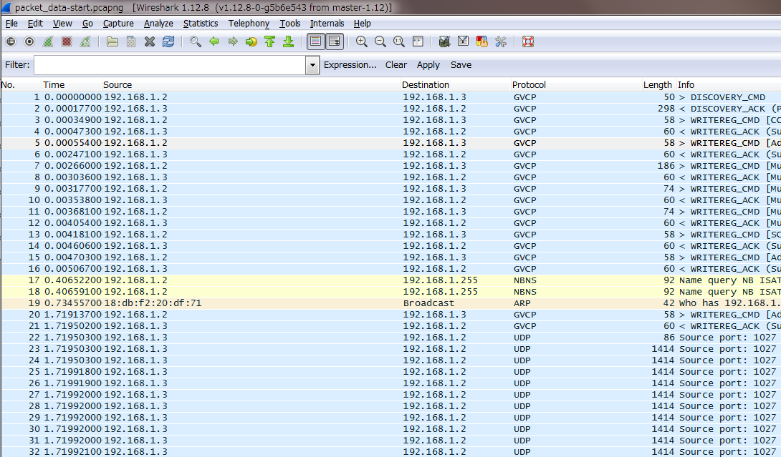
The beginning of capture in wireshark
LEADER ; Length 86 → UDP data payload = 44 bytes
Recv()`s return value is 44. This is expected.
PAYLOAD 1 ; Length 1414→ UDP data payload = 1372 bytes
Resv()`s return value is 1372. This is expected.
A series of
Capture data
(fragmented)
PAYLOAD 1 ; Length 1414→ UDP data payload = 1372 bytes
Resv()`s return value is 1372. This is expected.

Slide 3
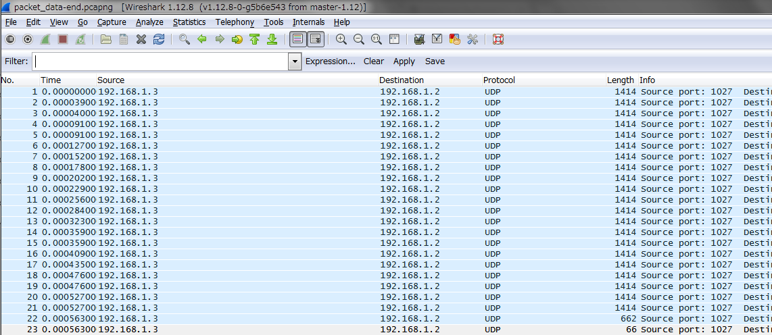
The end of capture in wireshark
PAYLOAD 1 ; Length 1414→ UDP data payload = 1372 bytes
Recv()`s return value is 1372. This is expected.
A series of
Capture data
(fragmented)
PAYLOAD 1 ; Length 1414→ UDP data payload = 1372 bytes
Recv()`s return value is 1372. This is expected.
PAYLOAD 1 ; Length 662→ UDP data payload = 620bytes
Recv()`s return value is 620. This is expected.
TAILER ; Length 66→ UDP data payload = 24bytes
Recv() ruturns nothing (blocking)
If socket is configured as non-blocking call, Recv() always returns 0.
Please note windows app using winsock can capture all of data completely.

