Slide 1
Packet flow for capturing data
LEADER
….
Capture Image
LEADER ; 44 bytes
→First packet to indicate data format and size
PAYLOAD(1-5067) ; 1372 bytes
→Capture data packet.
PAYLOAD (5068); 620 bytes
→Last Capture data packet
TAILER ; 24 bytes
→Last packet to indicate end of stream
PAYLOAD 1
PAYLOAD 2
….
PAYLOAD 5067
PAYLOAD 5068
TRAILER

Slide 2
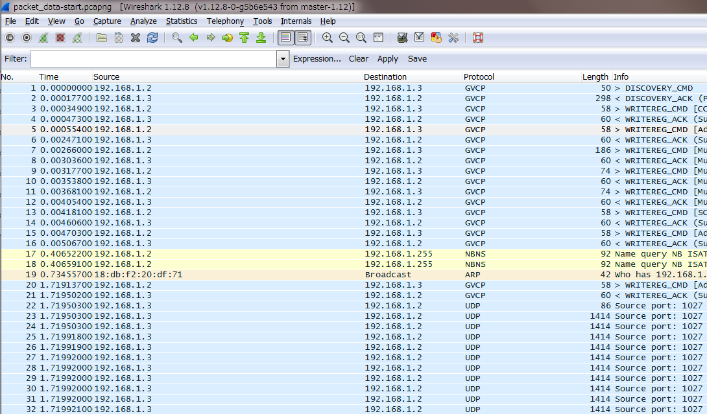
The beginning of capture in wireshark
LEADER ; Length 86 → UDP data payload = 44 bytes
Recv()`s return value is 44. This is expected.
PAYLOAD 1 ; Length 1414→ UDP data payload = 1372 bytes
Resv()`s return value is 1372. This is expected.
A series of
Capture data
(fragmented)
PAYLOAD 1 ; Length 1414→ UDP data payload = 1372 bytes
Resv()`s return value is 1372. This is expected.

Slide 3
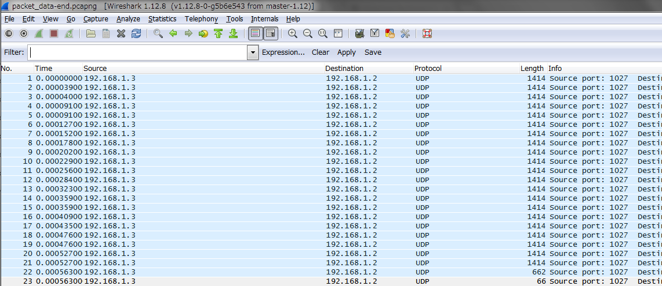
The end of capture in wireshark
PAYLOAD 1 ; Length 1414→ UDP data payload = 1372 bytes
Recv()`s return value is 1372. This is expected.
A series of
Capture data
(fragmented)
PAYLOAD 1 ; Length 1414→ UDP data payload = 1372 bytes
Recv()`s return value is 1372. This is expected.
PAYLOAD 1 ; Length 662→ UDP data payload = 620bytes
Recv()`s return value is 620. This is expected.
TAILER ; Length 66→ UDP data payload = 24bytes
Recv() ruturns nothing (blocking)
If socket is configured as non-blocking call, Recv() always returns 0.
Please note windows app using winsock can capture all of data completely.

Slide 4
udps and ips status during the later packets
 |  |  |  |  |  | Comment
packet sequence id | 5066 | 5067 | 5068 |  | 5069
udp packet size in bytes | 1372 | 1372 | 620 |  | 24
response of recv() in bytes | 1372 | 1372 | 620 |  | Lost
 |  |  |  |  | CPU halt
udps status after … | recv() | recv() | recv()
UINT32 RcvTotal; | 00008AB1 | 00008AB1 | 00008AB1 |  | 00008AB1 | no change during the packets
UINT32 RcvShort; | 00000000 | 00000000 | 00000000 |  | 00000000 | no change during the packets
UINT32 RcvBadLen; | 00000007 | 00000007 | 00000007 |  | 00000007 | no change during the packets
UINT32 RcvBadSum; | 00000000 | 00000000 | 00000000 |  | 00000000 | no change during the packets
UINT32 RcvFull; | 00000000 | 00000000 | 00000000 |  | 00000000 | no change during the packets
UINT32 RcvNoPort; | 00000000 | 00000000 | 00000000 |  | 00000000 | no change during the packets
UINT32 RcvNoPortB; | 00000000 | 00000000 | 00000000 |  | 00000000 | no change during the packets
UINT32 SndTotal; | 0000000F | 0000000F | 0000000F |  | 0000000F | no change during the packets
UINT32 SndNoPacket; | 00000000 | 00000000 | 00000000 |  | 00000000 | no change during the packets
ips status after … | recv() | recv() | recv() |  | CPU halt | no change during the packets
UINT32 Total; /* total packets received */ | 00008AB1 | 00008AB1 | 00008AB1 |  | 00008AB1 | no change during the packets
UINT32 Odropped; /* lost packets due to nobufs, etc. */ | 00000000 | 00000000 | 00000000 |  | 00000000 | no change during the packets
UINT32 Badsum; /* checksum bad */ | 00000000 | 00000000 | 00000000 |  | 00000000 | no change during the packets
UINT32 Badhlen; /* ip header length < data size */ | 00000000 | 00000000 | 00000000 |  | 00000000 | no change during the packets
UINT32 Badlen; /* ip length < ip header length */ | 00000000 | 00000000 | 00000000 |  | 00000000 | no change during the packets
UINT32 Badoptions; /* error in option processing */ | 00000000 | 00000000 | 00000000 |  | 00000000 | no change during the packets
UINT32 Badvers; /* ip version != 4 */ | 00000000 | 00000000 | 00000000 |  | 00000000 | no change during the packets
UINT32 Forward; /* packets forwarded */ | 00000000 | 00000000 | 00000000 |  | 00000000 | no change during the packets
UINT32 Noproto; /* unknown or unsupported protocol */ | 00000000 | 00000000 | 00000000 |  | 00000000 | no change during the packets
UINT32 Delivered; /* datagrams delivered to upper level */ | 00008AB1 | 00008AB1 | 00008AB1 |  | 00008AB1 | no change during the packets
UINT32 Cantforward; /* packets rcvd for unreachable dest */ | 00000000 | 00000000 | 00000000 |  | 00000000 | no change during the packets
UINT32 CantforwardBA; /* packets rcvd with illegal addressing */ | 00000000 | 00000000 | 00000000 |  | 00000000 | no change during the packets
UINT32 Expired; /* Packets not forwards becaused expired */ | 00000000 | 00000000 | 00000000 |  | 00000000 | no change during the packets
UINT32 Redirectsent; /* packets forwarded on same net */ | 00000000 | 00000000 | 00000000 |  | 00000000 | no change during the packets
UINT32 Localout; /* total ip packets generated here */ | 0000000F | 0000000F | 0000000F |  | 0000000F | no change during the packets
UINT32 Localnoroute; /* Local packets discarded due to no route */ | 00000000 | 00000000 | 00000000 |  | 00000000 | no change during the packets
UINT32 Reassembled; /* total packets reassembled ok */ | 00000000 | 00000000 | 00000000 |  | 00000000 | no change during the packets
UINT32 Fragments; /* fragments received */ | 00000000 | 00000000 | 00000000 |  | 00000000 | no change during the packets
UINT32 Fragdropped; /* frags dropped (dups, out of space) */ | 00000000 | 00000000 | 00000000 |  | 00000000 | no change during the packets
UINT32 Fragtimeout; /* fragments timed out */ | 00000000 | 00000000 | 00000000 |  | 00000000 | no change during the packets
UINT32 Fragmented; /* datagrams successfully fragmented */ | 00000000 | 00000000 | 00000000 |  | 00000000 | no change during the packets
UINT32 Ofragments; /* output fragments created */ | 00000000 | 00000000 | 00000000 |  | 00000000 | no change during the packets
UINT32 Cantfrag; /* don't fragment flag was set, etc. */ | 00000000 | 00000000 | 00000000 |  | 00000000 | no change during the packets
UINT32 CacheHit; /* Route cache hit */ | 0000000E | 0000000E | 0000000E |  | 0000000E | no change during the packets
UINT32 CacheMiss; /* Route cache miss */ | 00000001 | 00000001 | 00000001 |  | 00000001 | no change during the packets
UINT32 Filtered; /* packets filtered by firewall */ | 00000000 | 00000000 | 00000000 |  | 00000000 | no change during the packets
Blocking
Blocking

