Slide 1
HSDC Pro - ADC Auto Re-arm Trigger
User Flow

Slide 2
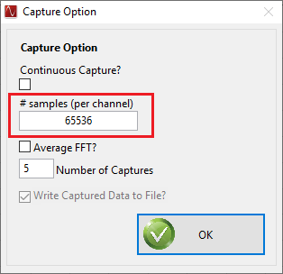
HSDC Pro - ADC Auto Re-Arm Trigger
Connect to Board
Select an ADC INI file as ADS54J40_LMF_8224_Auto_ReArm
Set required ADC Output Data rate
Select “Data Capture Options -> Capture Option” from menu
In the Capture Option dialog that appears, enter the Number of samples to be captured per channel per Trigger in “# Samples (per Channel)” control
Note: Value in “# samples (per Channel)” is number of samples per channel that has to captured when a single trigger occurs. When multiple triggers occur those corresponding captured data per trigger will be accumulated in the DDR. If the trigger is generated when the Board is capturing the data, the trigger is ignored. So the “# samples (per Channel)” has to be updated based on the Trigger Period.

Slide 3
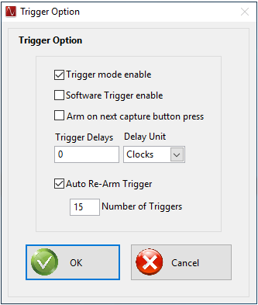
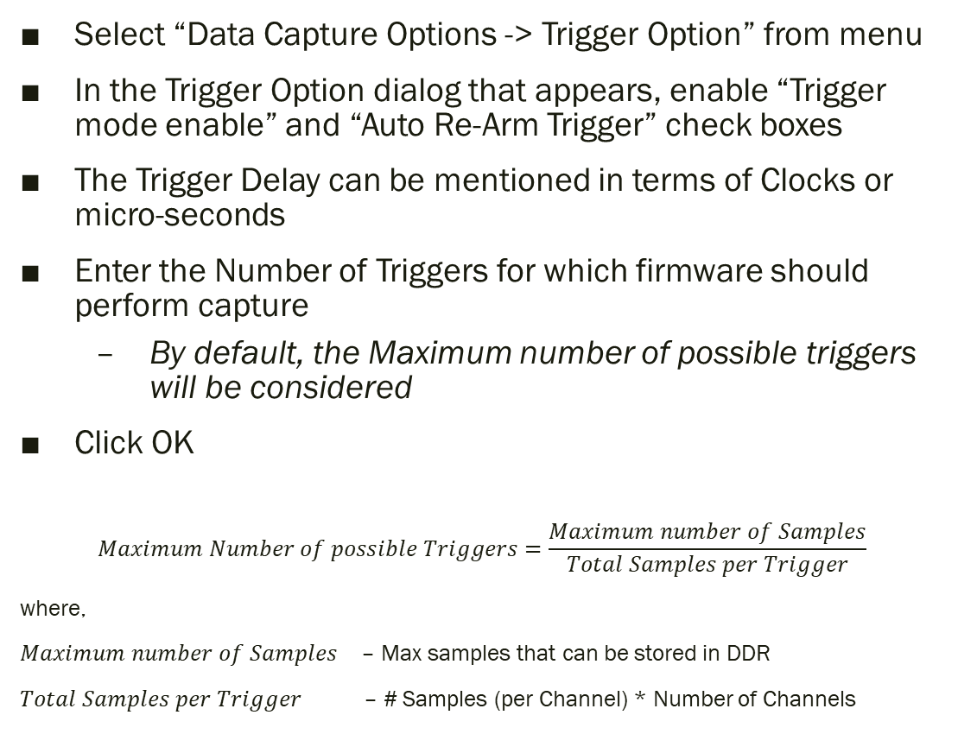
HSDC Pro - ADC Auto Re-Arm Trigger Cont…
Select “Data Capture Options -> Trigger Option” from menu
In the Trigger Option dialog that appears, enable “Trigger mode enable” and “Auto Re-Arm Trigger” check boxes
The Trigger Delay can be mentioned in terms of Clocks or micro-seconds
Enter the Number of Triggers for which firmware should perform capture
By default, the Maximum number of possible triggers will be considered
Click OK
$$Maximum Number of possible Triggers=\frac{Maximum number of Samples}{Total Samples per Trigger}$$
where,
𝑀𝑎𝑥𝑖𝑚𝑢𝑚 𝑛𝑢𝑚𝑏𝑒𝑟 𝑜𝑓 𝑆𝑎𝑚𝑝𝑙𝑒𝑠 – Max samples that can be stored in DDR
$Total Samples per Trigger$– # Samples (per Channel) * Number of Channels

Slide 4
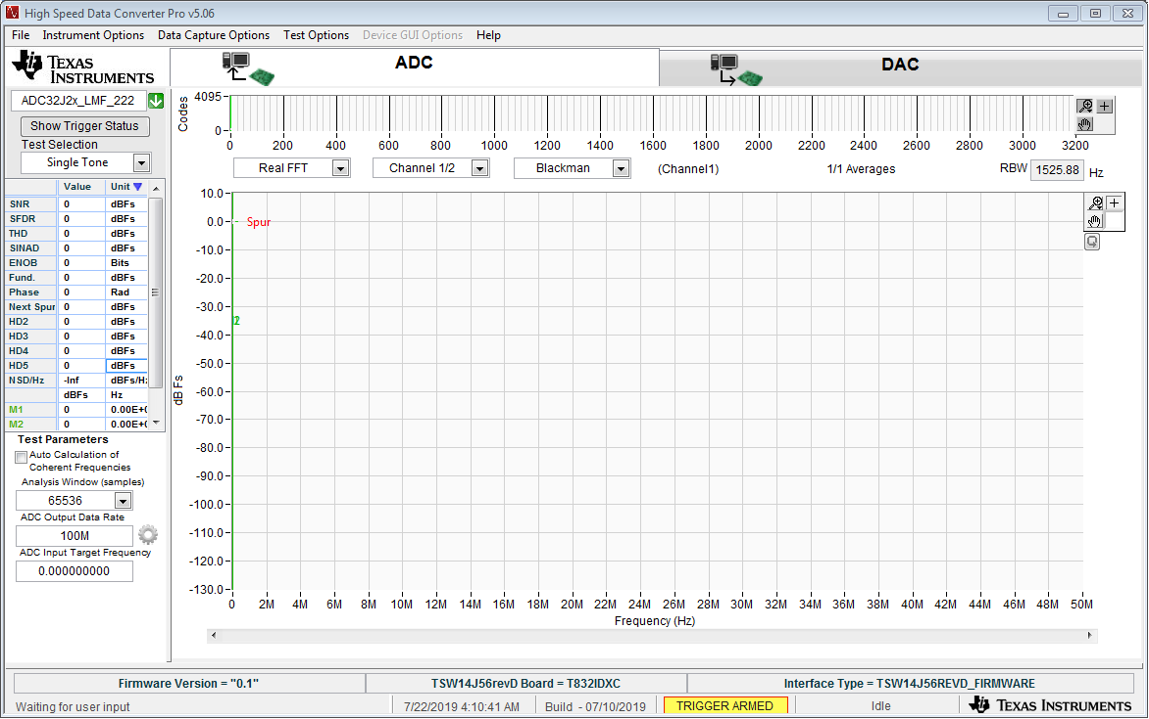
HSDC Pro - ADC Auto Re-Arm Trigger Cont…
Now the firmware will be configured in Auto Re-Arm Trigger mode and captures data when a trigger occurs
In HSDC Pro, the Capture button will be renamed as “Show Trigger Status”

Slide 5
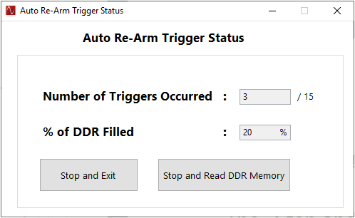
HSDC Pro - ADC Auto Re-Arm Trigger Cont…
Upon clicking “Show Trigger Status” button, Auto Re-Arm Trigger Status dialog appears.
Number of Triggers Occurred and Percentage of DDR filled will be shown in this pop-up
The “Stop and Read DDR Memory” button will stop the trigger operation in firmware and Reads the Captured data
When “Stop and Read DDR Memory” is clicked and a capture is in progress, the current capture will be completed and the data will be read from DDR
For Example, if the Number of Triggers Occurred is 5. When a 6th trigger has occurred (data capture is in progress) and the user clicks “Stop and Read DDR Memory”, then the 6th capture will be completed and the firmware stops looking for trigger.
“Stop and Exit” button will skip reading the DDR memory and resets the Auto Re-Arm Trigger Mode in firmware (So that it will start a fresh cycle of Trigger operation)

Slide 6
HSDC Pro - ADC Auto Re-Arm Trigger Cont…
The pop-up will be closed and the Captured data will be displayed in HSDC Pro
After reading all the data, the firmware will be re-configured in Auto Re-Arm Trigger Mode and captures data when trigger occurs
To stop Auto Re-Arm Trigger mode, uncheck “Auto Re-Arm Trigger” check box in Trigger Option Menu
Note: The Number of Triggers occurred will be shown in the Status bar of HSDC Pro

Slide 7
Automation function APIs for Auto Re-Arm Trigger
Trigger_Option – To Enable Trigger Option
ADC_Auto_ReArm_Trigger_Settings– To enable the Auto Re-arm trigger and set the number of triggers for which the capture has be made.
ADC_Auto_ReArm_Status – To know the current status of the Auto Re-Arm Trigger
ADC_Auto_ReArm_Reset - This function is used to reset the Auto Re-Arm Mode
ADC_Auto_ReArm_Get_Max_NoOfTriggers – To get the maximum numbers of triggers that can processed for the specified amount of the Samples per channel per trigger.
Read_DDR_Memory – To read the captured data for all the triggers that occurred so far.
The more information above mentioned Automation Function APIs can be found at the “HSDC Pro Automation DLL Manual.doc”.

